Slide 1
Cardiovascular System

Slide 2
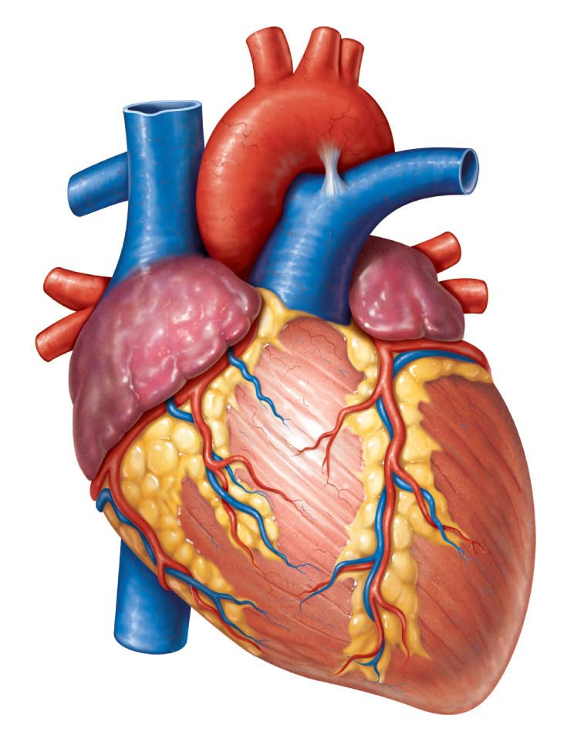
Cardiovascular System
Main function: Transportation
Blood = transport vehicle
Heart = pump
Blood vessels = network of tubes

Slide 3
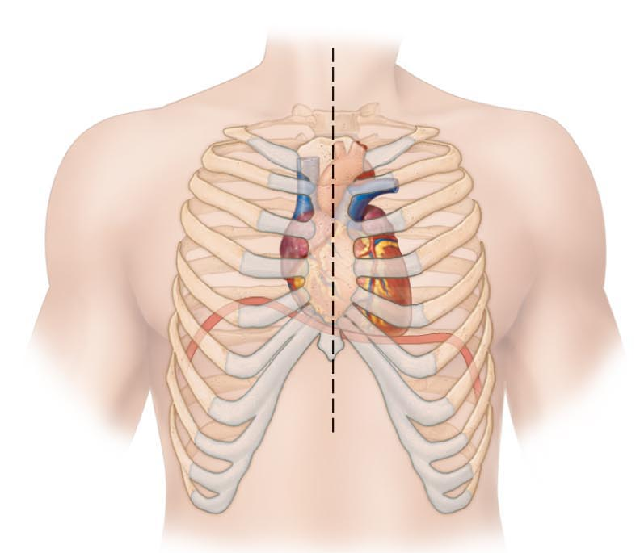
Anatomy of Heart
Size of fist
Weight < 1 lb.
Apex points toward left hip
Flanked by lungs
Surrounded by pericardium (double-walled sac)

Slide 4
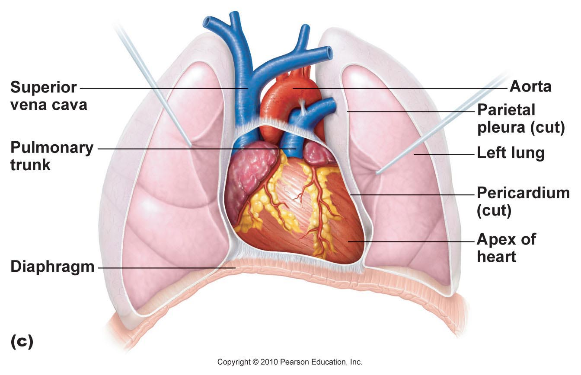

Slide 5
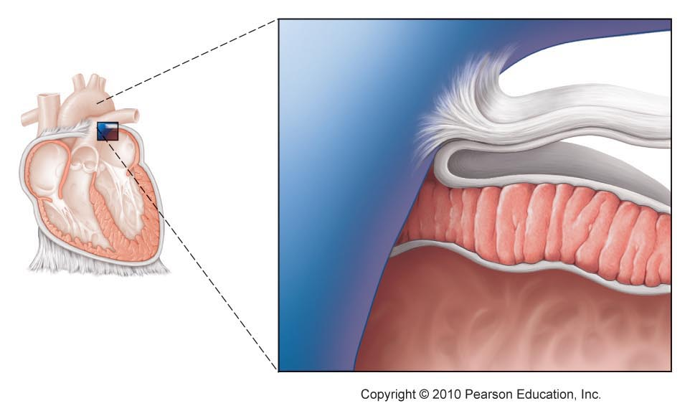
Layers of the Heart Wall
Epicardium – outer layer (pericardium)
Myocardium – cardiac muscle
Endocardium – endothelium lines chambers
Heart chamber

Slide 6
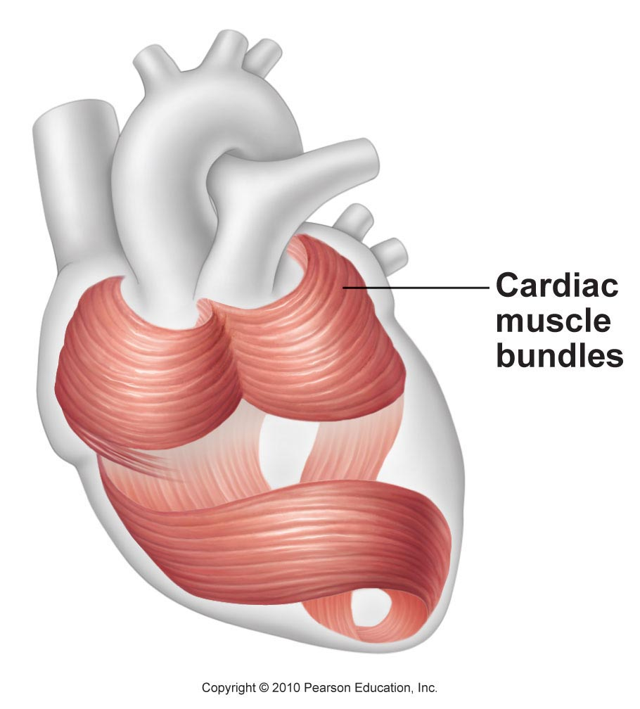

Slide 7
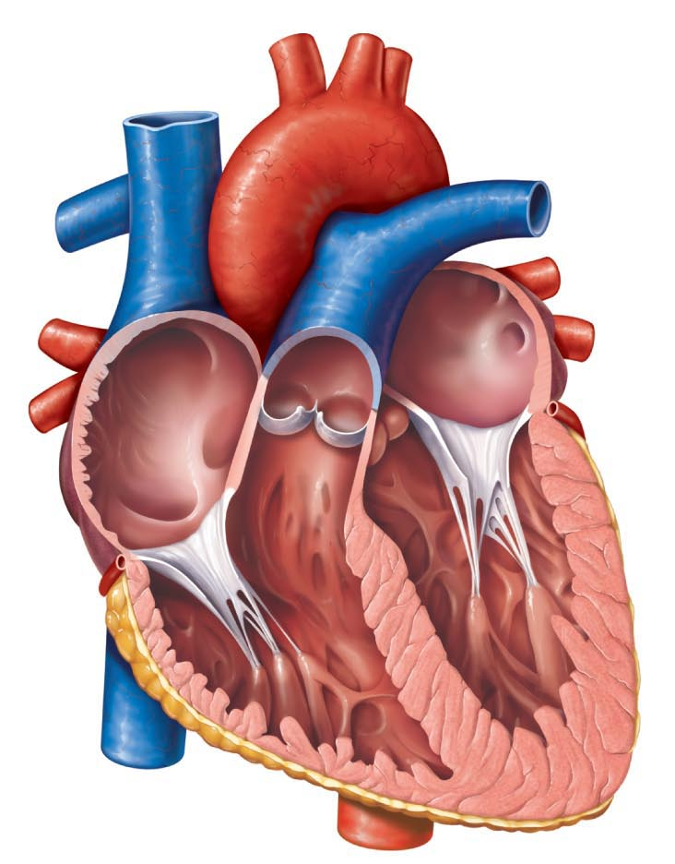
Heart Chambers
Right Side
Atrium (R & L): receive blood (entryway)
Ventricle (R & L): pump blood out
Septum: wall between atria & ventricles
Valves: prevent backflow of blood
Left Side

Slide 8
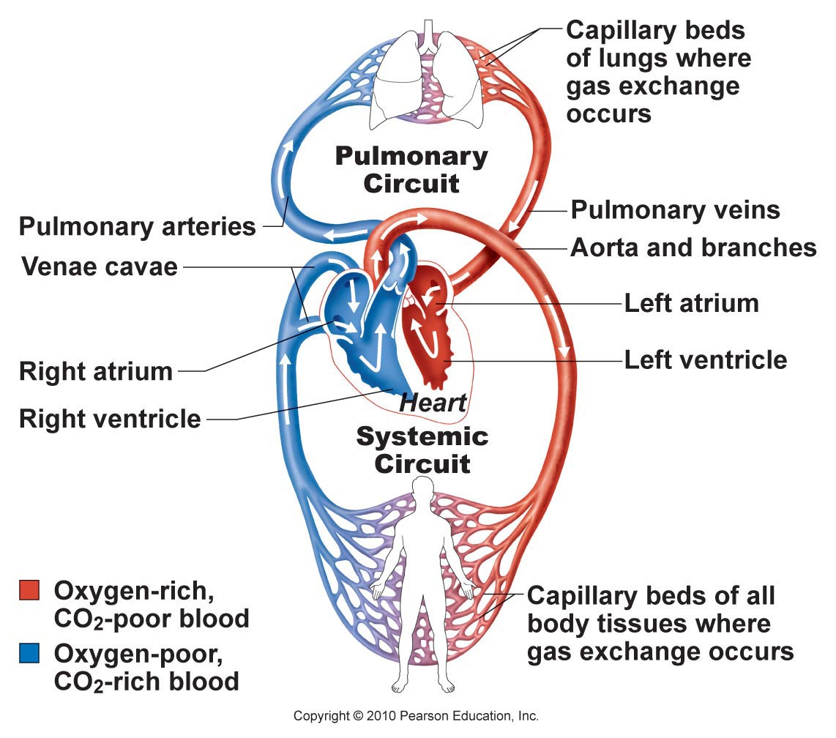
Double Circulation Loop
Pulmonary circuit: blood to/from lungs
Systemic circuit: blood to/from all body tissues

Slide 9
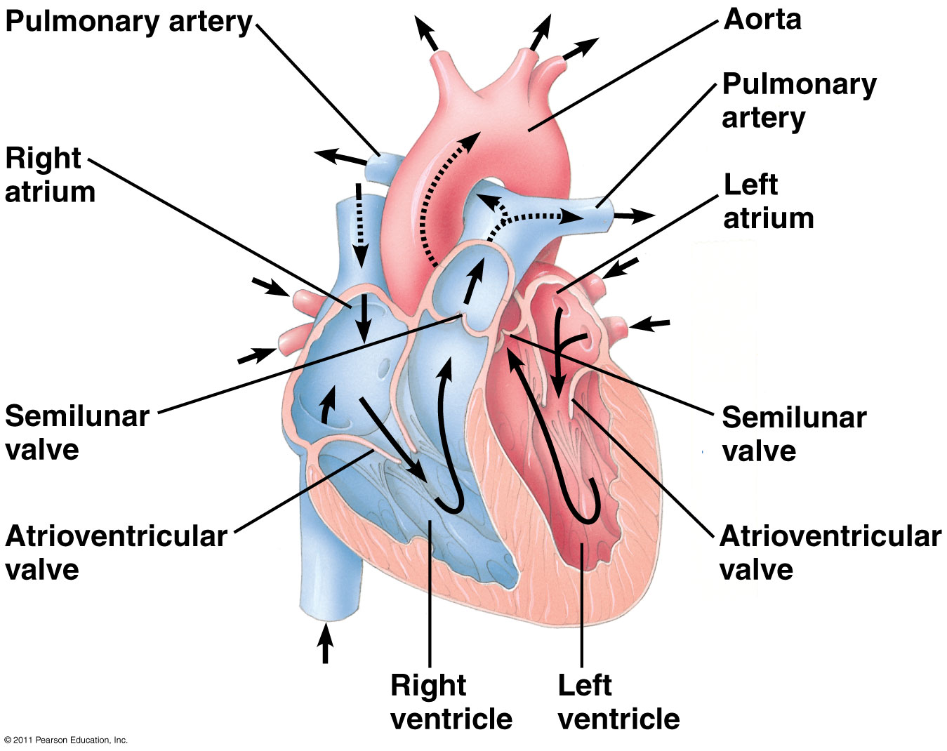
Pathway of blood through heart

Slide 10
Pathway of Blood Through Heart
To Right Atrium:
Superior vena cava (above diaphragm)
Inferior vena cava (below diaphragm)
Coronary sinus (from myocardium)
To Left Atrium:
4 Pulmonary veins (lungs to heart)
Mitral (bicuspid) valve
Tricuspid valve
Left Ventricle:
Aorta (to body)
→ Coronary arteries
Right Ventricle:
2 Pulmonary arteries (to lungs)
Aortic valve
Pulmonary valve

Slide 11
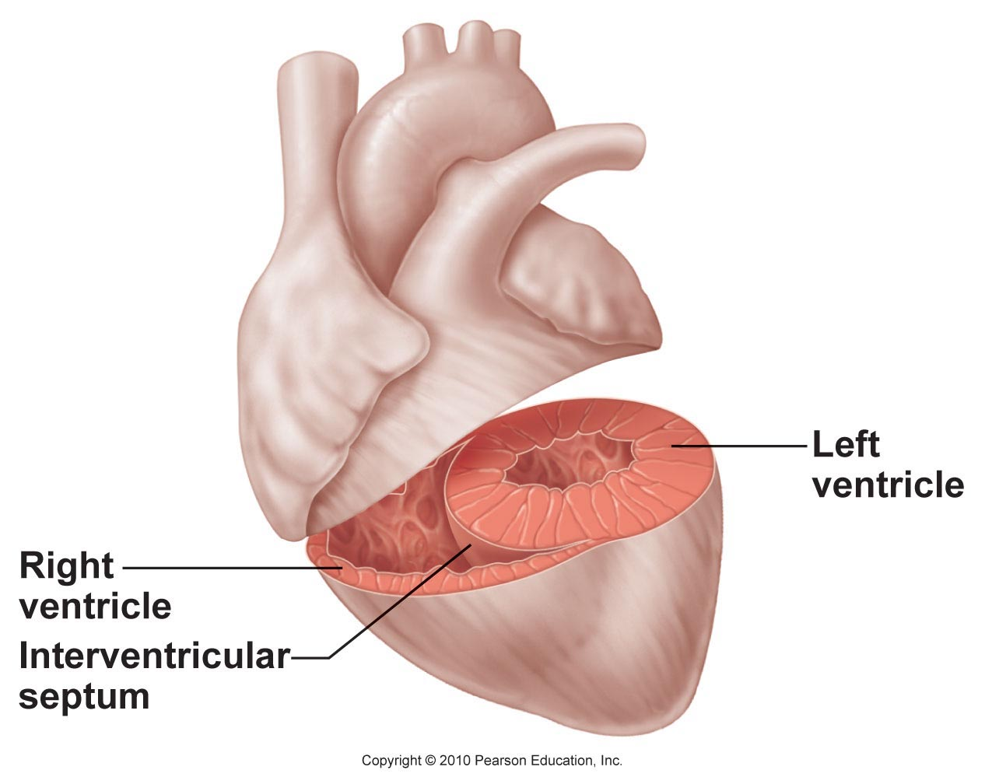
Right Ventricle
Left Ventricle
Pulmonary circuit = low pressure
Systemic circuit = high resistance to blood flow
More powerful pump
3X as thick as right ventricle

Slide 12
Coronary Circulation
Coronary arteries
Coronary veins

Slide 13
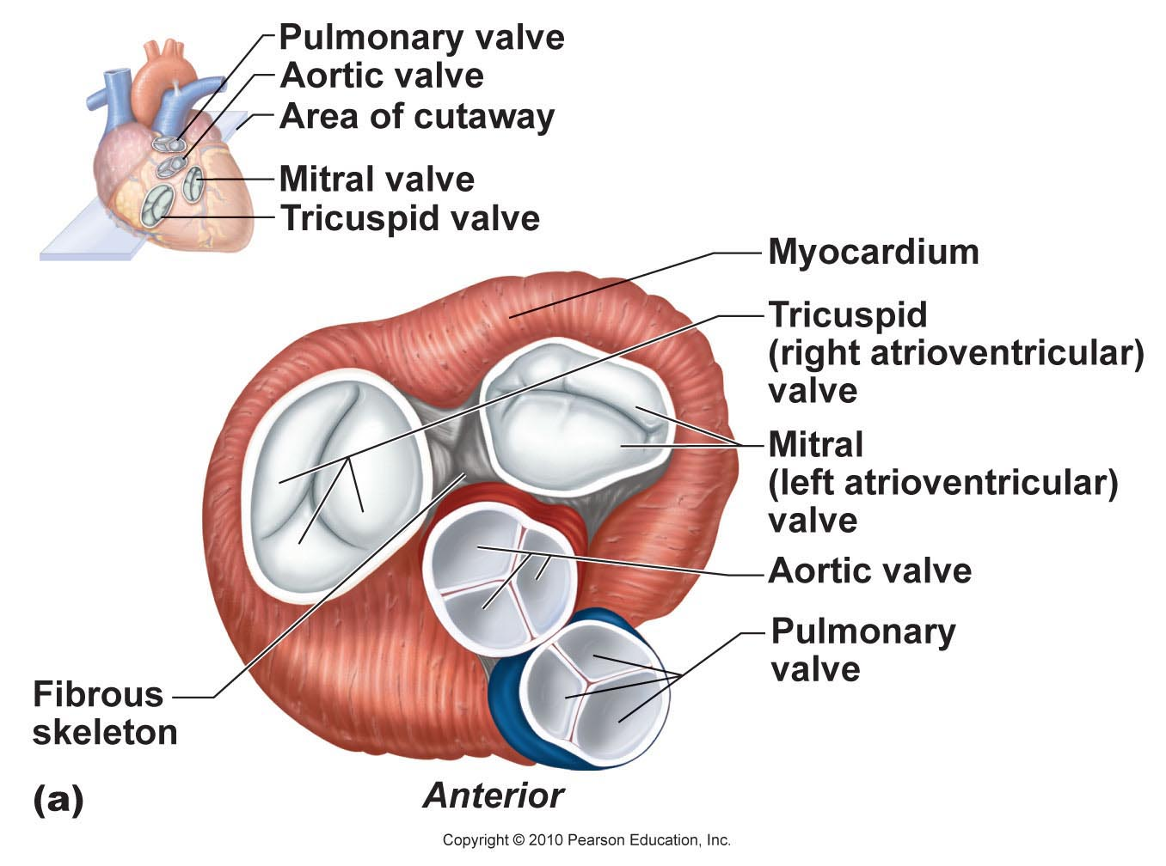
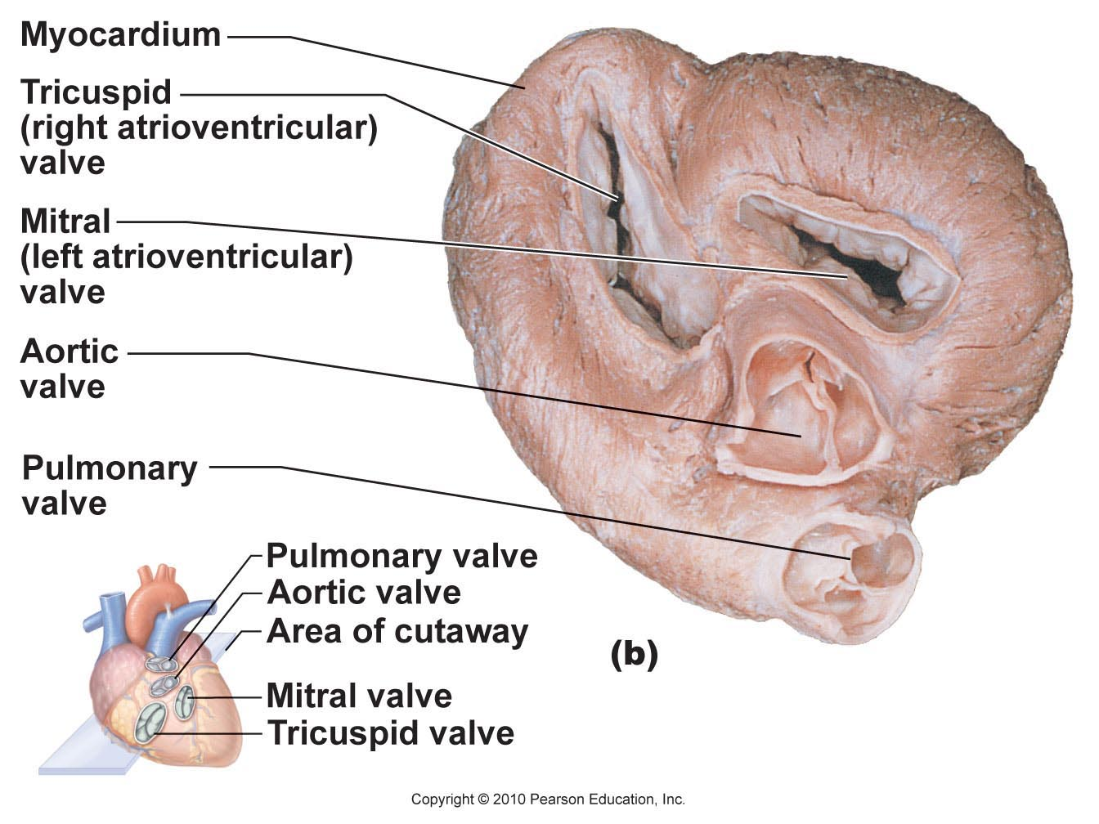
Heart Valves
Atrioventricular (AV) valves (tricuspid, bicuspid)
Semilunar valves (pulmonary, aortic)

Slide 14
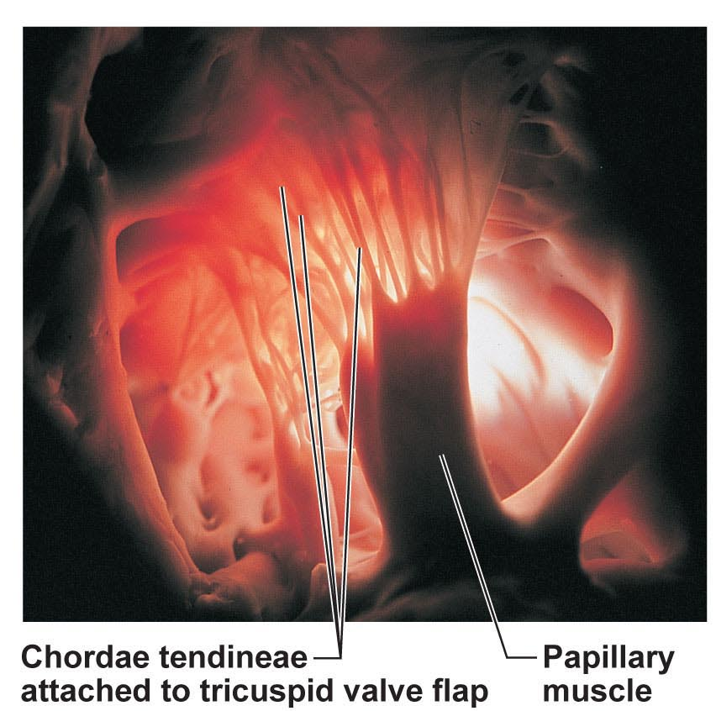
Heart Valves
Chordae tendineae: anchors valve flaps in their closed position

Slide 15
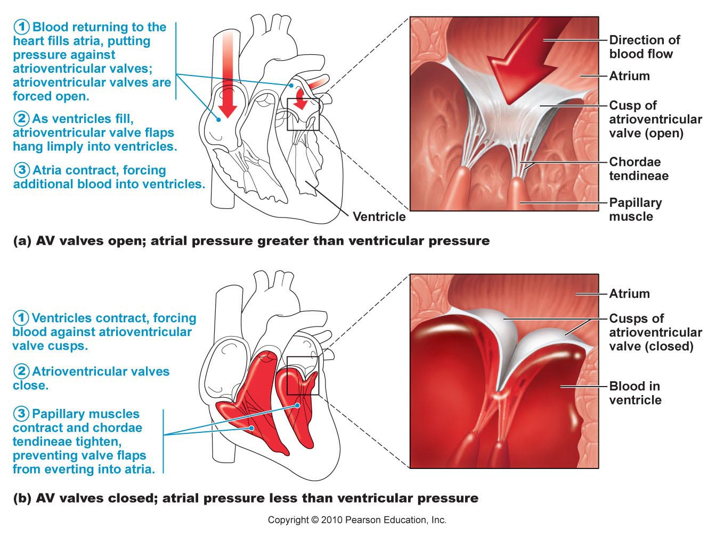

Slide 16
Anatomy of the Heart Web Activity
http://www.wisc-online.com/Objects/ViewObject.aspx?ID=ap12504

Slide 17
Heart Physiology

Slide 18
Heart Rhythm
Cardiac muscle cells can contract spontaneously and independently
Regulation of heart activity:
Autonomic nervous system
Epinephrine, thyroxine: ↑ heart rate
Low Ca²⁺ levels: ↓ heart rate
Intrinsic conduction system
Built into heart tissue & sets basic rhythm
Pacemaker = Sinoatrial (SA) Node

Slide 19
Intrinsic conduction system
Sequence of action:
Sinoatrial (SA) node – right atrium
Generates impulses → Starts each heartbeat
Atrioventricular (AV) node – between atria & ventricles
Atria contract
Bundle of His (or AV bundle)
Bundle branches – interventricular septum
Purkinje fibers – spread within ventricle walls
Ventricles contract

Slide 20
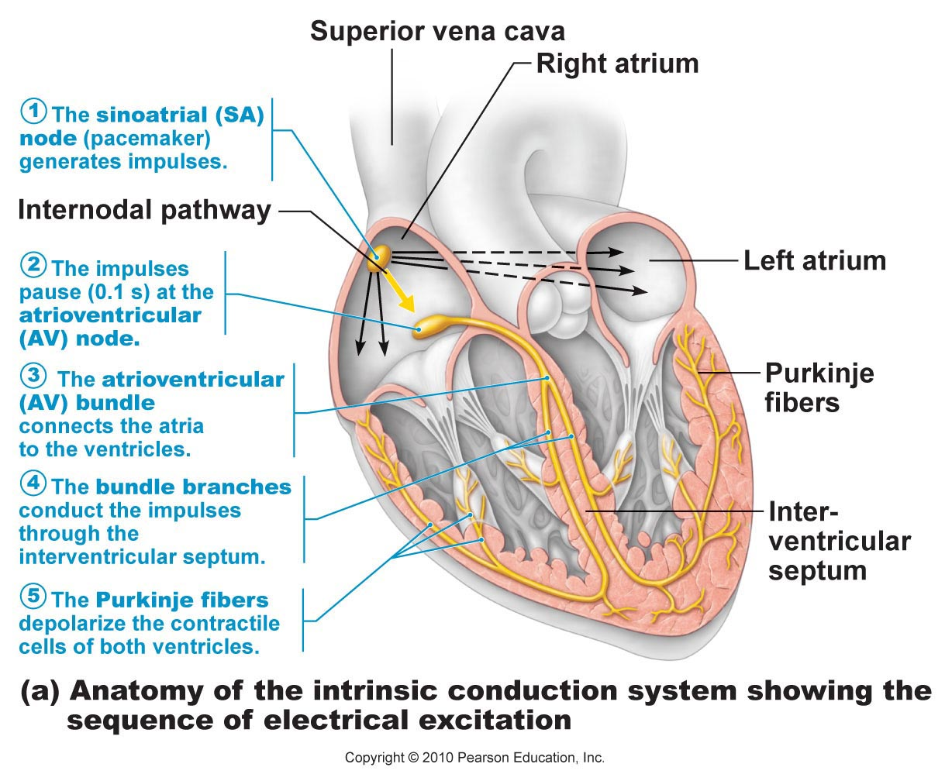

Slide 21
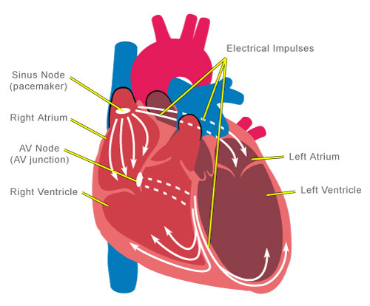

Slide 22
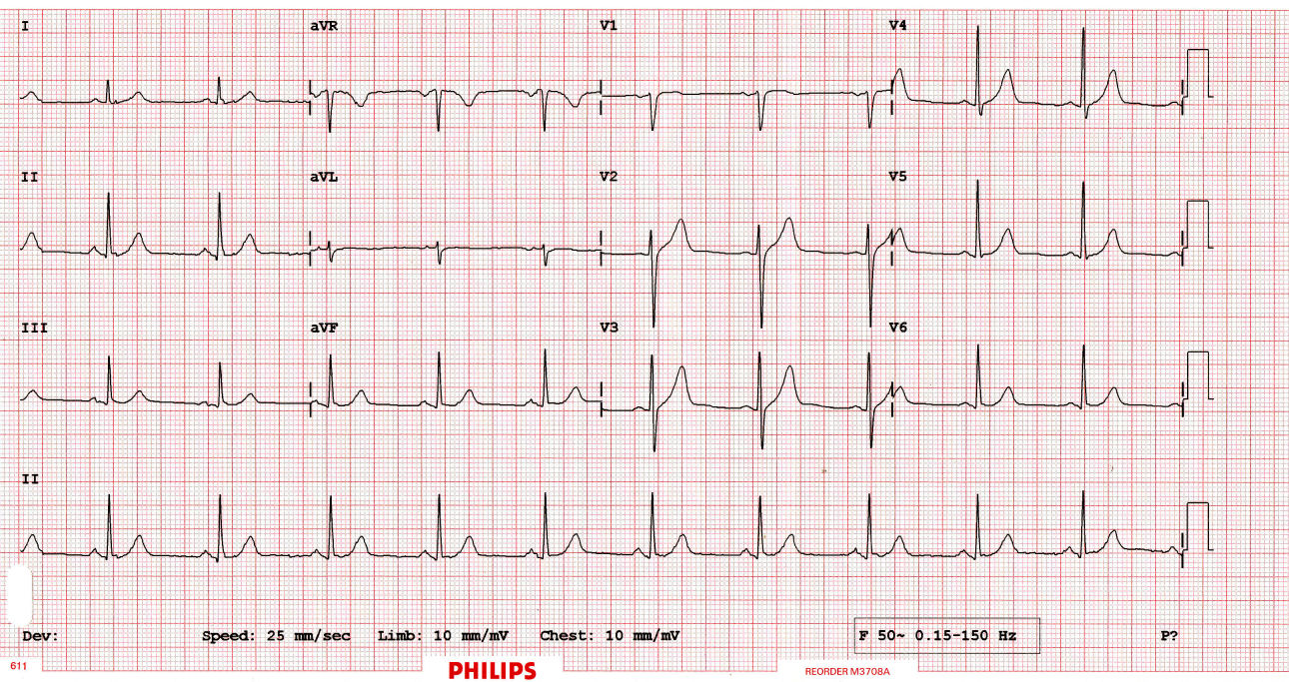
Electrocardiogram (ECG/EKG)
Records the electrical activity of the heart
Electrocardiograph: graphic record of heart activity

Slide 23
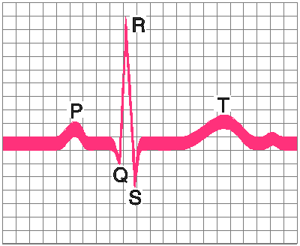
How to read an ECG
P wave: atria contact
QRS complex: ventricles contract
T wave: ventricles relax

Slide 24
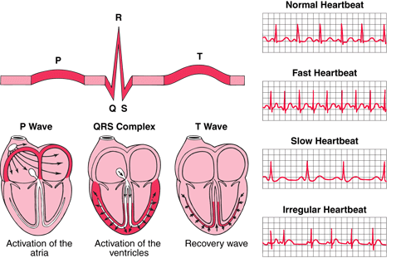

Slide 25
Video: How the heart’s electrical system works

Slide 26
YouTube Video: How to Read an ECG/EKG

Slide 27
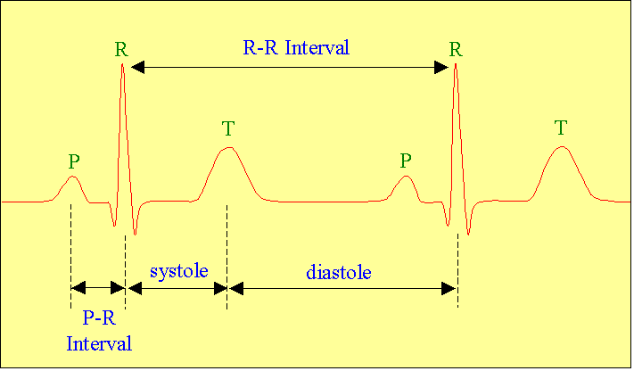
Cardiac Cycle
Cardiac cycle = events of one heartbeat
Systole: contraction of ventricles
Diastole: relaxation of ventricles
Cardiac Output Animation

Slide 28
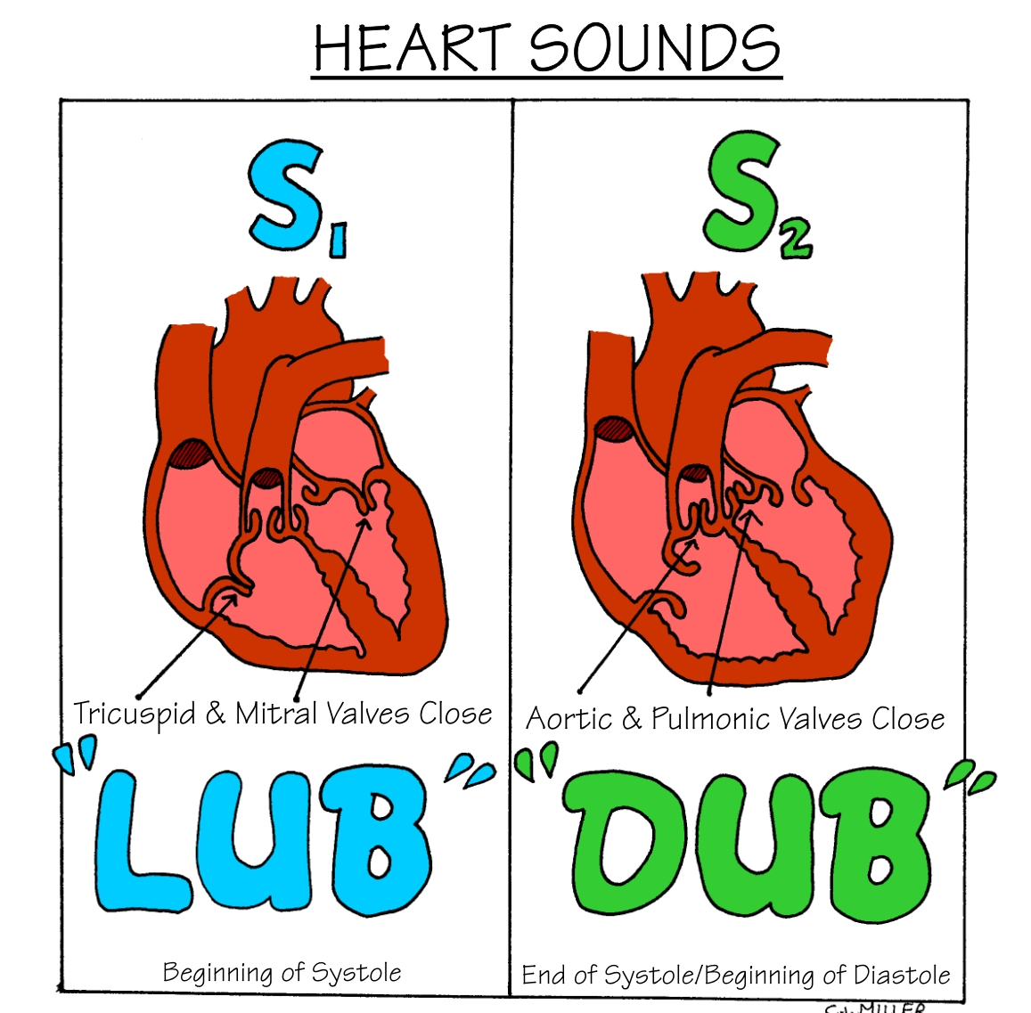
Heart Sounds
“Lub”: closing of AV valves
“Dub”: semilunar valves close at end of systole

Slide 29
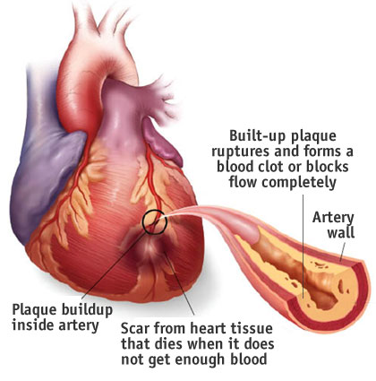
Homeostatic Imbalances
Angina pectoris: heart muscle deprived of O₂,crushing chest pain
Myocardial infarction (Heart Attack): prolonged angina, heart cells may die

Slide 30
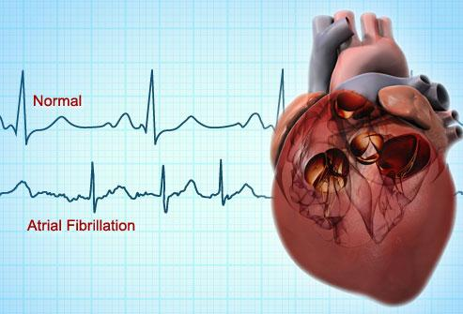
Homeostatic Imbalances
Ischemia: Lack of adequate blood supply to heart
Fibrillation: uncoordinated shuddering of heart muscle, useless pump
Major cause of death from heart attacks

Slide 31
Homeostatic Imbalances
Damage to SA node → slower heart rate
Install artificial pacemaker
Damage to AV node → Heart block: ventricles beat at own rate (slower or not at all)
Tachycardia: rapid heart rate (>100 beats/min)
Bradycardia: very slow heart rate (<60 beats/min)
Heart murmur: abnormal or unusual heart sounds
Often valve problems

Slide 32
Cardiac Output
Cardiac Output (CO) = Heart Rate (HR) x Stroke Volume (SV)
Stroke volume: volume of blood pumped out by one ventricle with each best
Average adult:
CO = HR (75 beats/min) x SV (70 ml/beat)
CO = 5250 ml/min

Slide 33
Congestive Heart Failure
Progressive weakening of heart
Low heart efficiency → circulation inadequate to meet tissue needs
Caused by:
Coronary atherosclerosis – clogged coronary vessels
Persistent high blood pressure
Multiple heart attacks – scar tissue

Slide 34
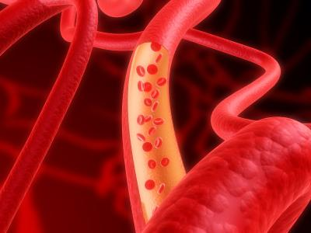
Blood Vessels & Circulation

Slide 35
Vascular System: blood circulates inside closed transport systems
Types of Blood Vessels:
Arteries (takes blood away from heart)
Arterioles
Capillary beds
Venules
Veins (return blood back to heart)

Slide 36
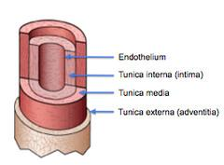
Anatomy of Blood Vessels
Three coats (tunics):
Tunica intima: endothelium lines the interior of vessels; decreases friction as blood flows
Tunica media: smooth muscle & elastic tissue (dilates & constricts vessels)
Tunica externa: fibrous connective tissue on outside supports and protects vessels

Slide 37
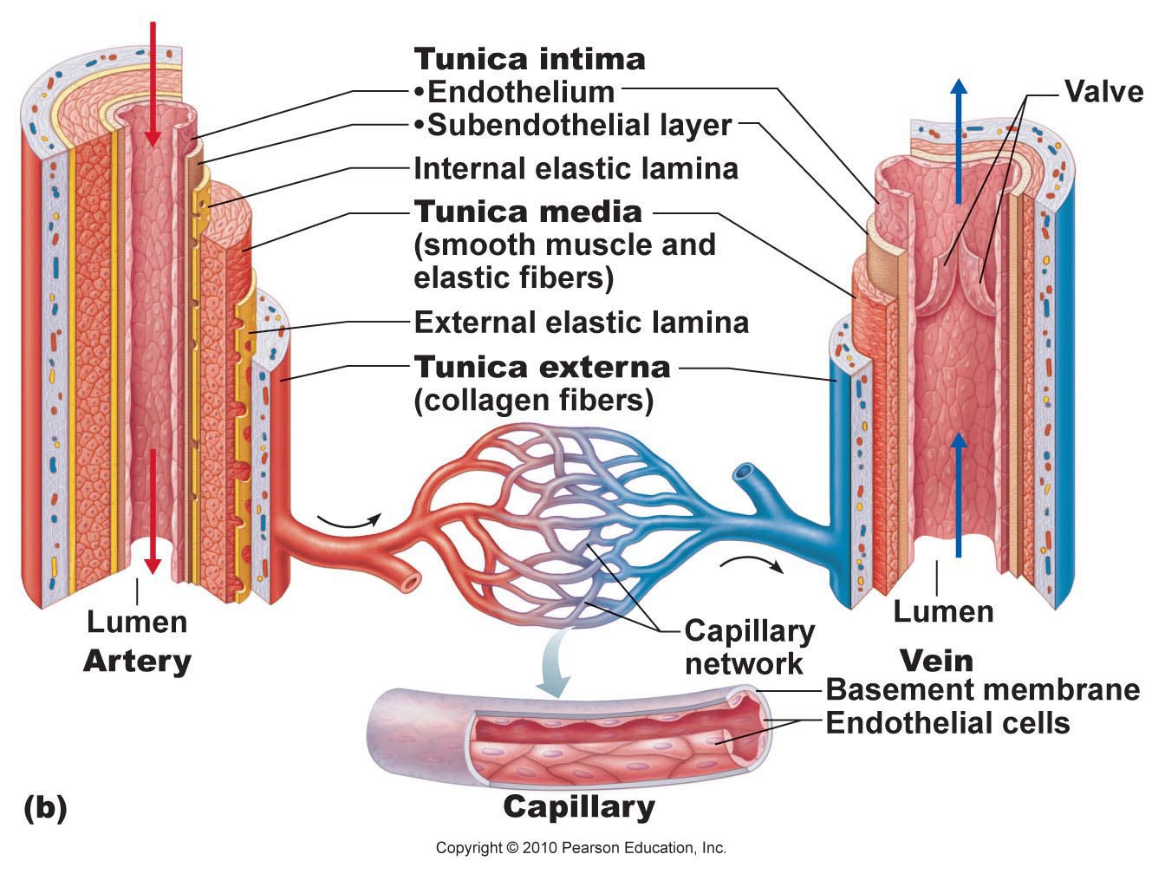

Slide 38
Arteries
Capillaries
Veins
Blood away from heart
Thicker walls
Withstand high pressure
Walls 1-cell thick
Exchange gases between blood and tissue cells
Blood back to heart
Thinner walls
Low pressure
Large lumen
Valves: prevent blood backflow
Skeletal muscles enhance venous return

Slide 39
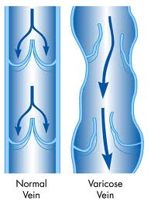
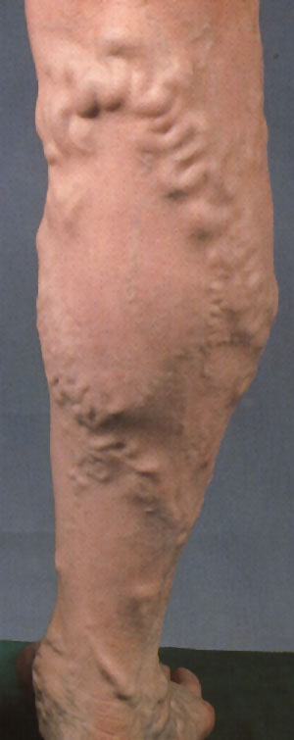
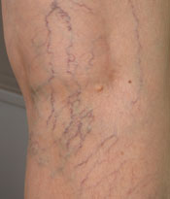
Vericose Veins
People stand for long periods of time → inactivity or pressure on veins
Blood pools in feet and legs
Valves weaken → veins become twisted & dilated
Treatment: compression stockings, exercise, laser treatment, surgery

Slide 40
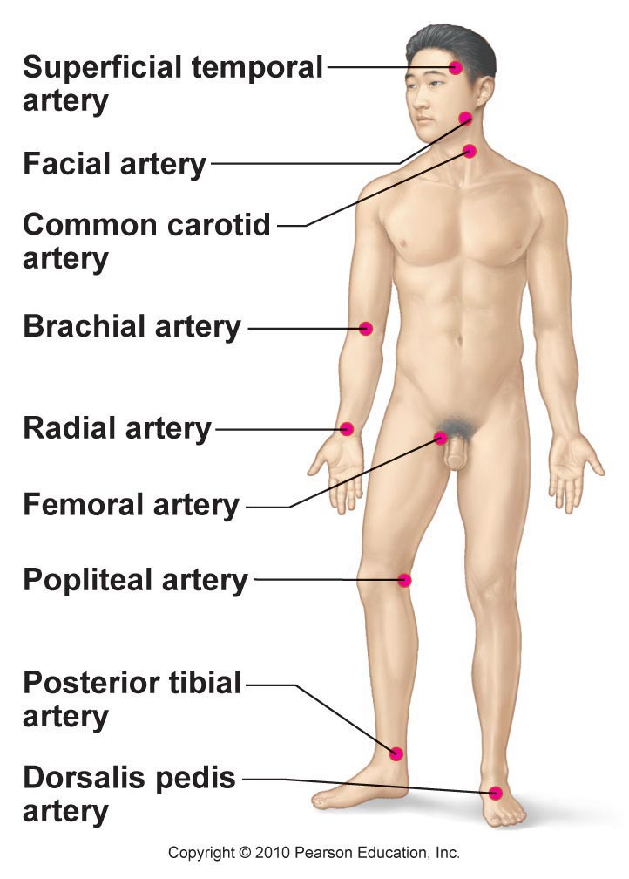
Vital Signs
Pulse: expansion & recoil of an artery with each beat of left ventricle
Pressure points (eg. carotid artery, radial artery)
Normal resting: 70-76 beats/min

Slide 41
Vital Signs
Blood pressure: pressure of blood on inner walls of blood vessels
Systolic presure: peak of ventricular contraction
Diastolic pressure: ventricles relaxed
Written: Systolic/Diastolic
Normal: (120 mm Hg)/(70 mm Hg) or 120/70

Slide 42
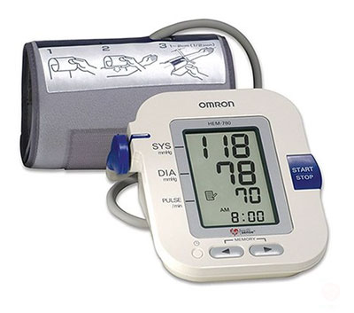
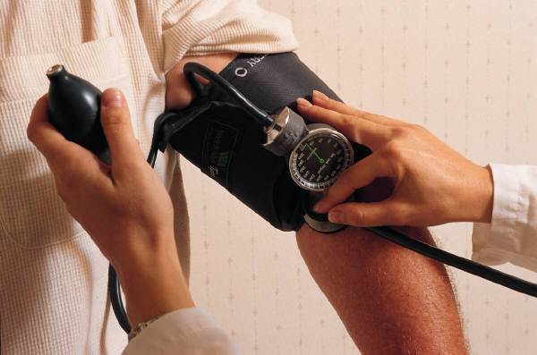
Measuring Blood Pressure

Slide 43
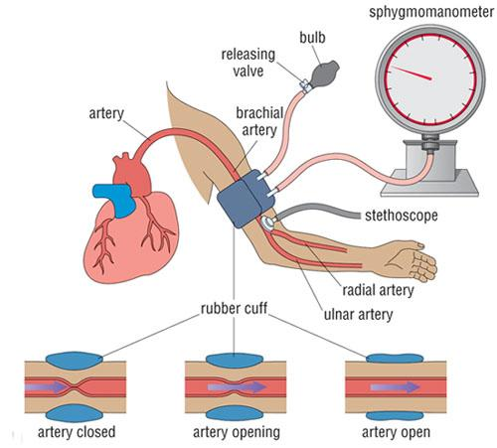

Slide 44
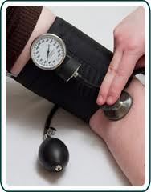
Using a sphygmomanometer
Wrap cuff around upper arm
Place stethoscope on brachial artery
Inflate cuff to 180 mm Hg
Slowly release air → listen for whooshing sounds in brachial artery (Korotkoff sounds)
Systolic: when sound begin to appear
Diastolic: when sounds disappear

Slide 45
YYouTube: How to Measure Blood Pressure

Slide 46
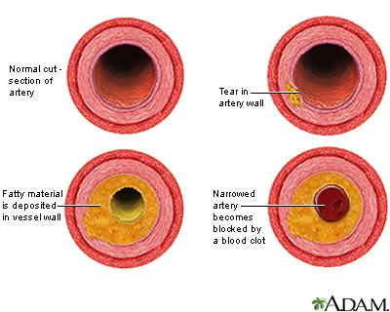
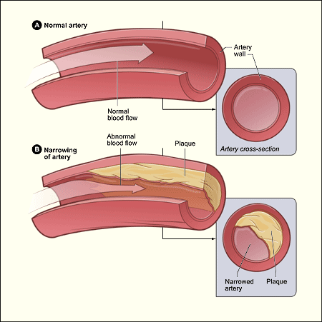
Homeostatic Imbalances
Hypertension: high blood pressure (>140/90)
Circulatory shock: acute hypotension
Blood loss
Atherosclerosis – artery walls thicken due to fatty deposits (plaques)

Slide 47
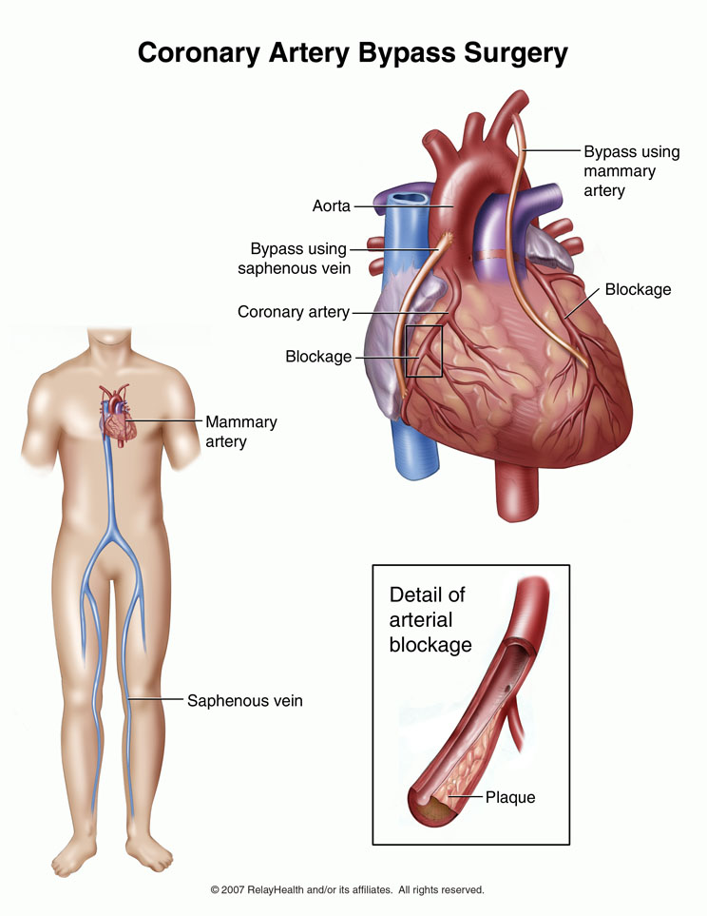
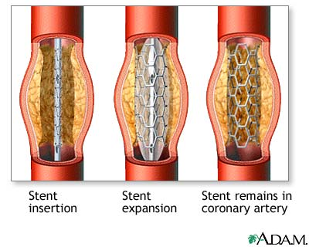
Stent vs. Bypass Surgery

Slide 48
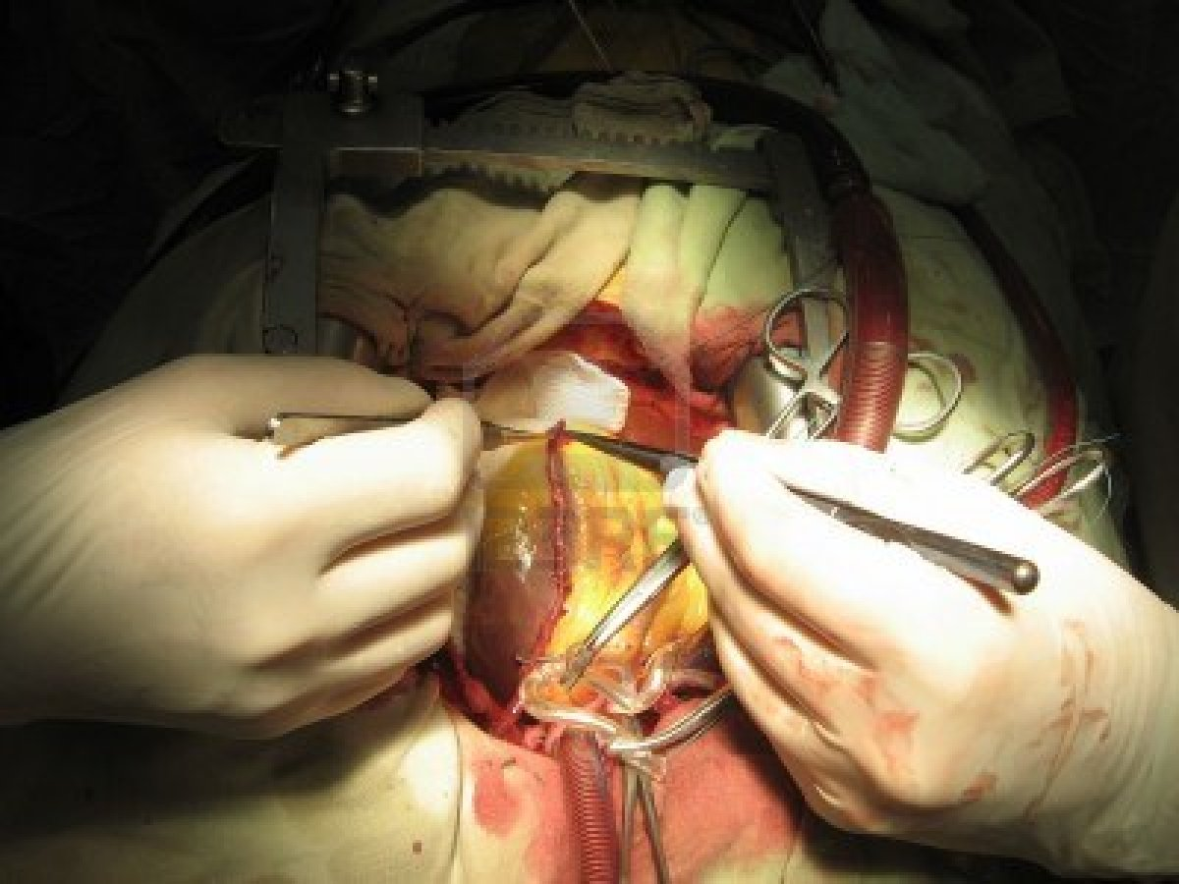

Slide 49
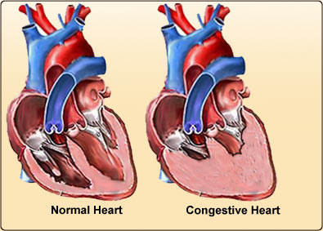
Congestive Heart Failure
Progressive weakening of heart
Low heart efficiency → circulation inadequate to meet tissue needs
Caused by:
Coronary atherosclerosis
Persistent high blood pressure
Multiple heart attacks – scar tissue

Slide 50
Functions of Blood
Deliver O₂, nutrients to all body cells
Transport waste products from cells for elimination
Transport hormones
Maintain body temp (distribute heat)
Maintain pH (carry buffers)
Maintain fluid volume
Prevent blood loss (clotting)
Prevent infection (WBCs, antibodies)

Slide 51
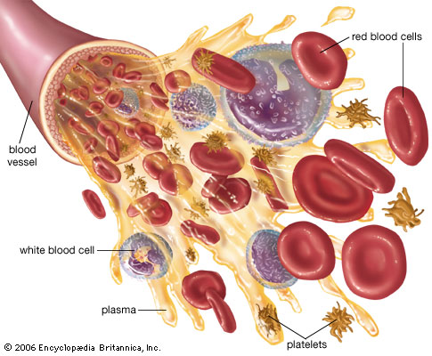
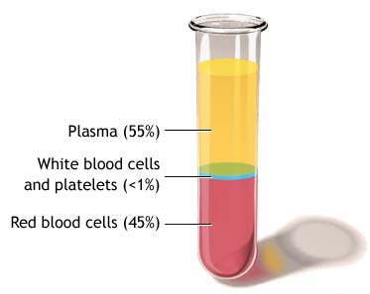
Blood Components
Plasma (55%)
water (90%), ions, proteins, gases, nutrients, wastes, hormones
Cells (45%)
RBCs, WBCs, platelets
Develop from stem cells in bone marrow

Slide 52
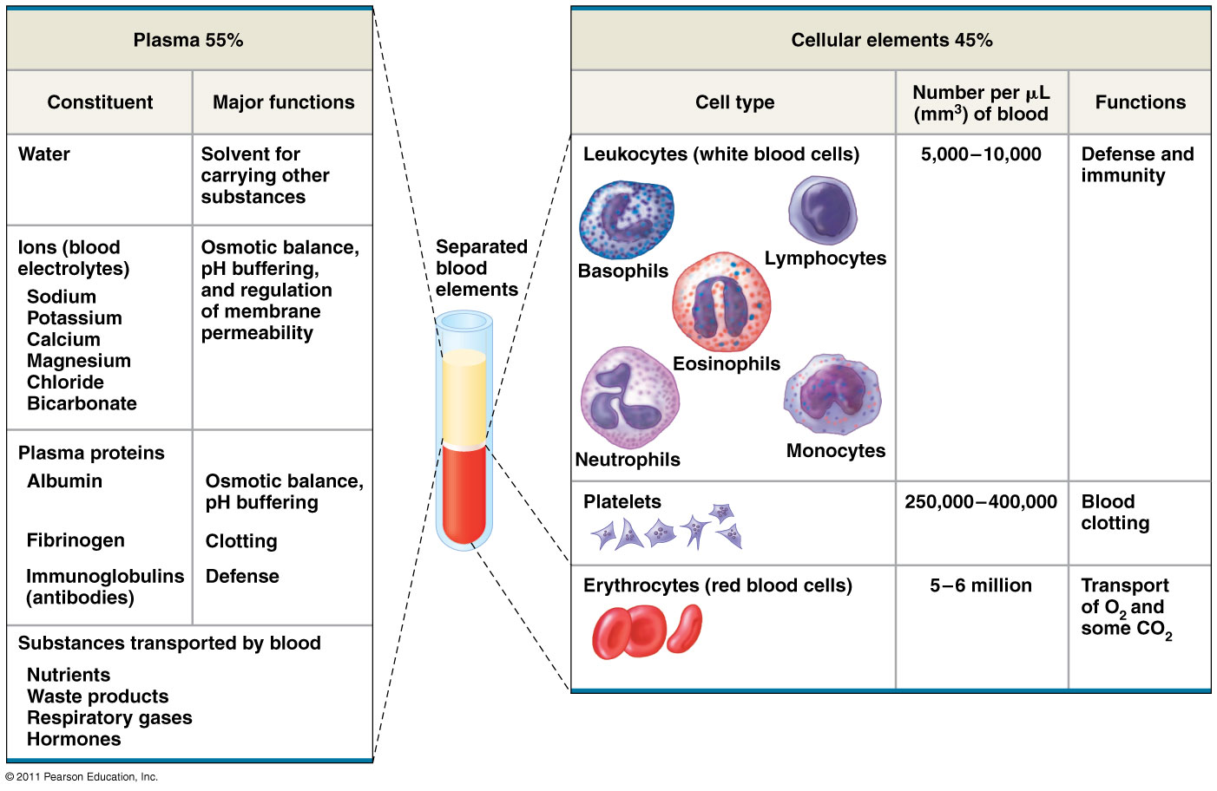

Slide 53
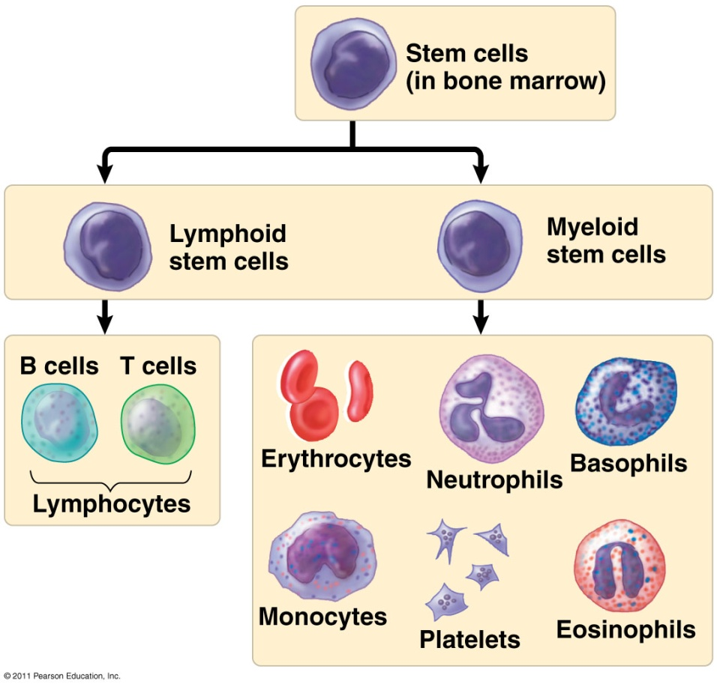
Blood Cell Formation
Hematopoiesis: blood cell formation
Occurs in red bone marrow
Skull, pelvis, ribs, sternum, humerus, femur

Slide 54
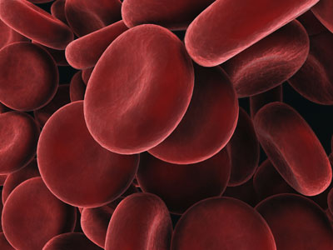
Erythrocytes
Red blood cells (RBCs)
Transport O₂ in blood
Biconcave discs
Anucleate (no nucleus)
Hemoglobin: iron-containing protein, binds to O₂
Life span: 100-120 days

Slide 55
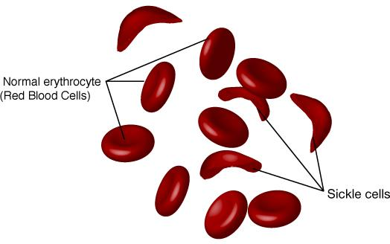
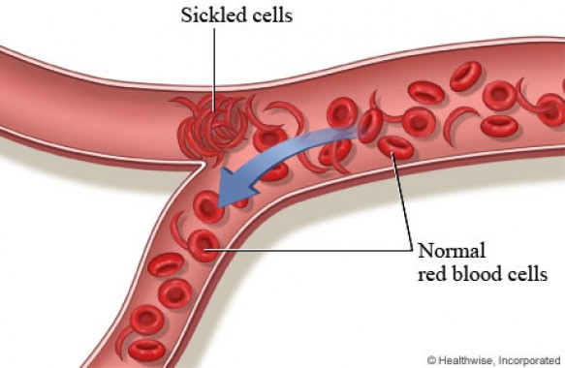
Anemia: decrease in oxygen-carrying ability of blood
Low RBC count or deficient hemoglobin content
Sickle-Cell Disease: abnormal hemoglobin
Genetic disorder
Carriers of 1 allele are resistant to malaria in Africa

Slide 56
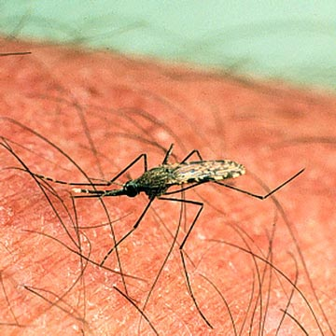
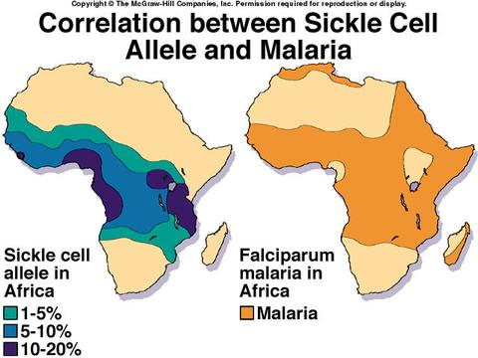
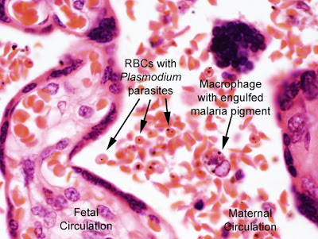

Slide 57
Leukocytes
White blood cells (WBCs)
Defend body against infection and tumors
Locate areas of tissue damage by responding to chemicals
Types: neutrophils, eosinophils, basophils, lymphocytes, monocytes

Slide 58
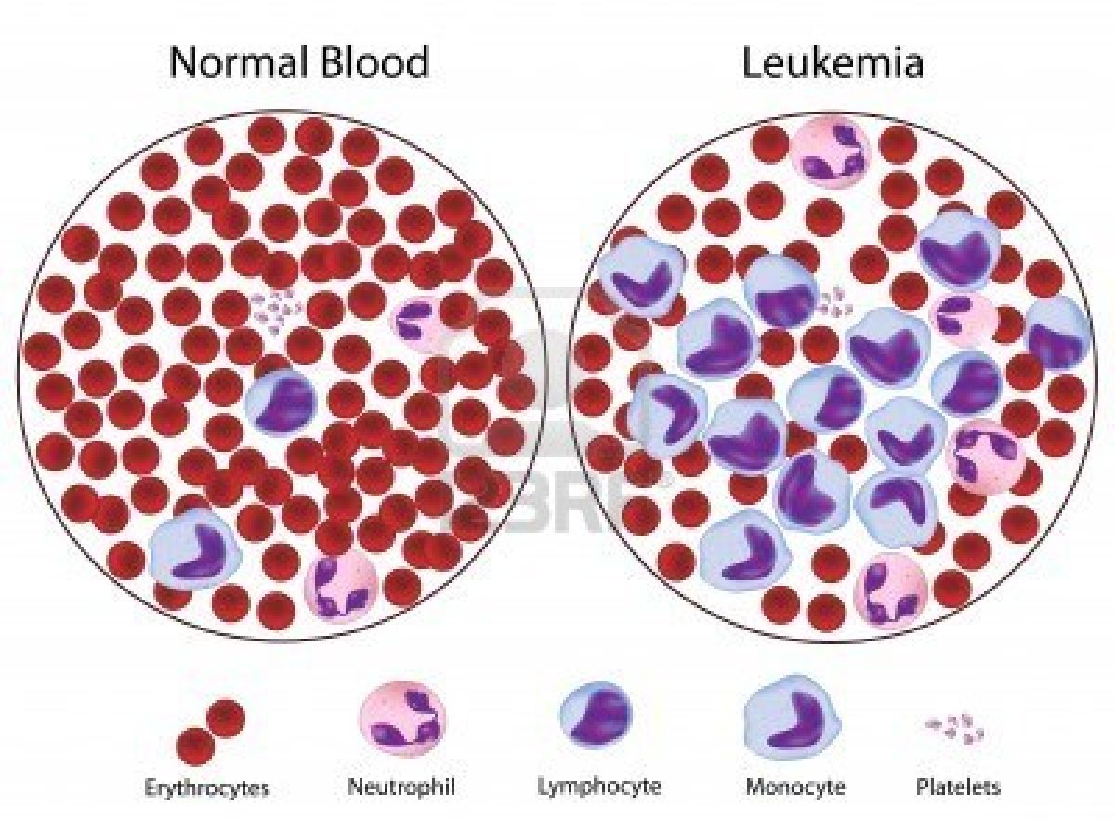
Leukemia: bone marrow becomes cancerous → huge numbers of WBCs
Treatment: chemotherapy, radiation, stem cell transplant

Slide 59
Platelets
Cell fragments (irregularly-shaped bodies)
Needed for clotting blood

Slide 60
Hemostasis = stoppage of bleeding
Vascular spasm
Constrict damaged blood vessels
Platelet plug forms
Platelets stick and bind to damaged site
Release chemicals to attract more platelets
Coagulation
Blood clotting
Fibrin threads forms mesh that traps RBCs
Time: blood clot normally forms within 3-6 min.

Slide 63
Disorders
Thrombus: clot in unbroken blood vessel
Coronary thrombosis = heart attack
Embolus: thrombus breaks away from vessel wall and floats freely
Cerebral embolus = stroke
Hemophilia: hereditary bleeding disorder, lack clotting factors

Slide 64
Human Blood Groups
Antigen: foreign substance that immune system recognizes
Antibodies: Y-shaped proteins secreted by WBC’s that attach to antigens
Agglutination: clumping caused by antibodies binding to antigens on RBCs
RBC surface proteins:
A antigen
B antigen
Rh antigen

Slide 65
ABO Blood Groups
42%
12%
3%
43%
Type A: has A antigen on surface of RBC
Type B: has B antigen
Type AB: has both A & B antigens
Type O: has no antigens on surface

Slide 66
Rh antigen found on RBC’s in Rhesus monkeys (1940)
Rh+ : 85%
Rh- : 15%

Slide 68
Blood Typing Game

Slide 70
Blood Typing Analysis
Blood sample mixed with 3 antibodies
If blood clumps, antigens are present
If no clumps, no antigens are present
Anti-A antibody test
Rh antibody test
Anti-B antibody test

