Slide 1
REVIEW

Slide 2
Fluid in which organelles float in
Cytosol: fluid
Eg. water, proteins, salts, sugars
Organelles: specific functions

Slide 3
Membranous = membrane-bound
Mitochondria, peroxisomes, lysosomes, ER, Golgi apparatus
Nonmembranous = no membrane
cytoskeleton, centrioles, ribosomes

Slide 4
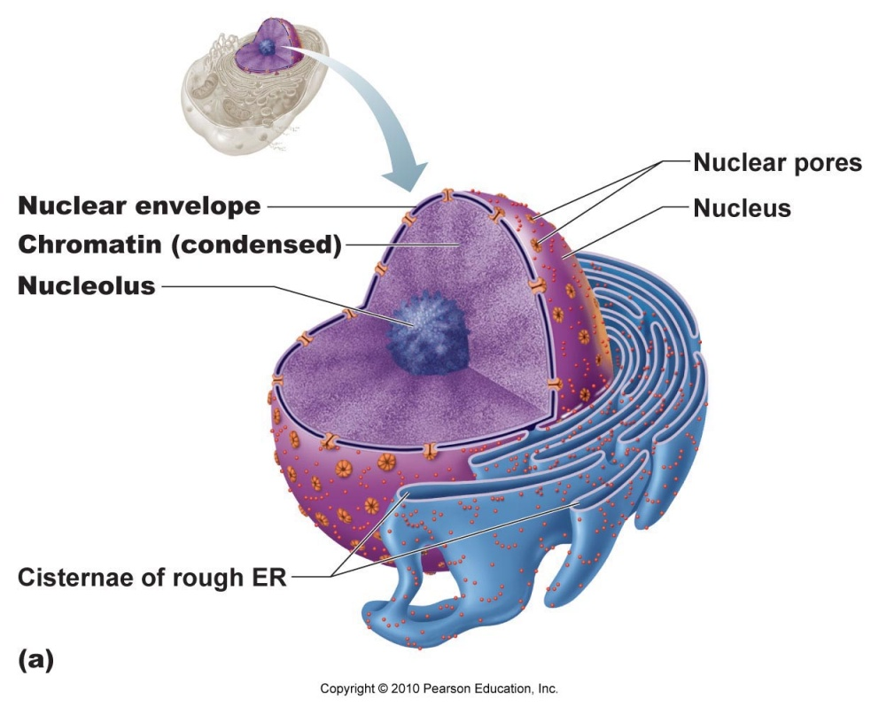
Control center → contains DNA

Slide 5
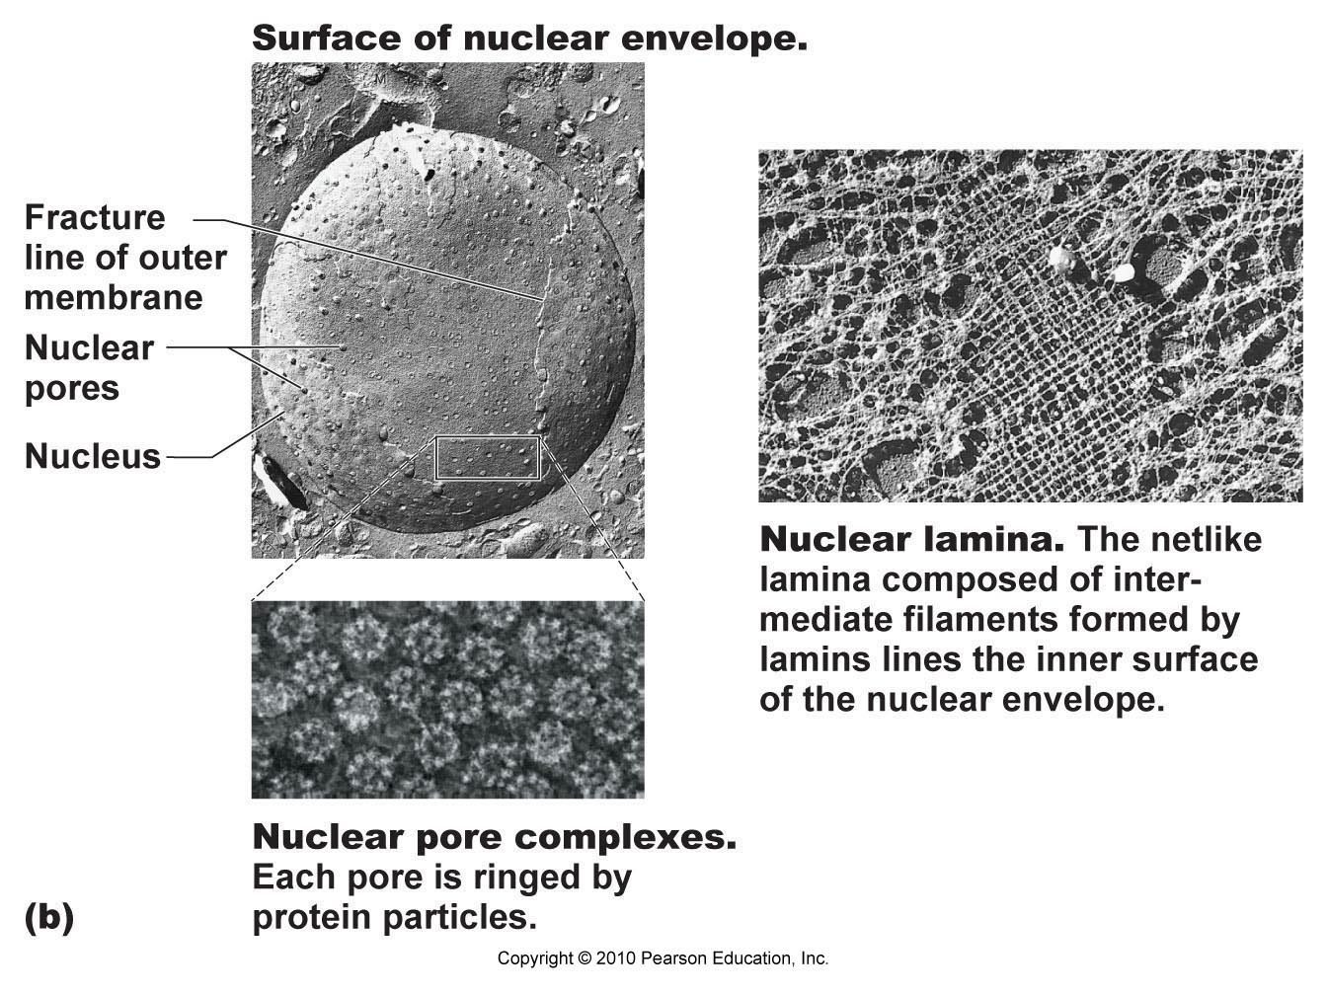
Double membrane barrier surrounds nucleus
Outer part continuous with Rough ER

Slide 6
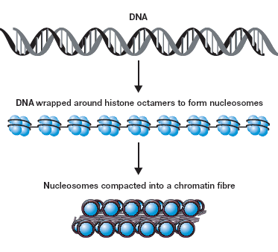
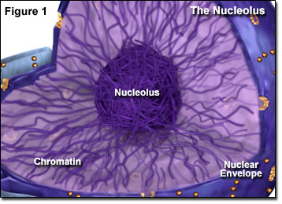
Chromatin = DNA + Proteins
Nucleosome = DNA wrapped around 8 histone proteins
Histones allow for compact and orderly packing of long DNA molecules

Slide 7
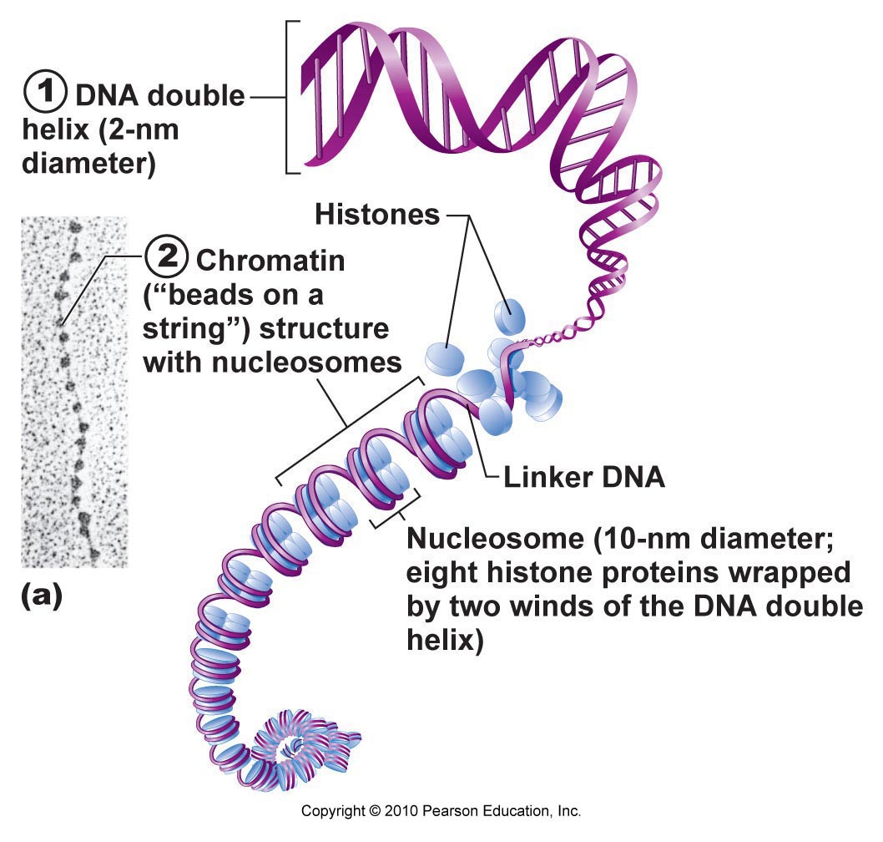

Slide 8
Function: enclose cell contents, control exchange of substances with environment, cell communication
Made of:
Lipid bilayer
Cholesterol
Glycolipids
Proteins

Slide 9
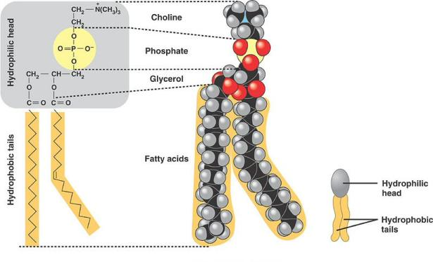
Phospholipid:
Polar/hydrophilic (water-loving) “head”
Nonpolar/hydrophobic (water-fearing) “tail”

Slide 10
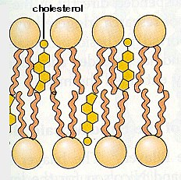
Cholesterol
20% of membrane lipid
Stabilize membrane
Maintain fluidity

Slide 11
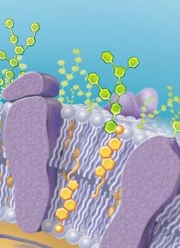
Glycolipids
Lipid + sugar attached
5% membrane lipid
For cell recognition
glycolipid

Slide 12
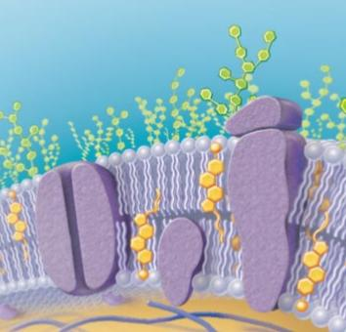
Integral Proteins
Inserted into lipid bilayer
Have both hydrophilic & hydrophobic regions
Functions: enzymes, transport, receptors (relay messages)
integral proteins

Slide 13
Peripheral Proteins
Attached loosely to membrane
Functions: support, enzymes, movement, linkage
peripheral protein

Slide 14
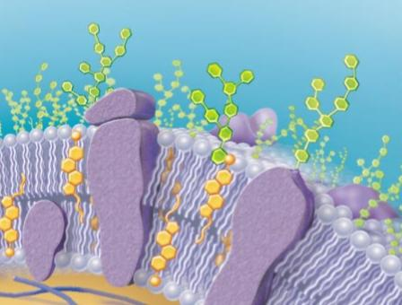
protein + sugar attached
Serves as specific biological marker → cell recognition
glycoprotein

Slide 15
Folded double membrane
Several within cell
ATP production
Membrane bound sac
Storage and transport of substances (waste, water, food, etc.)
Mitochondria
Vesicles/Vacuoles

Slide 16
Single membrane surrounding nucleus
Protein synthesis and processing
SIngle membrane surrounding nucleus
Lipid synthesis
Rough Endoplasmic Reticulum
Smooth Endoplasmic Reticulum

Slide 17
Single membrane found folded near the ER
Packages proteins for export, forms secretory vesicles
Single membrane organelle
Digests macromolecules and cell debris, recycles
Golgi Apparatus
Lysosomes

Slide 18
Single membrane organelle
Oxidizes fatty acids, ethanol, and other compounds
Two pairs of bunched microtubules
Anchor and assemble microtubules, assist in cell replication
Peroxisome
Centrioles

Slide 19
Network of protein filaments
Support and give the cell structure
Small proteins embedded within cell and on rough ER
Protein synthesis
Cytoskeleton
Ribosomes

Slide 20
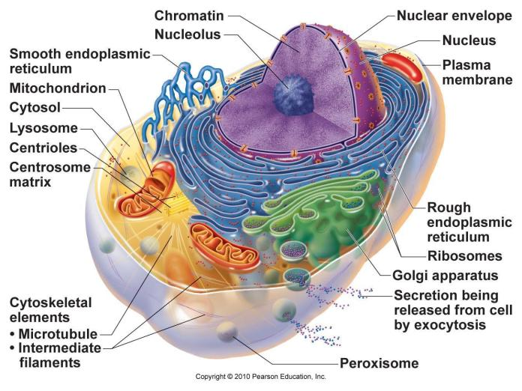

Slide 21
No energy (ATP) needed
Molecules move down concentration gradient from HIGH → LOW concentration
Types: diffusion, filtration

Slide 22
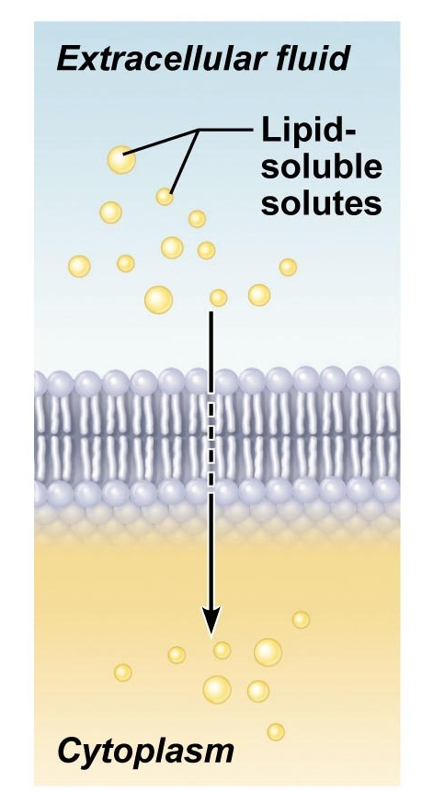
Nonpolar & lipid-soluble substances diffuse directly through lipid bilayer
Eg. O₂, CO₂, fat-soluble vitamins

Slide 23
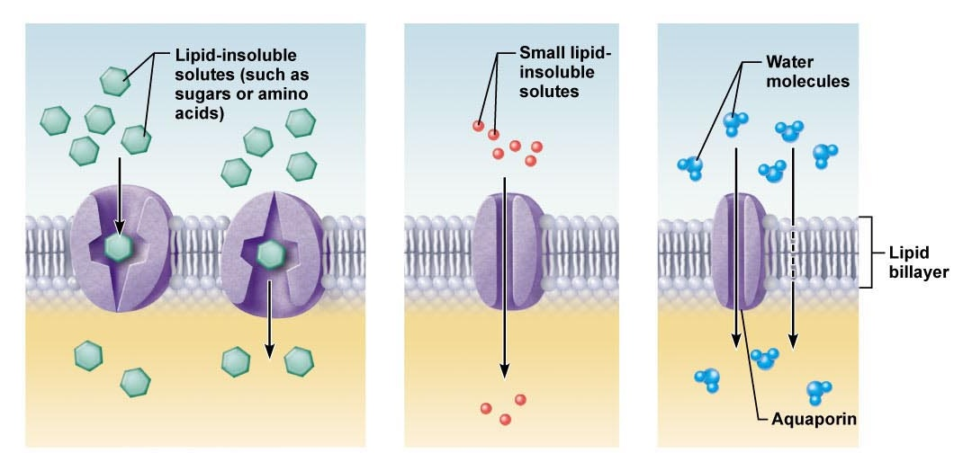
Transport proteins (carrier or channel proteins) assist molecules across membrane
Eg. glucose, amino acids, H₂O, ions

Slide 24
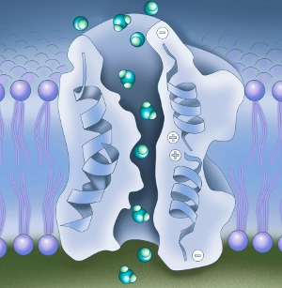
Diffusion of H₂O
Aquaporins: channel proteins for H₂O passage

Slide 27
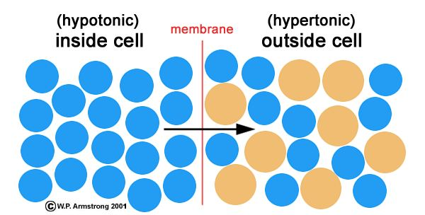
Ability of solution to change shape or tone of cells by changing water volume
Isotonic = equal concentration solutes
Hypertonic = higher conc. of solutes
Hypotonic = lower conc. of solutes

Slide 28
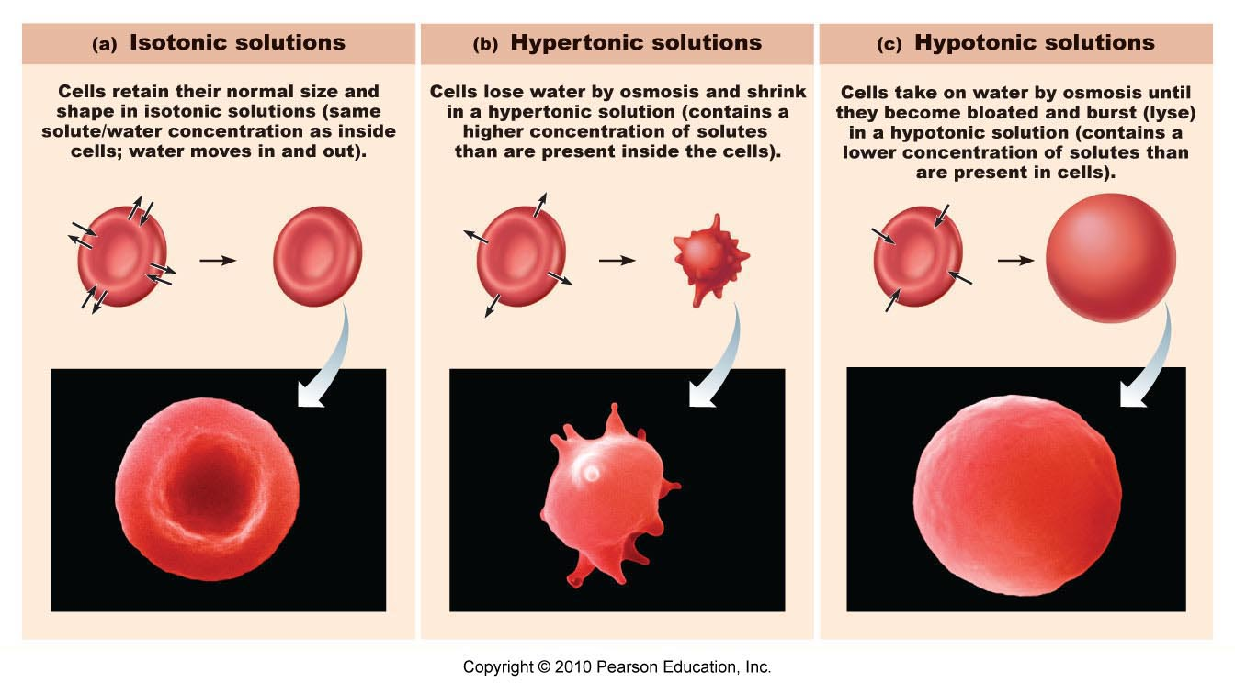

Slide 29
Energy (ATP) is needed!!
Move molecules against concentration gradient from LOW → HIGH concentration
Types: Primary and Secondary

Slide 30
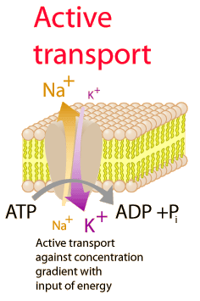
Directly uses ATP to drive transport
Eg. Ca²⁺ pump, H⁺ pump, Na⁺-K⁺ pump

Slide 31
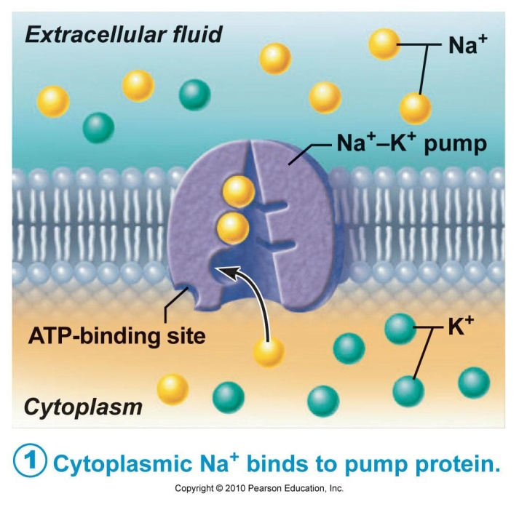
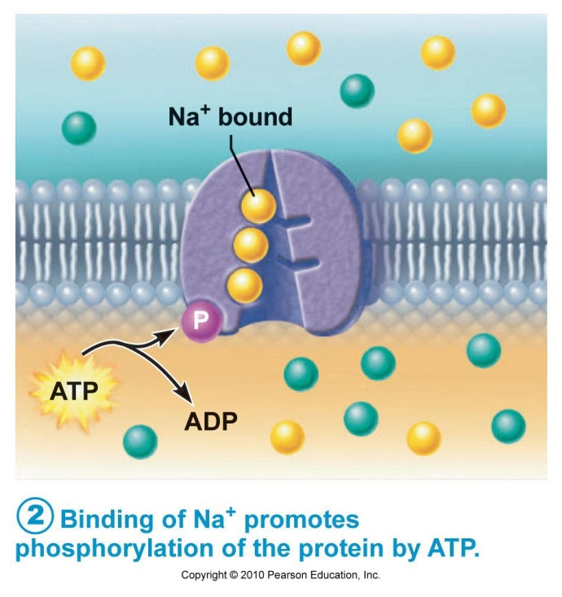
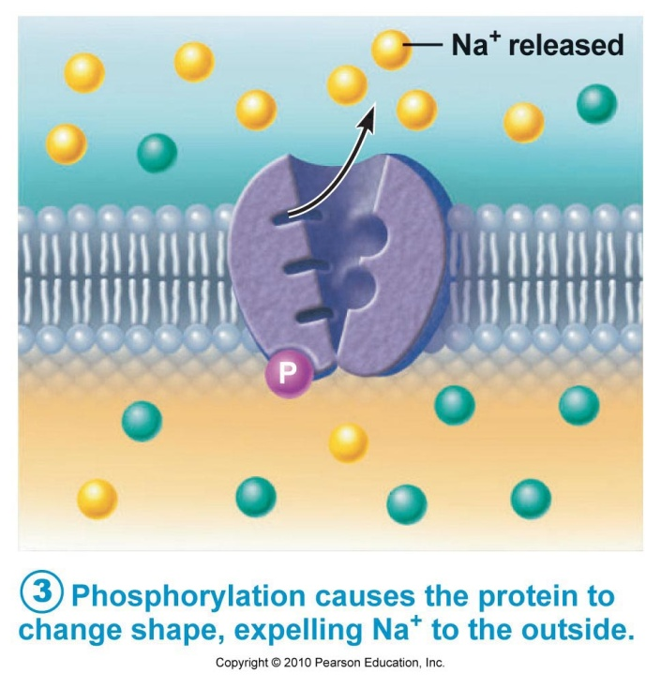
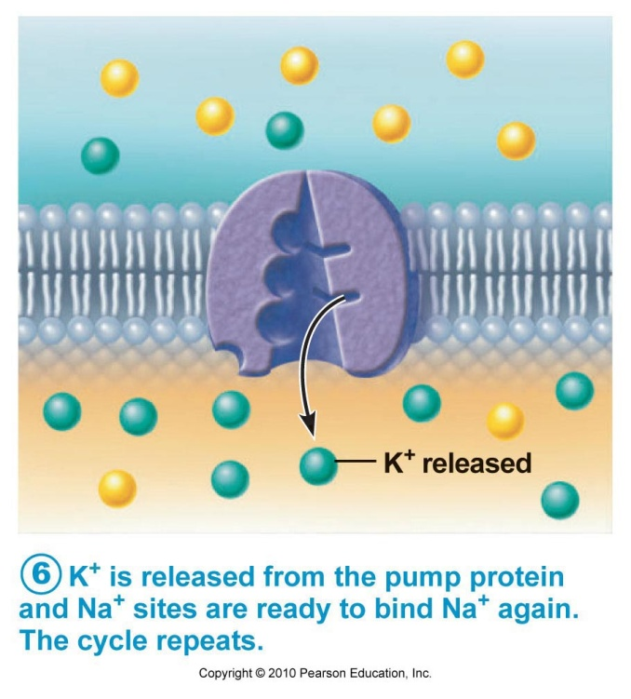
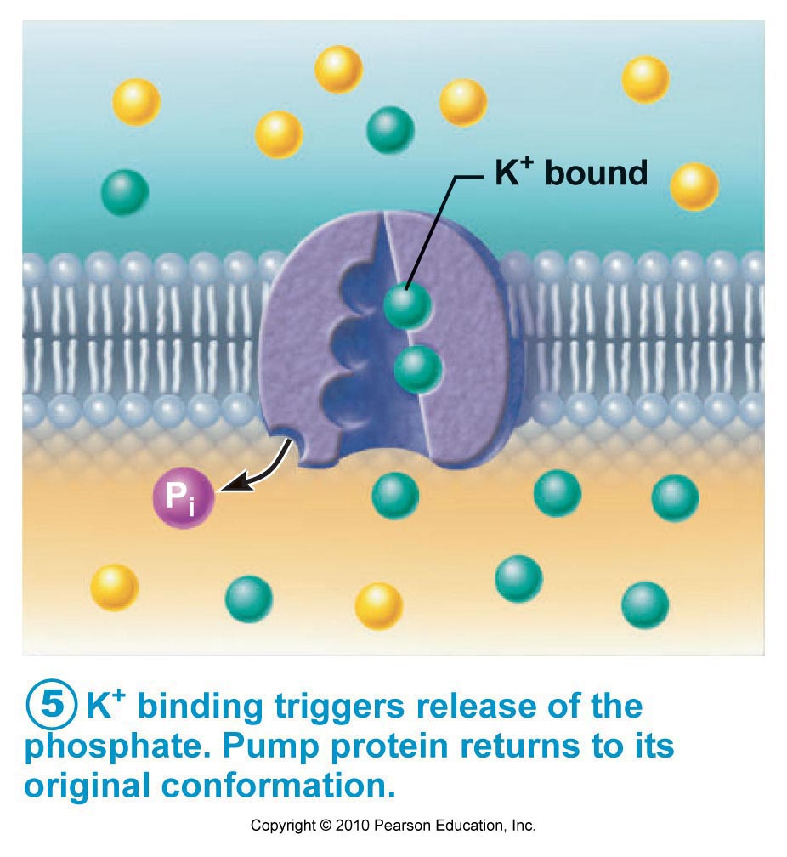
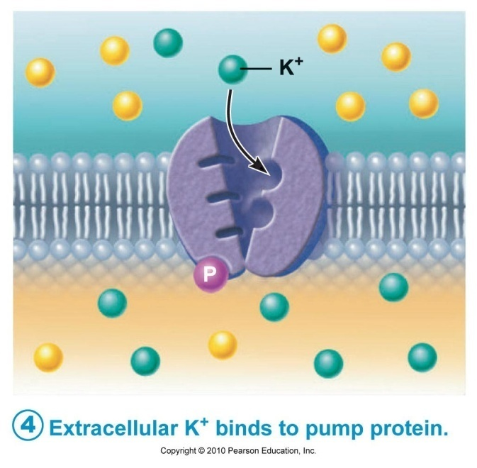
Sodium-Potassium Pump

Slide 32
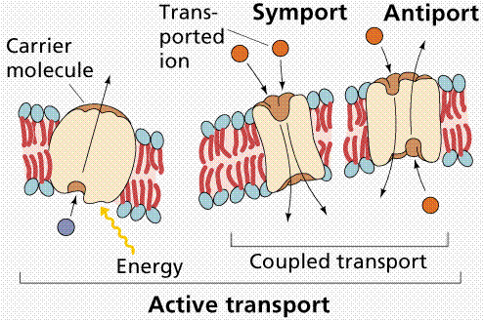
Move more than 1 substance at a time
Symport: 2 substances moved in same direction
Antiport: 2 substances cross in opposite directions
Eg. cotransport of sugars, animo acids, ions

Slide 33
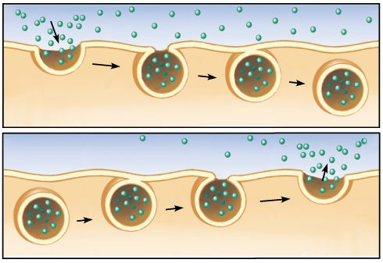
Fluid & large particles transported across membranes in vesicles (sacs)
Exocytosis: “out of cell” – eject substances
Endocytosis: “within the cell”- ingest substances

Slide 34
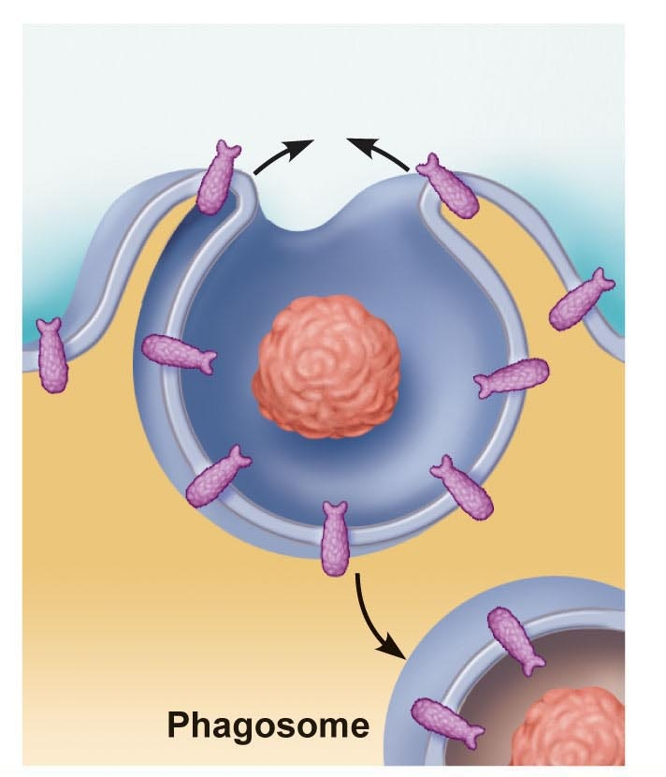
Phagocytosis: (cell eating) – engulf large or solid material
eg. WBC engulf bacteria

Slide 35
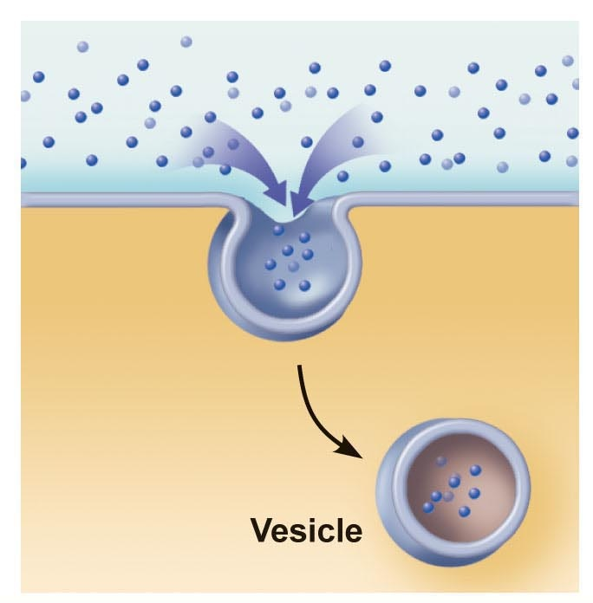
Pinocytosis: (cell drinking) – fluid w/dissolved molecules
Eg. intestinal cells

Slide 36
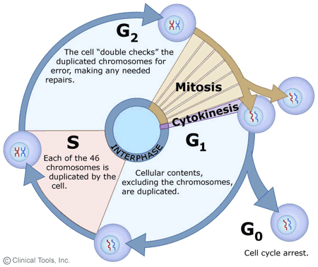
Cell Cycle

Slide 37
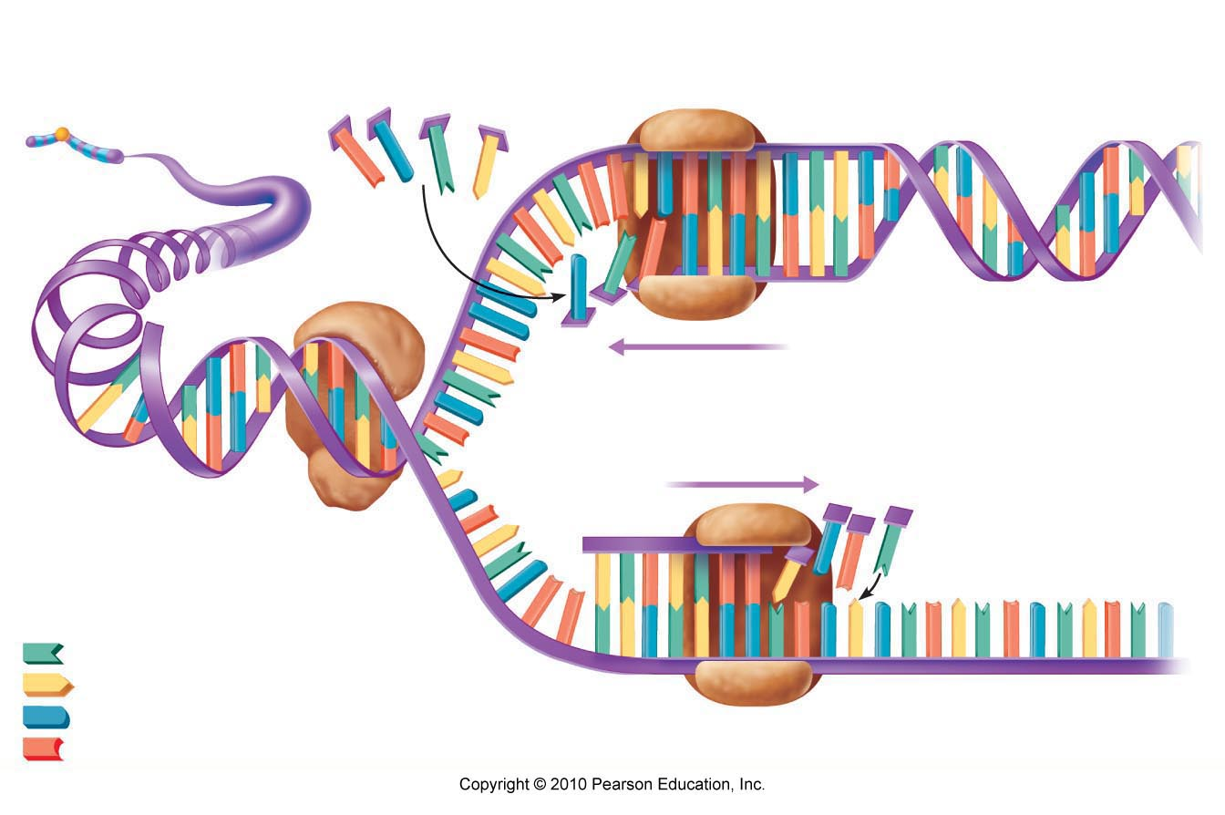
Make identical copies of DNA before a cell divides

Slide 38
DNA replication
occurs during interphase of cell
DNA helix unwinds
DNA separates into 2 chains
Strands act as a template
2 new strands of DNA are created

Slide 39
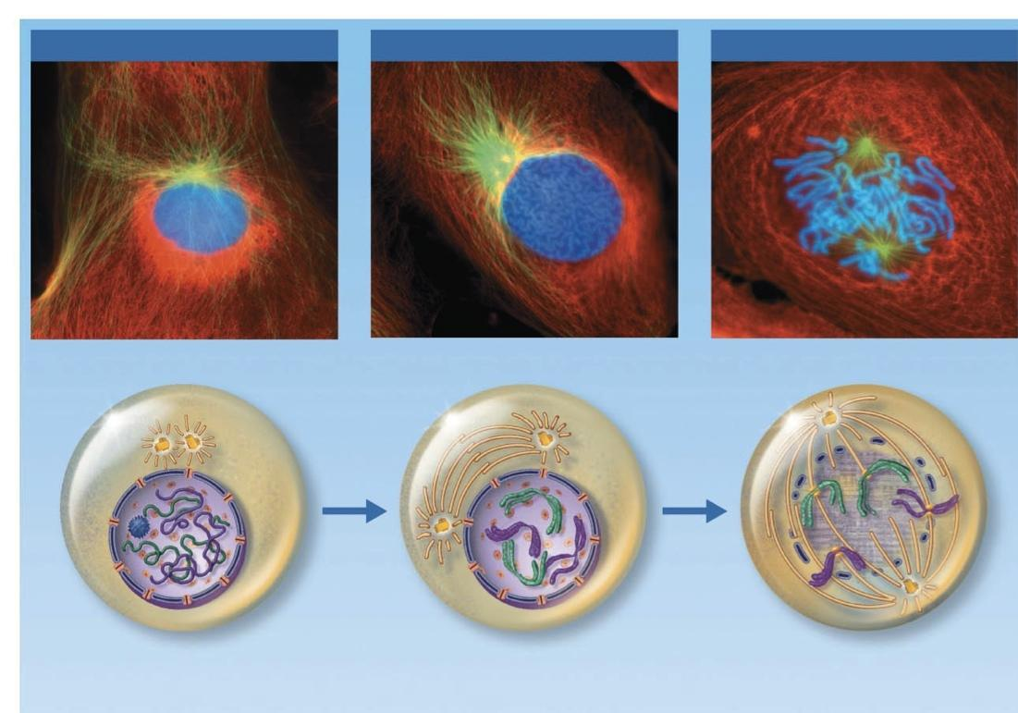
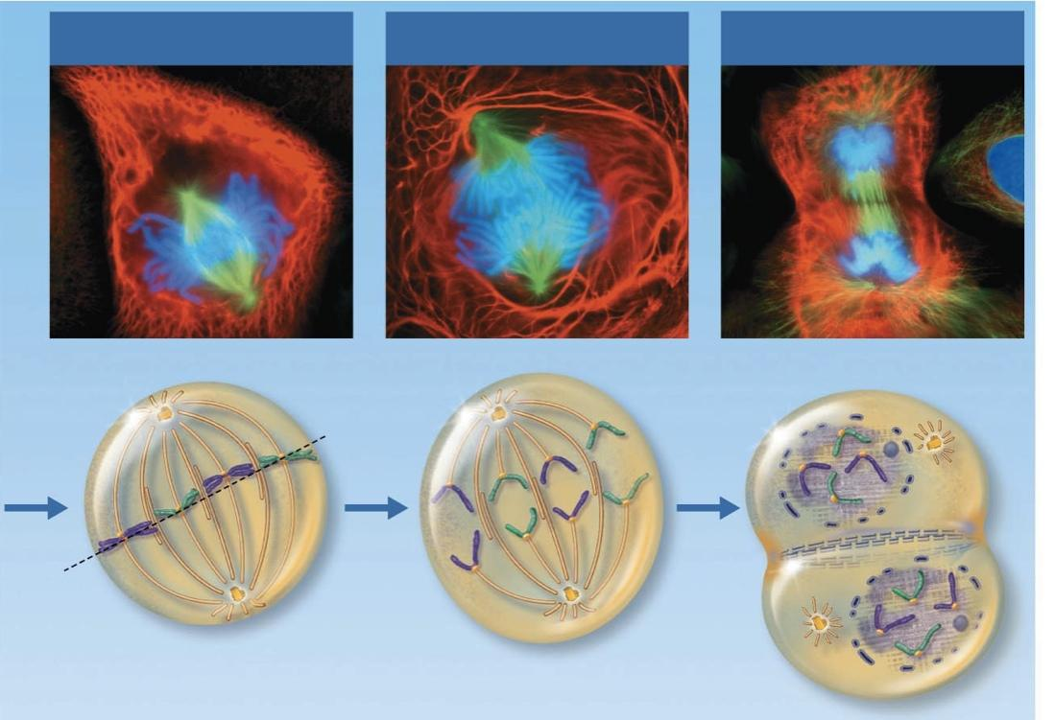
Part of cell division
Replicated DNA divided into 2 daughter cells
Usually lasts about an hour
Interphase → prophase → metaphase → anaphase → telophase & cytokinesis

Slide 40
Cell Division
Mitosis
Eukaryotes
One cell replicates to create 2 identical copies
Meiosis
Eukaryotes
Gametogenesis
One cell replicates twice to create 4 copies
Binary Fission
Prokaryotes
One cell replicates to create 2 identical copies

Slide 41
Prophase- DNA replicates, centrioles migrate
Metaphase- chromosomes line up along, spindle fibers attach to centromeres
Anaphase- spindle fibers pull chromosomes to opposites sides, chromosomes split at centromere
Telophase- nuclear envelope forms around chromosomes, cell divides into 2 daughter cells

Slide 42
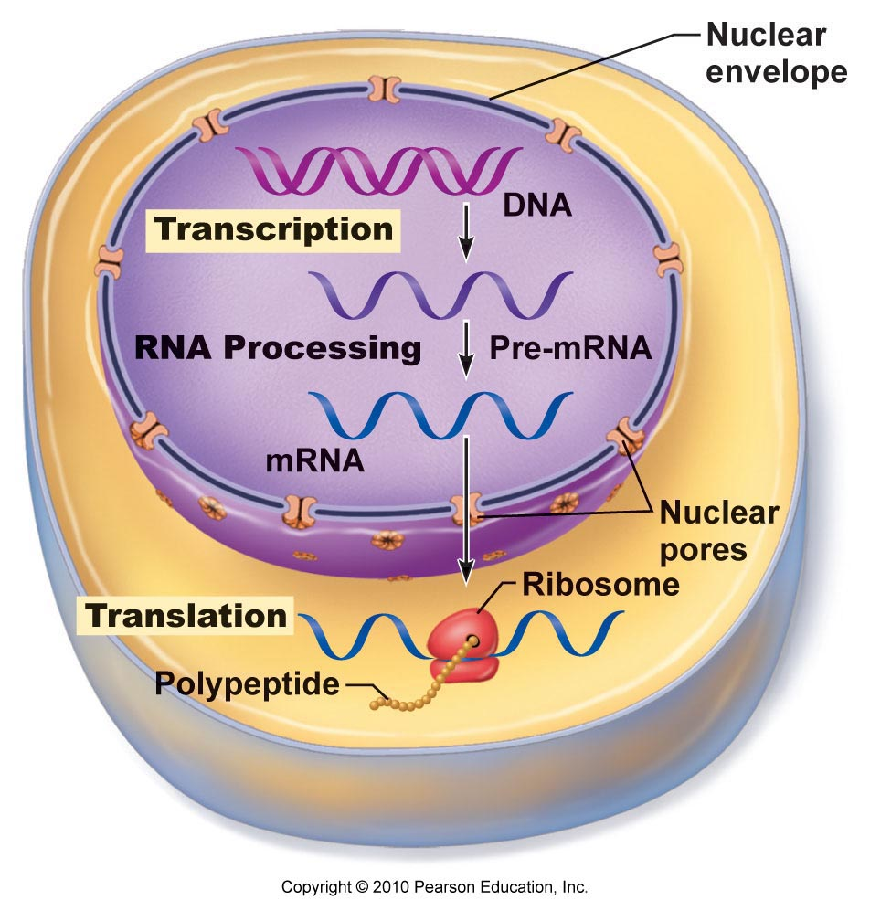

Slide 43
Transcription: RNA formed from DNA
Occurs in nucleus
Types: mRNA, tRNA, rRNA
Translation: protein synthesis
polypeptide formed from mRNA
Occurs in cytoplasm
By ribosomes
GENE → PROTEIN

Slide 44
mRNA- messenger RNA
-replicates gene of DNA in nucleus
-leaves nucleus and binds onto rRNA
rRNA- ribosomal RNA
-binds onto mRNA and acts as site for tRNA to read mRNA
tRNA- transfer RNA
-binds onto specific codon (triplet) on mRNA sequence
-has specific amino acid attached based on codon
-binds amino acids with peptide bonds to make polypeptide

Slide 45
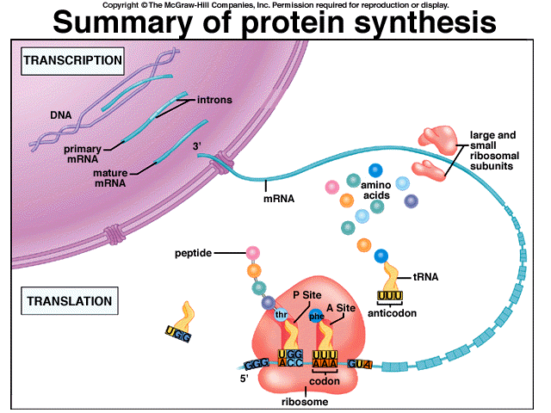

Slide 46
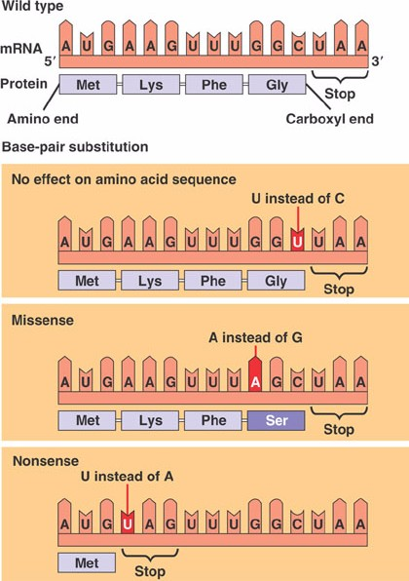
Everyone makes mistakes
Frameshift mutation- inserting or deleting bases, whole polypeptide is effected
Missense- incorrect sequence of bases, resulting in incorrect polypeptide
Nonsense- incorrect sequence of bases, resulting in a STOP codon

Slide 47
Frameshift Mutation: Insertion or Deletion
Cancer
Crohn’s Disease
Cystic Fibrosis
Tay-Sach’s
Missense Mutation: Swapping a base, change an amino acid
Cancer
Nonsense Mutation: Swapping a base, creating a stop codon
Cystic fibrosis
Duchenne muscular dystrophy
Hurler’s syndrome

Slide 48
Stem cells
Obtained from embryos (blastocysts- a hollow ball of cells) and adults
Undifferentiated cells that can assist in the healing of wounds and diseases
IPS cells- induced pluripotent stem cells

