Slide 1
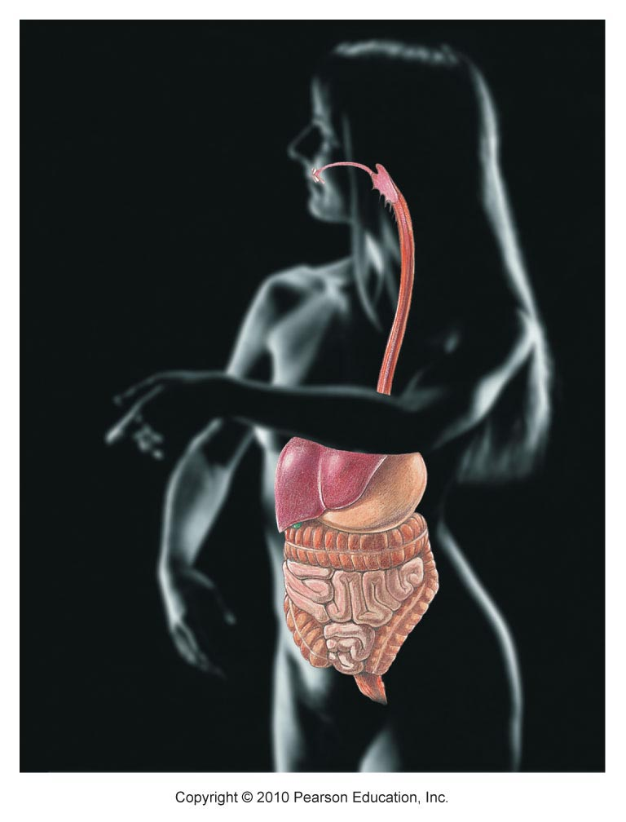
DIGESTIVE SYSTEM
Chapter 23

Slide 2
Warm Up!
Part 1: Eat one of your crackers. Discuss the following questions
Where does digestion of the cracker begin?
What is the sequence of organs that the cracker must travel through before it is no longer in the body?
What other organs are involved in digestion?
What did the cracker taste like? What was it’s texture?

Slide 3
Warm Up!
Part 2: Let the cracker sit in your mouth for 1.5 minutes before chewing. Discuss the following questions.
How did the taste and texture of the cracker change? How?
If so, what caused it?
Compare and contrast the process of eating the cracker immediately and after it sits in your mouth.

Slide 5
Functions
Ingestion - mouth
Digestion
Mechanical – fragment food into smaller particles (teeth, tongue, stomach, SI)
Chemical – enzymes, water
Mouth = carbs
Stomach = proteins
SI = carbs, proteins, fats, nucleic acids
Absorption – transport from SI to blood
Defecation – eliminate indigestible residues (feces)

Slide 6
Nutrition
Nutrient: substance in food used to promote growth, maintenance, and repair
Major nutrients:
Carbohydrates – sugars & starches
Lipids – saturated/unsaturated fats
Proteins – eggs, milk, meat (complete – all AA); legumes, nuts, cereals (incomplete)
Vitamins – A, B, C, E, D, K
Minerals – Ca, P, K, S, Na, Cl, Mg

Slide 7
Anatomy
Alimentary canal
Gastrointestinal (GI) tract
Mouth → pharynx → esophagus → stomach → small intestine → large intestine
Accessory digestive organs
Teeth, tongue, digestive glands

Slide 8
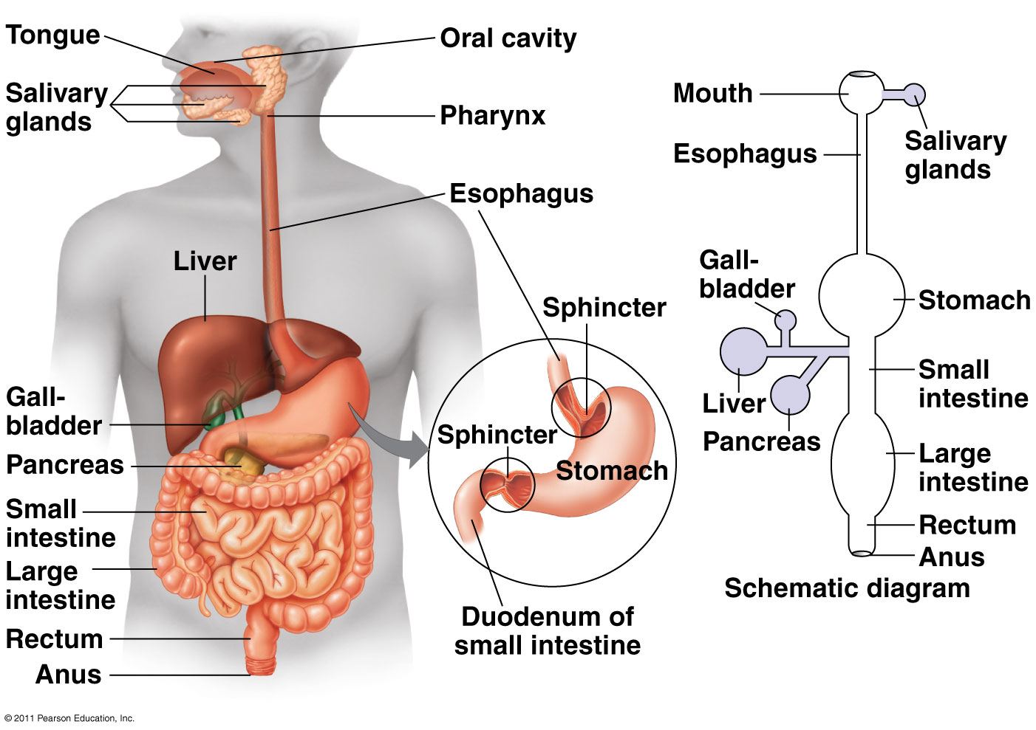

Slide 9
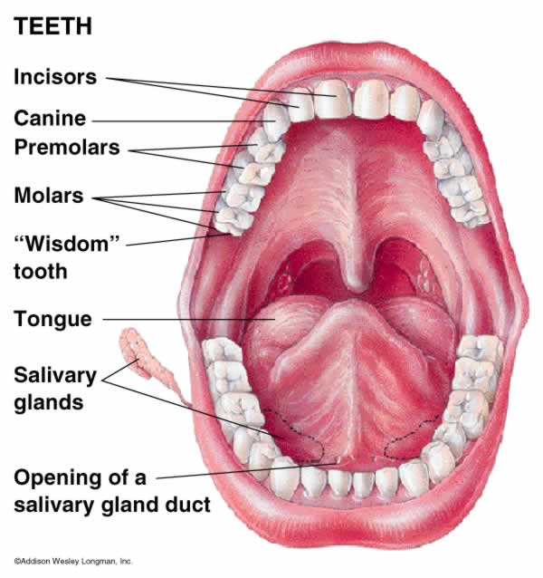
Mouth
Oral cavity: mechanical, chemical digestion
Salivary glands: saliva lubricates food
Saliva = mucus, salivary amylase (starch breakdown)
Mastication: teeth chew food
Tongue mixes food + saliva

Slide 10
Pharynx: back of throat
Epiglottis: flap of cartilage, covers trachea when swallowing
Peristalsis (involuntary waves of muscle contraction)
Esophagus (gullet): passageway to stomach

Slide 11
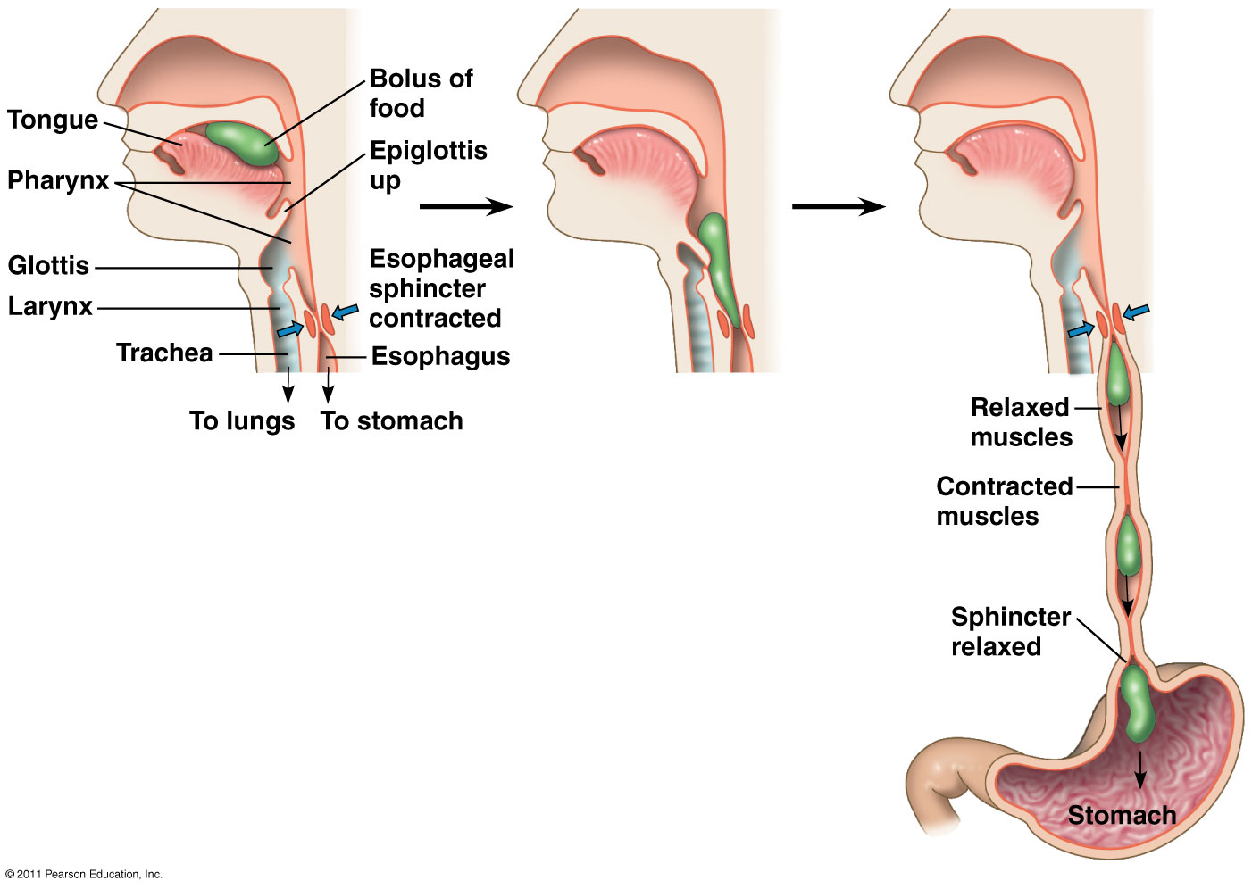

Slide 12
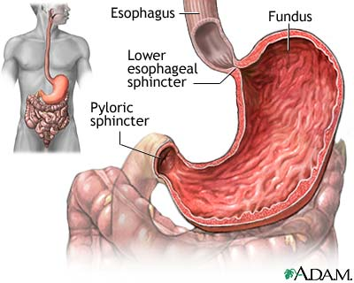
Stomach
Stores food & breaks down food
Mechanical – churn, mix
Chemical – protein digestion
Gastric juice: converts meal to acidic chyme
HCl: pH 2, kills bacteria, denatures proteins
Pepsin: enzyme breaks down proteins
Rugae = large folds
Mucus = protects lining of stomach

Slide 13
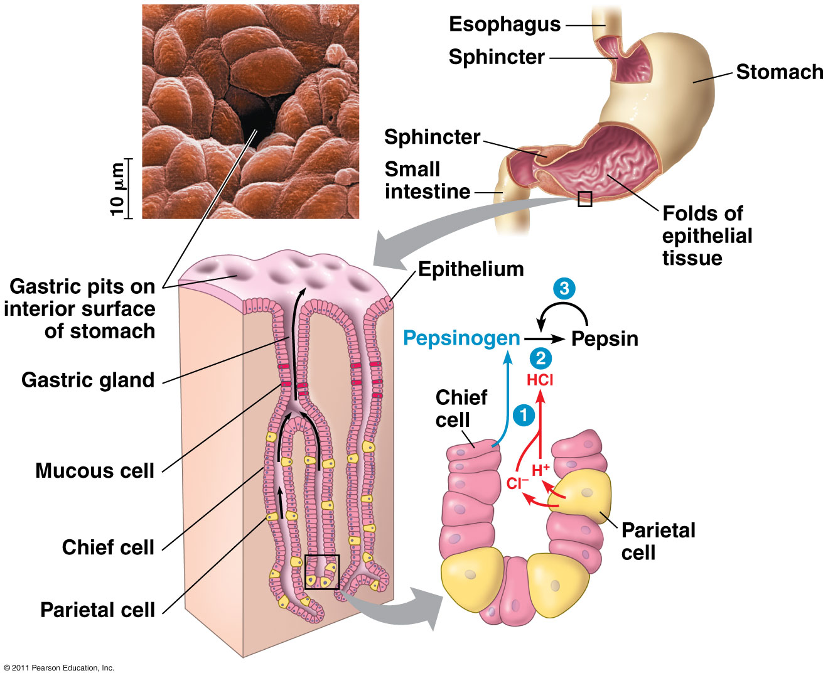

Slide 14
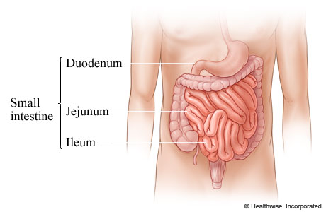
Small Intestine
Digestion & absorption
Duodenum: (1st section) digestive juices, major chemical digestion
Villi contain enzymes peptidase, maltase, sucrase, and lactase
Jejunum (2nd): absorb nutrients
Ileum (3rd): absorb Vit. B₁₂, bile salts, remaining nutrients

Slide 15
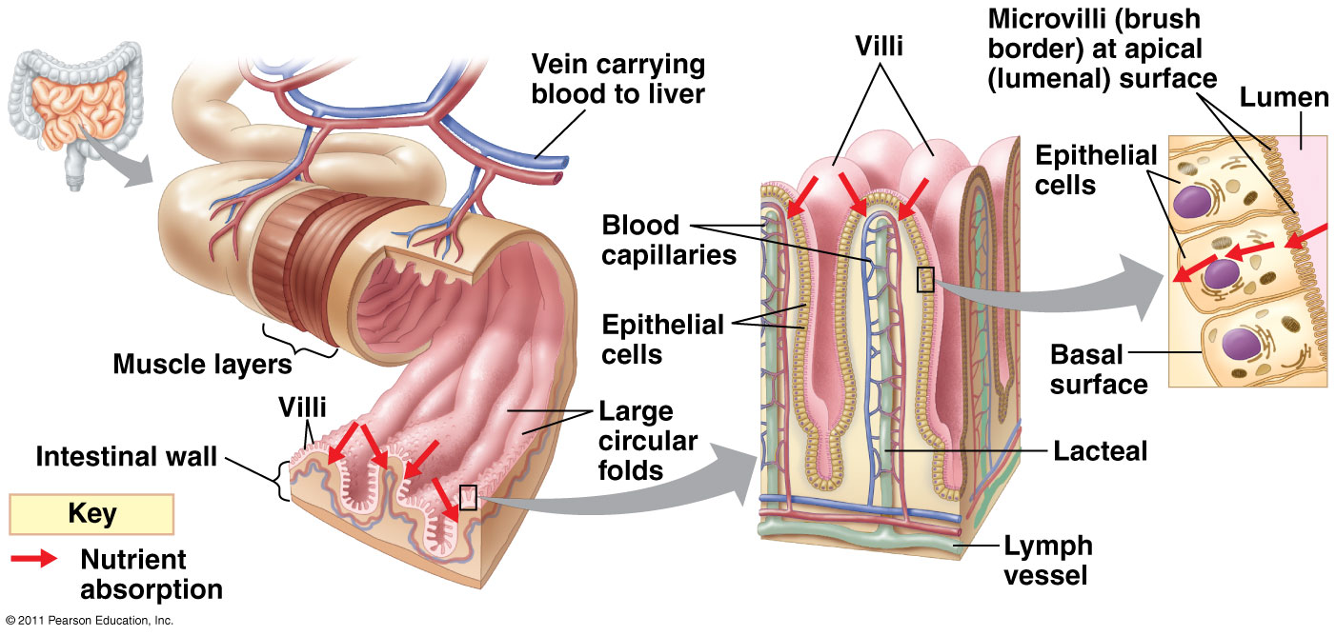
Folds, villi and microvilli increase surface area for absorption

Slide 16
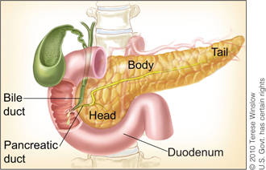
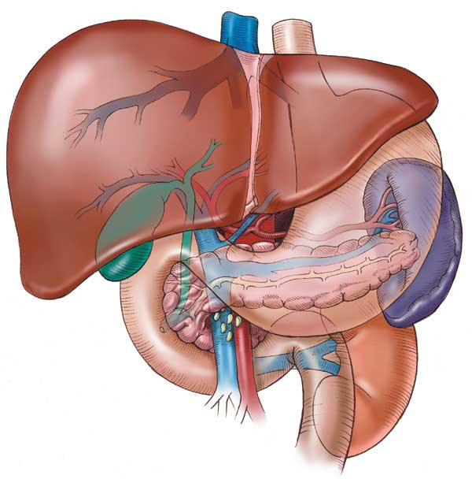
Digestive Glands
Secrete into SI (duodenum)
Pancreas: neutralize acidic chyme (bicarbonate), enzymes (amylase, proteases, lipase)
Secretes hormones insulin and glucagon
Bile salts: made in liver, stored in gallbladder
Emulsify fats (make smaller droplets)

Slide 17
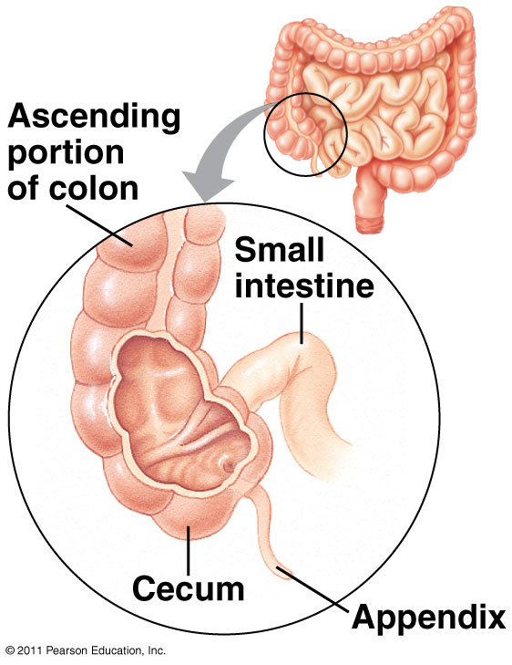
Large Intestine (Colon)
Absorb water, eliminate food residue
Cecum: pouch where SI & LI meet, ferment plant material
Appendix = extension of cecum, role in immunity
Bacteria: make Vitamin K, produce gases
Rectum: feces stored until elimination

Slide 18
HOMEOSTATIC IMBALANCES OF DIGESTIVE SYSTEM

Slide 19
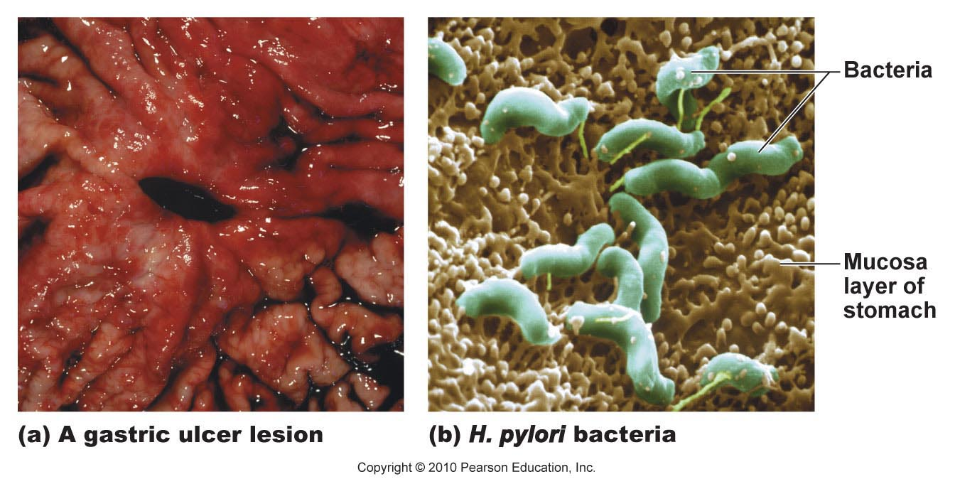
Gastric Ulcers
Lesions in the stomach lining
Caused mainly by bacterium Heliobacter pylori

Slide 20
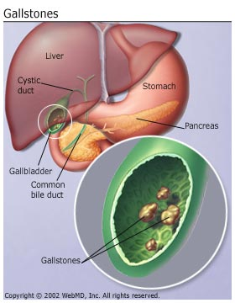
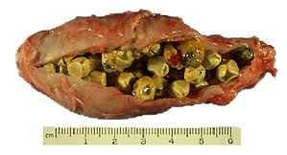
Gall Stones
Crystallized cholesterol in gallbaldder
Bile stored too long or too much water removed

Slide 21
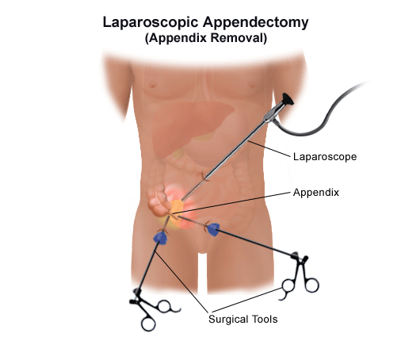
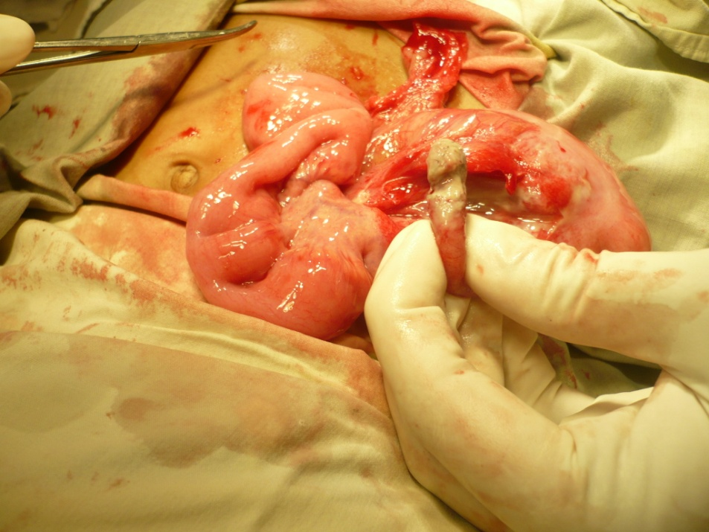
Appendicitis
Inflammation of appendix
Vestigial organ previously used to digest cellulose

Slide 22
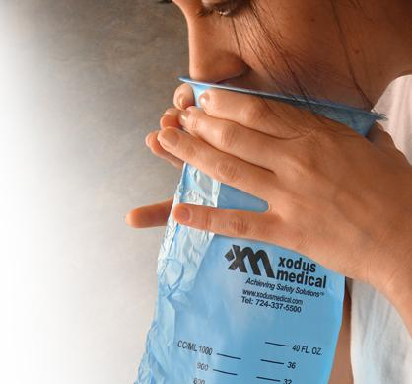
Vomiting (emesis)
Caused by irritation of stomach; inner ear disturbance
Abdominal muscles & diaphragm contract
“reverse peristalsis”

Slide 23
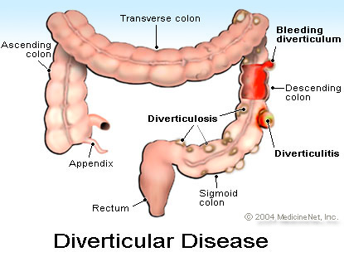
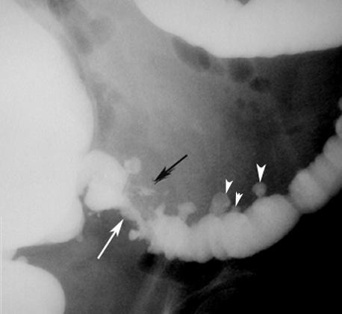
Diverticulosis
When diet lacks bulk (low-fiber diet)
Diverticula: pouches form on colon wall
Diverticulitis: when diverticula become inflamed → feces gets trapped, bacteria grow in pouch

Slide 24
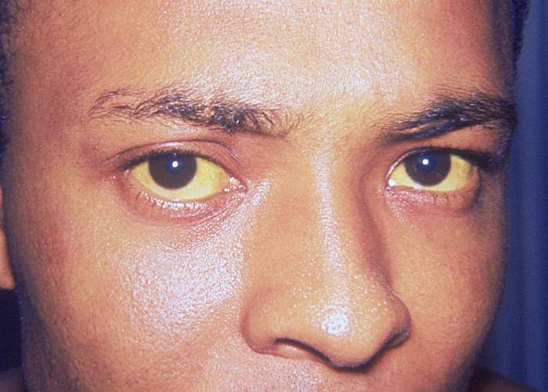
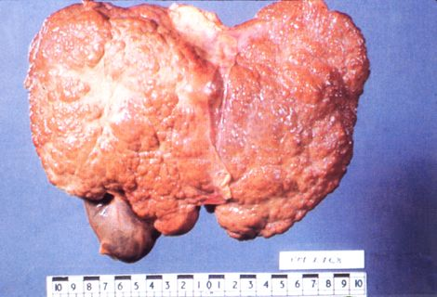
Hepatitis
Inflammation of liver
Viral infection from contaminated water, blood transfusions, needles
5 different kinds: A, B, C, D, E
Jaundice

Slide 25
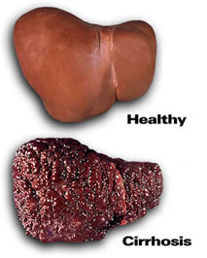
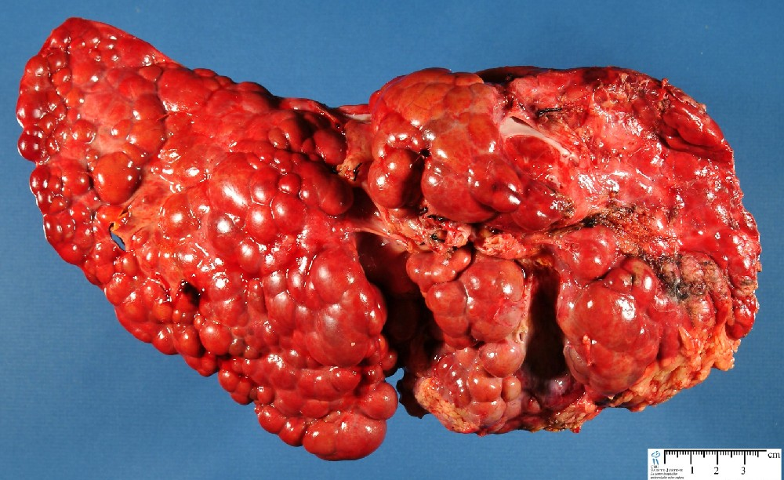
Cirrhosis
Chronic inflammation of liver
Severe damage → hard and fibrous liver
Alcoholism

