Slide 1
Warm Up
Complete this on the sheet you picked up (Table with # 1-5)
What are 3 of the Lab Safety Rules?
What are the procedures to deal with broken glass?
What are the consequences for not turning in the lab safety agreement?
What is a hypothesis?
Why haven’t you signed up for the class website?!

Slide 2
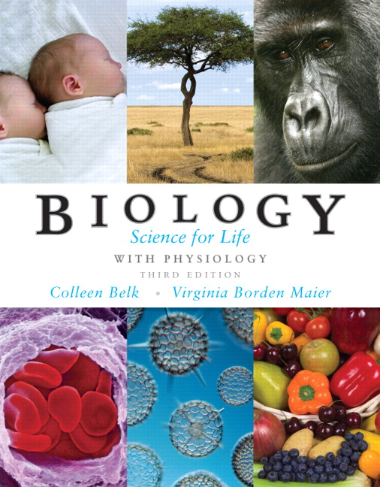
Unit One – Scientific Thinking and Connections in Biology

Slide 3
1.1 What is Science?
Science is NOT just a collection of facts, concepts and useful ideas, but rather a method of investigating nature and discovering reliable knowledge.
Reliable knowledge is knowledge that has a high probability of being true because it has been justified by a reliable method.

Slide 4
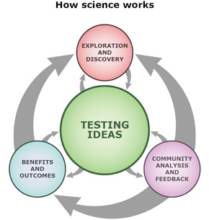
There are three critical components to reliable scientific/critical thinking.
The use of empirical evidence – evidence you can experience (see, hear, etc) and that can be repeated, versus circumstantial evidence, testimonial evidence and authoritarian evidence
The practice of logical reasoning – requires careful analysis of evidence before:
Deductive reasoning – drawing conclusions based on evidence
Inductive reasoning – expanding on conclusions
The use of skepticism – constant questioning of the source and reliability of your beliefs and conclusions, holding beliefs tentatively, requiring adequate evidence or reason (Schafersman, 1997).

Slide 5
Practice with Graphing
By yourself:
Complete Graphing with Scientific Data Practice Sheet (8 minutes)
With a partner:
Compare answers (1 minute)
Questions? Raise your hand silently!

Slide 6
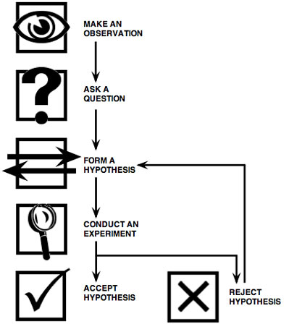
Summary and example: The Scientific Method collects data using the critical analysis traits that scientists value.
Summary and example:
Summary and example:
Summary and example:
Summary and example:
Summary and example:

Slide 7
Scientific Method Presentations
Group One: describe independent and dependent variables. Explain the differnence between them
Group Two: Explain the procedure for setting up a experiment. Describe the control and experimental groups
Group Three: Provide the “rules” for good data using examples
Group Four: Define “good science.” Explain the difference between theories and laws

Slide 8
Warm Up
YOU HAVE HOMEWORK:
UNIT 1, MODULE 1 PROBLEM SET #1-10
FINISH THE PAPER TOWEL LAB
In your own words, define science
What is changed in an experiment
Dependent Variable
Independent Variable
Control Group
Why do you need a control group in an experiment?
What is the next step when your hypothesis is rejected?
Draw a graph and label the x and y axis

Slide 10
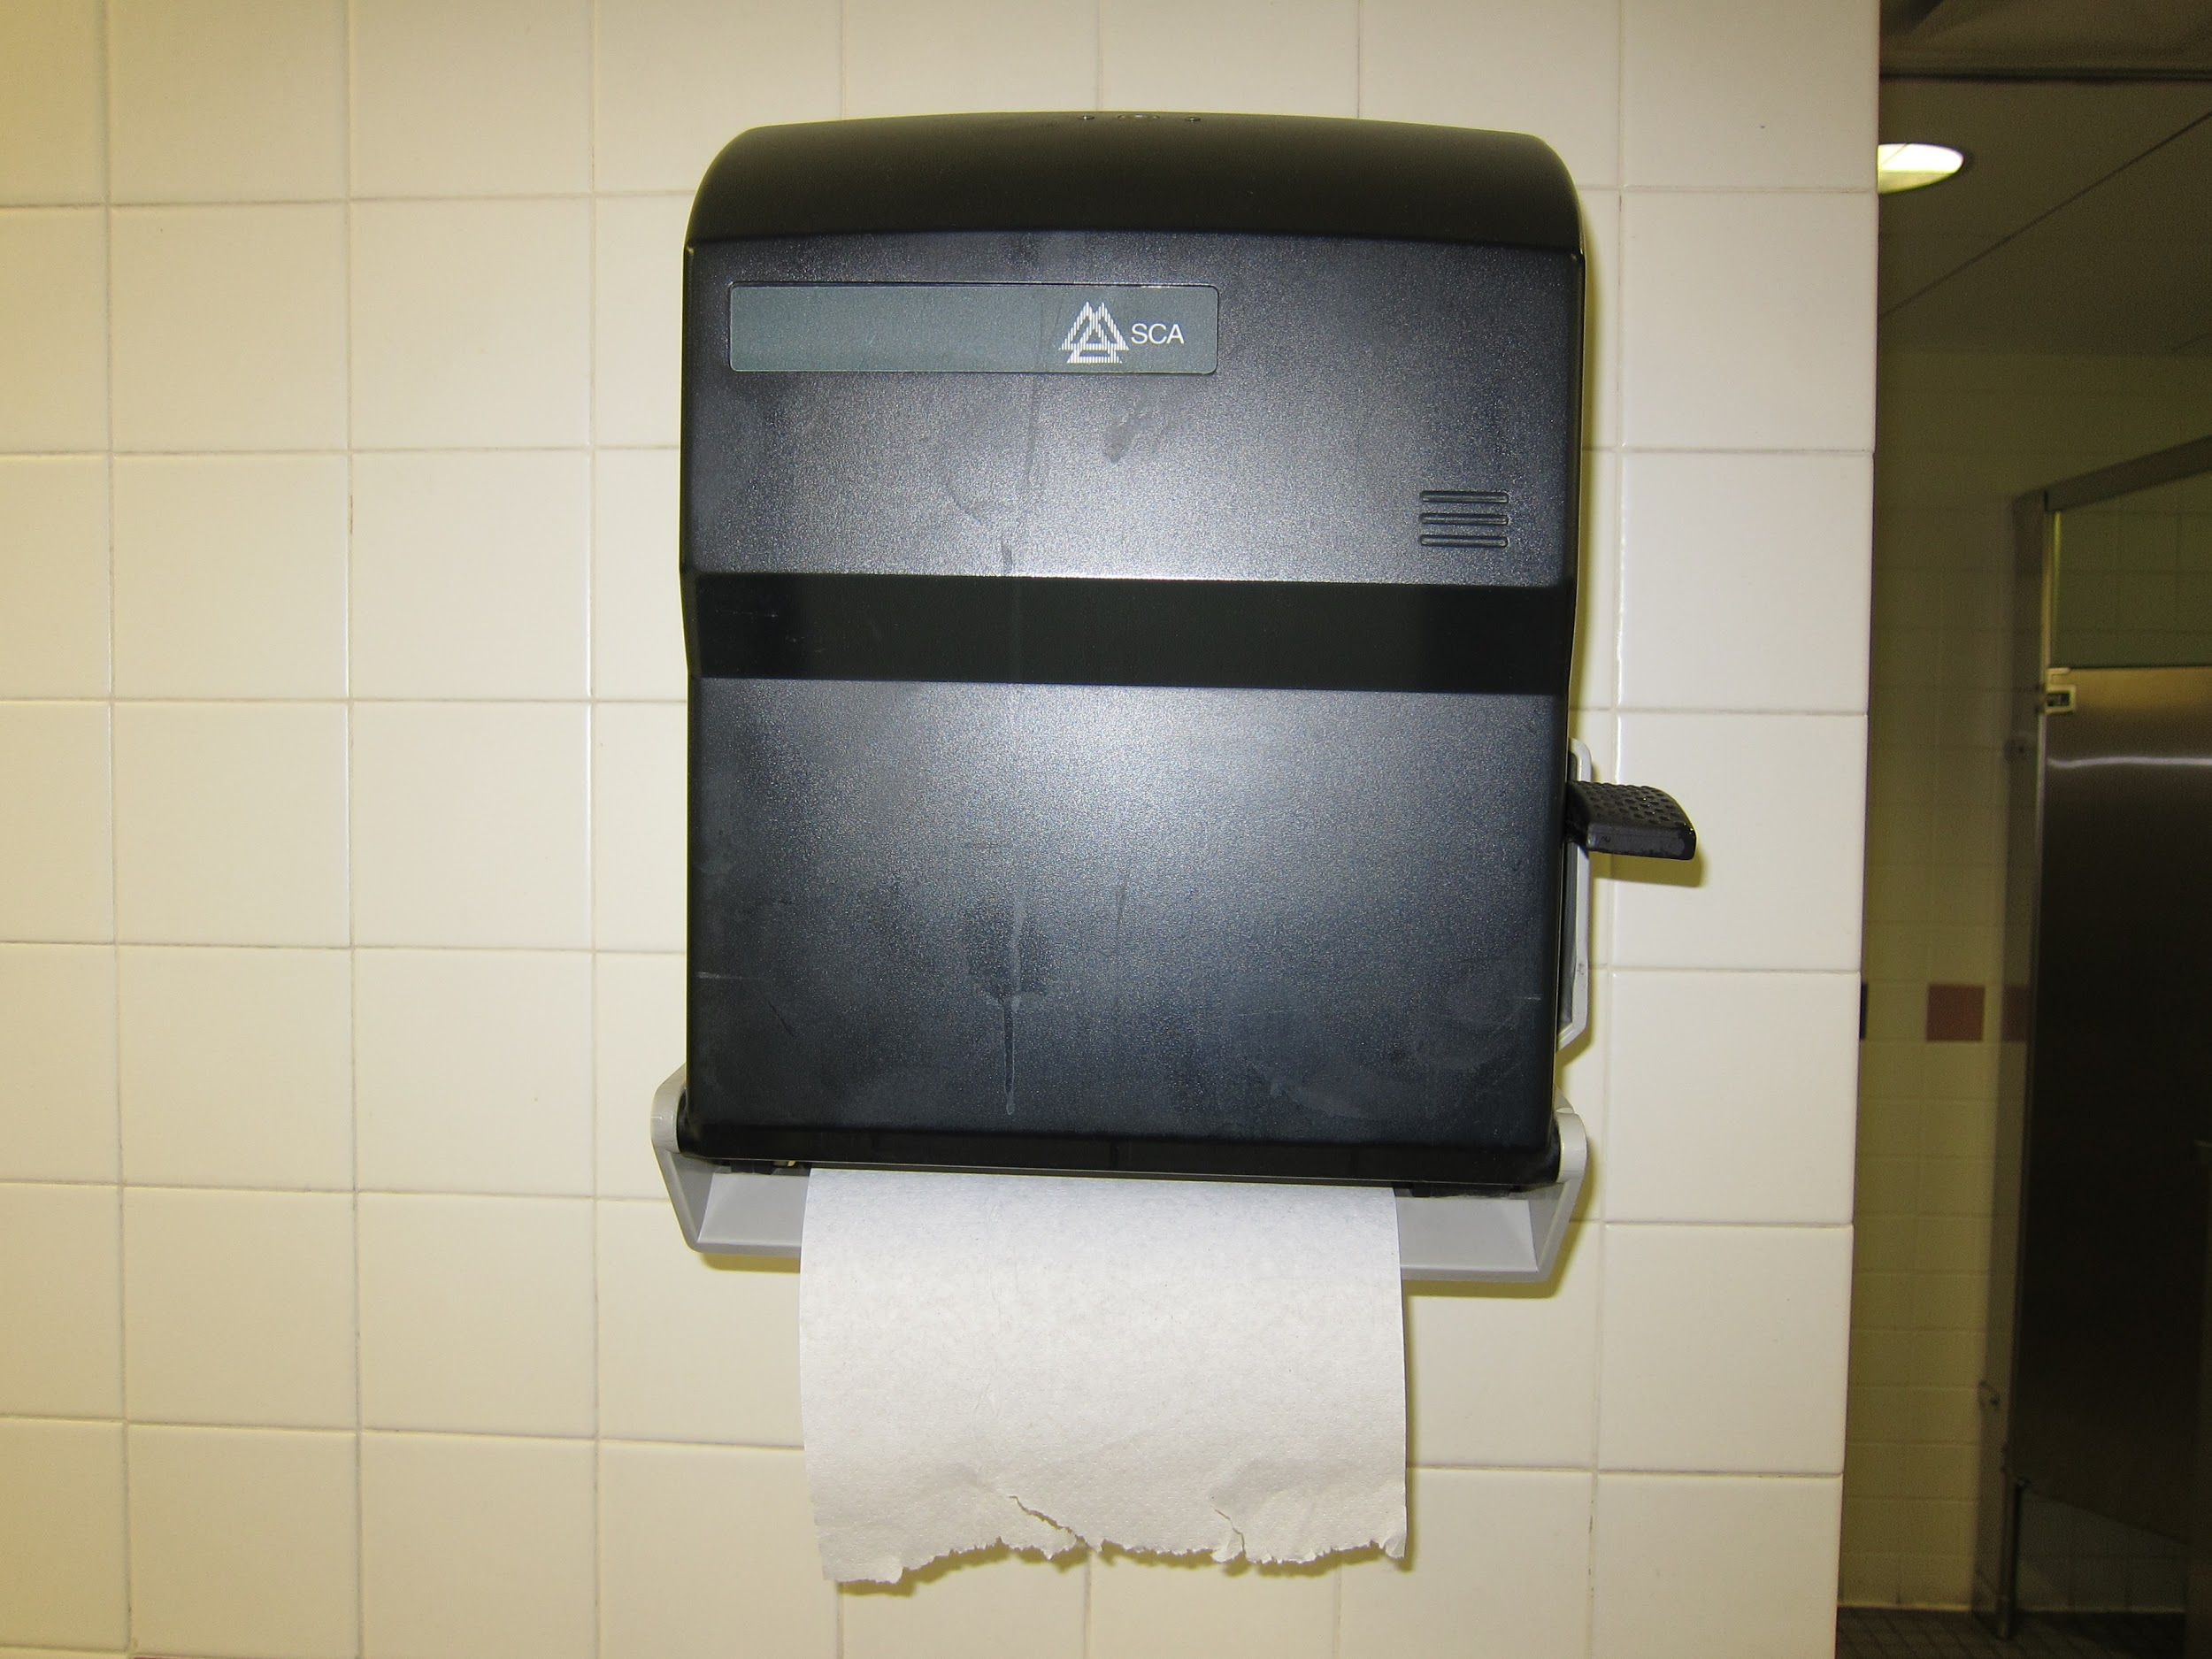
Paper Towel Lab!
Listen to Ms. S for directions!
Roles:
Student with the closest birthday: Read directions and make sure experiment is performed correctly
Tallest student: Gather lab materials & pour water
Shortest student: Write down data in tables
Remaining student: Keep track of time and perform any calculations

Slide 11
Group Work!
Complete Scientific Method Worksheet with a partner
That partner must have the matching part of the story! (One person will have a picture of Patrick, the other will have Spongebob)

Slide 12
Exit Ticket
Alex is studying the effect of sunlight on plant growth. His hypothesis is that plants that are exposed to sunlight will grow better than plants that are not exposed to sunlight. In order to test his hypothesis, he follows the following procedures. He obtains two of the same type of plant, puts them in identical pots with potting soil from the same bag. Then he puts one plant in the sunlight and the other in a dark room. He waters the plants with 200 mL of water every other day for two weeks.
Identify the
Independent Variable
Dependent Variable
Control Group
Experimental Group
Constants
YOU HAVE HOMEWORK:
UNIT 1, MODULE 1 PROBLEM SET #1-10
FINISH THE PAPER TOWEL LAB

Slide 13
Warm Up
TURN IN YOUR HOMEWORK!
Write the 6 steps of the Scientific Method
How did we use the scientific method yesterday?
What is the difference between a law a theory?
What is an experimental group?
Which paper towel brand was the most absorbent in your experiment?

Slide 14
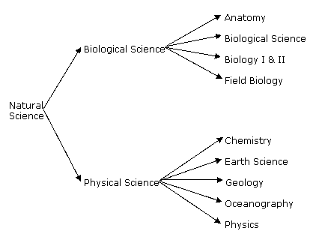
What does Biology study? Science is divided into disciplines that examine different components of the natural world.
Biology is the study of life.
The smallest unit of life is a cell.
Some organisms are multi-cellular and consist of tissues, organs and organ systems.
In order to understand cells, we need to know what they are made of. EVERYTHING, living or non-living is made of matter.
The smallest unit of matter is an atom.
Multiple atoms are held together by bonds to form both small and large molecules.

Slide 15
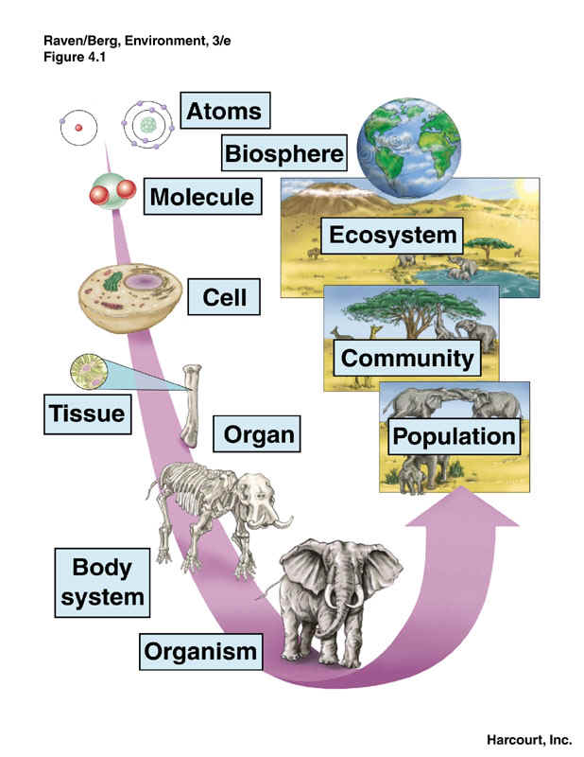
The matter in the universe is arranged in repeating units that give each set of matter unique characteristics. All matter is composed of atoms of elements. Important elements to life include Carbon, Hydrogen and Oxygen. Other important elements are abbreviated as CHNOPS.

Slide 16
These elements bond together by sharing electrons to form molecules.
Molecules can be grouped as organic (contains CHO) or inorganic. The most important inorganic molecule is water.
All life is carbon-based and there are four important organic macromolecules needed to build cells.
We will discuss these later
Summary:

Slide 17
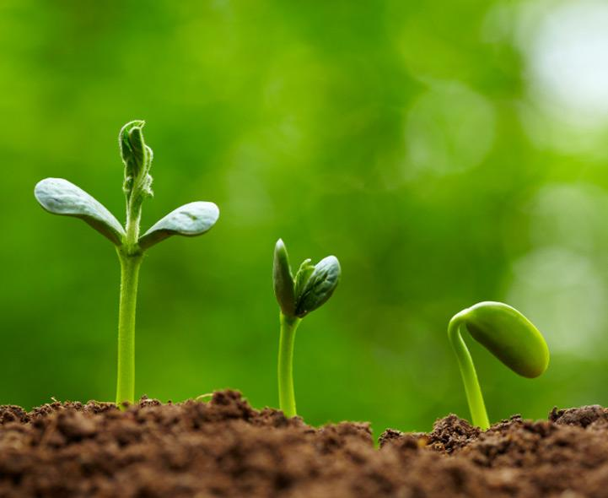
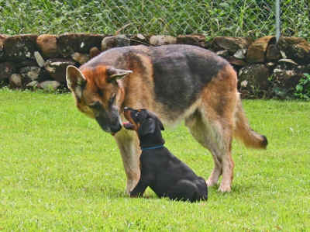
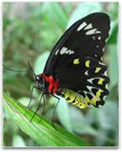
What do you need to be considered living?

Slide 18
CARSMOG
made of Cells
Adapt
Reproduce
Stimulus and response
Metabolism
Organized
Growth

Slide 19
Station Activity
Using your Living, Nonliving, Dead worksheet, complete the table by moving from station to station (There are 12)
Noise should be at level 2
Ms. S will not take any questions. Use your classmates for help/opinions
When you are finished, take a seat and work on #20-25 on the problem set (same sheet as your homework from last night!)

Slide 20
Exit Ticket
What does CARSMOG stand for?
What is the basic unit of life?
In the experiment, “The effect of energy drink on the growth of a plant”
3. What is the independent variable?
4. What is the dependent variable? 5. What is the control group?

Slide 21
Warm Up
Write and describe 2 characteristics that are required to be considered living.
What is the most fundamental unit of matter
Tissue
Atom
Cell
Organ system
What are cells?
What is an independent variable?
Name one of the letters of STERNGRR and what is means

Slide 22
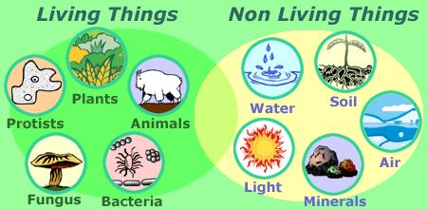
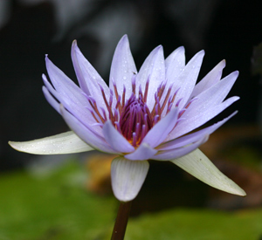
1.2 Living organisms share many characteristics, such as having enzymes. These characteristics can be described in many ways, but one method is to list all the processes that living organisms perform.
Synthesis – organisms build body structures like hair and nails
Transport –organisms move things within their body, like using blood
Excretion – organisms get rid of solid, liquid and gas waste
Regulation – organisms control their body temperature

Slide 23
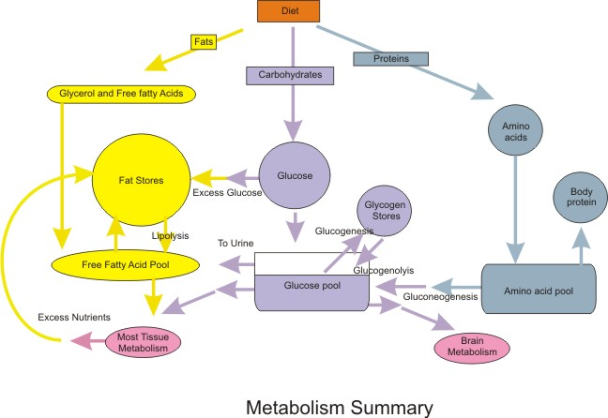
Nutrition – organisms either make or consume food
Growth and development – multicellular organisms get bigger in a variety of ways
Respiration – organisms all need to break down carbs to get energy in the form of ATP, often using oxygen
Reproduction – organisms make offspring, either asexually or sexually
Summary:
Together these STERNGRR reactions and processes make up every organism’s metabolism. An organism will complete all 8 processes. Organisms also regulate their internal conditions in a process known as homeostasis.

Slide 24
Living organisms share many characteristics, but they come in many different forms. Organisms can be grouped or classified into 6 main kingdoms based on their similarities and differences.
Eubacteria – a kingdom of simple unicellular organisms known as prokaryotes. These are the main bacteria you hear of like Staph, Strep and Salmonella.
Archaebacteria– a kingdom of simple prokaryotic unicellular organisms that live in extreme environments. They are even found living in the Dead Sea!
Protists – a kingdom of complex cells with a nucleus, but some are unicellular, some are multi. These include algae and brain-eating amoebas!

Slide 25
Plantae – a kingdom of complex multicellular organisms who make their own food. They are divided into 4 main groups within this kingdom.
Fungi – a kingdom of complex organisms that consume their food extracellularly. These include mushrooms, molds and yeasts.
Animalia – a kingdom of complex organisms that move and consume food.
Some don’t fit…. Viruses!!! These organisms don’t have cells and don’t perform any of the life functions on their own. In order to survive, they must invade YOUR cells to reproduce!

Slide 26
WHEN YOU ARE DONE
Finish Unit 1, Module 1 Problem Set
ALL PROBLEMS
And if you finish that?
See Ms. S
S
T
E
R
N
G
R
R

Slide 27
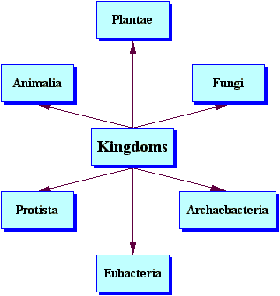
Summary:

Slide 28
Exit Ticket
In your own words, define synthesis
What is homeostasis?
Why do organisms need energy?
What is the difference between adaptation and response?
Define biology

Slide 29
So we might have a fire drill… listen to Ms. S for instruction.

Slide 30
Warm Up
Name one of the 6 Kingdoms of Life
How are the experimental group and the control group different?
What is an example of a material that a plant would transport?
STERNGRR is used to explain
Processes of living organisms
Whether or not something is living
How to maintain homeostasis
How long a plant will live
5. How ready do you feel for this quiz?

Slide 31
Let’s Review!
QUESTIONS?!

Slide 32
When you are done…
-Fill out the vocab 1 sheet and rank the words from 1-5 (read directions)
-Relax, decompress
-Do other work you might have
As long as you hide your cell phones from an administrator that walks in, I don’t see them =)
(and don’t tell your other teachers I let you use them…)

Slide 33
If you have finished the vocab sheet, go get a purple Biology book from the cabinet on the right side of the room (opposite the door) and look up terms!

Slide 34
Exit Tickets
What is one of the 3 components to critical thinking?
What are the steps to the scientific method?
What is the difference between a dependent and independent variable?
Write a hypothesis for this question: What will happen if you run a mile after eating 20 donuts?
When does a scientist use the scientific method?

Slide 35
Alex is studying the effect of sunlight on plant growth. His hypothesis is that plants that are exposed to sunlight will grow better than plants that are not exposed to sunlight. In order to test his hypothesis, he follows the following procedures. He obtains two of the same type of plant, puts them in identical pots with potting soil from the same bag. Then he puts one plant in the sunlight and the other in a dark room. He waters the plants with 200 mL of water every other day for two weeks.
Identify the
Independent Variable
Dependent variable
Control Group
Experimental Group
Constants

Slide 36
What does CARSMOG stand for?
What is the basic unit of life?
In the experiment, “The effect of nicotine on the heart rate of a cat?”
The independent variable is
The dependent variable is
The control group is

Slide 37
Define synthesis in your own words
What is homeostasis?
Why do organisms need energy?
What is the difference between adaptation and response?
What does biology mean?

Slide 38
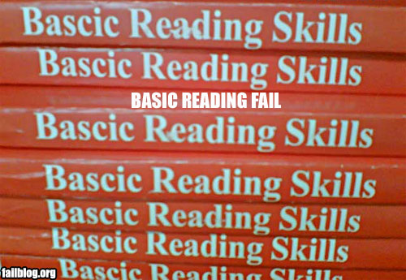
Unit 2 Vocabulary!
Use your book!

Slide 39
Exit Ticket
None =)

