Slide 1
Warm Up
Make sure you have each one of the sheets from the table as you walk in
Pick any seat
Begin your Warm Up “Get to know you” sheet
If you finish early, begin reading through the syllabus

Slide 2
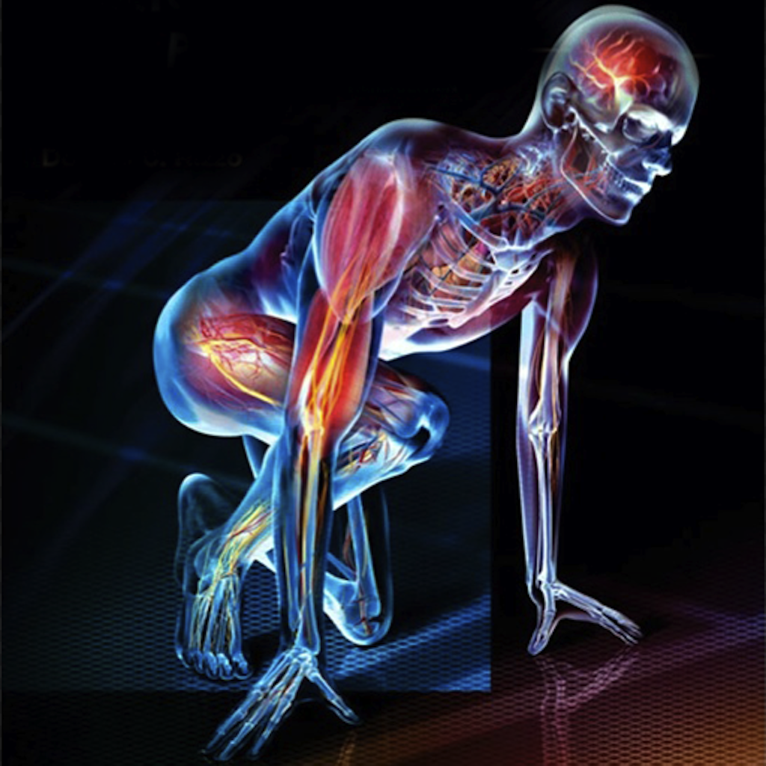
Welcome to Honors Human Anatomy & Physiology
Ms. Shust
Room 605

Slide 3
Agenda
Welcome Back/Introductions
Review Syllabus
Go over rules & expectations
Lab Safety
Intro to Ana/Phys

Slide 4
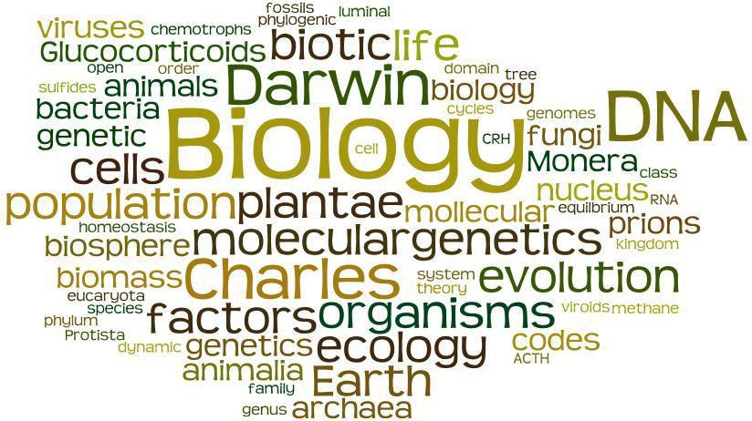
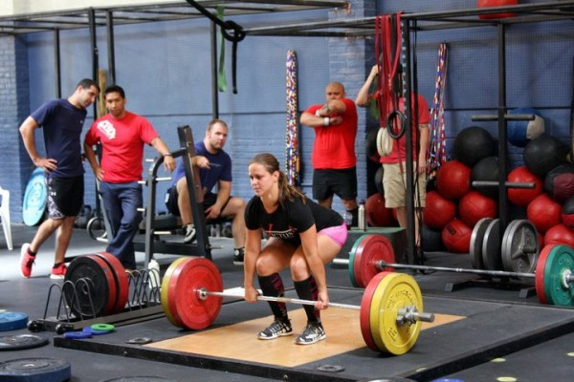
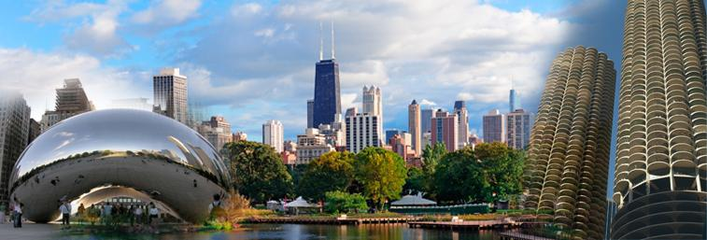
A Bit About Me
Ms. Shust (Ms. S)
From Chicago, Illinois
Graduated from Elon with a Bachelor of Science in Biology
Likes: Working out, Music, Cooking, Eating, SCIENCE

Slide 5
And who are you?
Briefly Share:
Your Name
One thing you did this summer
A Pandora station you’d want to listen to

Slide 6
Syllabus & Other Forms
READ THE SYLLABUS AND LAB AGREEMENT & HAVE A PARENT SIGN THEM
Due by Wednesday
Failure to turn this in means you cannot participate in lab on Thursday

Slide 7
Expectations
Show respect
Be prepared
Follow rules and procedures
Participate your best effort every day
What do you expect from Ms. S?

Slide 8
Lab Safety

Slide 9
Let’s Review...
What do you have to get signed?
When is it due?
What happens if you do not turn these into Ms. S?
Do we have a class website?
How do you access it?
Where do you turn in homework?
When is it due?

Slide 10
What is Health?
Wikipedia: Health is the level of functional or metabolic efficiency of a living organism
Merriam-Webster: the condition of being well or free from disease; the overall condition of someone's body or mind; the condition or state of something
Google: the state of being free from illness or injury
Let’s create a list...

Slide 11
Introduction to Anatomy & Physiology
Anatomy
Definition: the study of body structure
Types:
Gross Anatomy- general body structures that can be seen with the naked eye
Microscopic anatomy- small and requires a microscope
Cytology- study of cells
Histology- study of tissues
Physiology
Definition: the study of functions of body parts
Relationship between anatomy and physiology:
The structures (anatomy) determine what functions (physiology) take
Turn and Talk: Create an example to describe this relationship

Slide 12
Looking Forward...

Slide 13
Exit Ticket
Complete this on the other side of your “Get to Know You” sheet
Name 3 of the 10 Rules of Lab Safety
What are the 4 expectation of this class?
Define anatomy or physiology in your own words
How is health related to anatomy & physiology?
If you have time: What is something you’d like to do in this class?

