Slide 1
Chapter 5

Slide 2
HAP in the News
Title: Arm mole count 'predicts skin cancer risk'
Concepts: Skin, cancer, moles, melanoma, freckles, precaution
Prereading questions:
What are some causes of skin cancer?
How do we detect the presence of skin cancer?
How can you tell if a mole is cancerous?
http://www.bbc.com/news/health-34551467

Slide 3
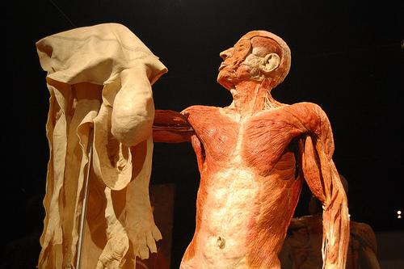
Skin and its derivatives (sweat & oil glands, hairs, nails)

Slide 4
Protection from:
Mechanical damage (bumps & cuts)
Chemical damage (acids & bases)
Thermal damage (heat/cold)
Bacteria
UV radiation
Desiccation (drying out)
Temperature regulation (sweat glands)
Excrete urea
Synthesize Vitamin D
Immunity
Sensory reception (touch, heat, pain, pressure)

Slide 5
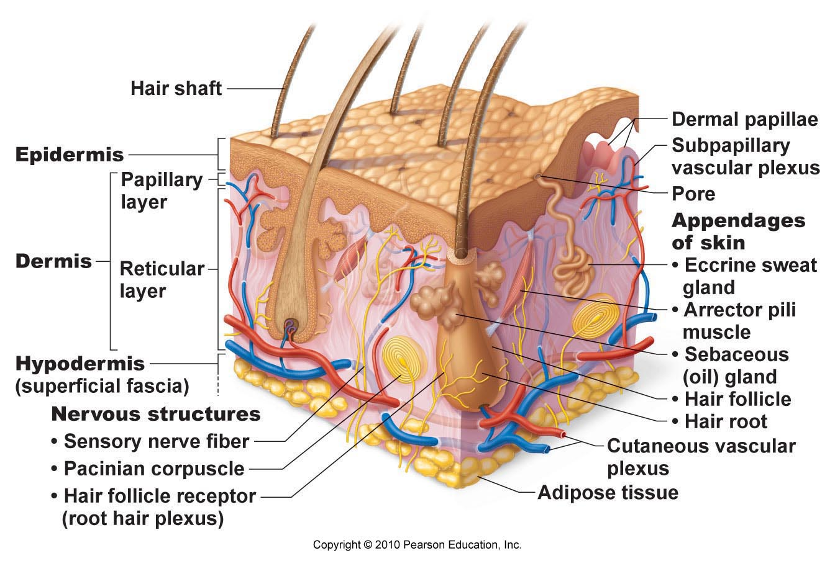

Slide 6
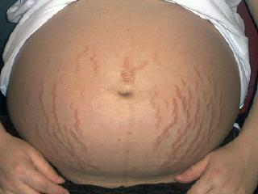
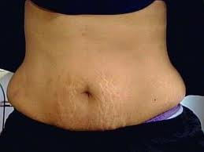
Collagen: give skin strength; binds water (hydrate skin)
Elastic fibers: stretch-recoil properties of skin
Aging: fewer fibers, less subcutaneous fat → skin loses elasticity and sags/wrinkles
Extreme stretching of skin (pregnancy): dermal tearing leaves white scars = “stretch marks”

Slide 7
Two regions:
Epidermis – keratinized stratified squamous epithelium
Dermis – fibrous connective tissue
Hypodermis (subcutaneous fascia)
Adipose tissue underneath skin
Anchor skin to muscle below
Shock absorber
Store fat
Insulation

Slide 8
Cells of the epidermis:
Keratinocytes
Produce keratin = fibrous protein
Growth starts in deepest epidermal layer (stratum basale) → pushed upward by new cells underneath
Top layer = dead, scalelike structures
Melanocytes
Produce melanin = pigment (yellow/brown/black)
Melanin granules taken up by nearby keratinocytes
Shields DNA from UV radiation

Slide 9
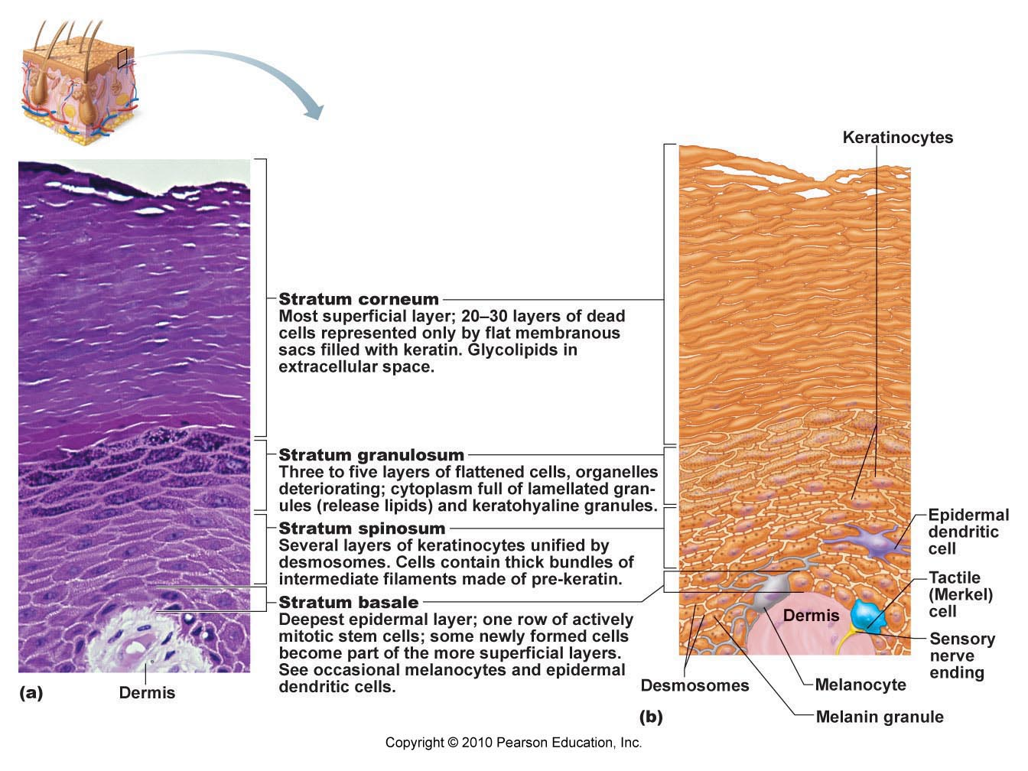

Slide 10
“Overcoat” for body
Protect against abrasion, penetration, & water loss (keratin & glycolipids)
20-30 cells thick
Shingle-like dead cells
Clear, flat, dead cells
Thick layer on palms of hands, soles of feet
Cells become flatter, full of keratin
Water-resistant glycolipid fills spaces
Thick bundles of pre-keratin
Abundant melanin granules
Single row of stem cells
Receive nutrients from dermis
Rapid cell division
Stratum Corneum
(horny layer)
Stratum Lucidum
(clear layer)
Stratum Granulosum
(granular layer)
Stratum Spinosum
(prickly layer)
Stratum Basale
(basal layer)

Slide 12
Strong, flexible connective tissue
Semi-fluid matrix with fibers (collagen, elastic)
Leather “hide” of animals
Contains:
nerve fibers
blood vessels
lymph vessels
hair follicles
oil glands
sweat glands
Cells: fibroblasts, macrophages, mast cells, WBC’s

Slide 13
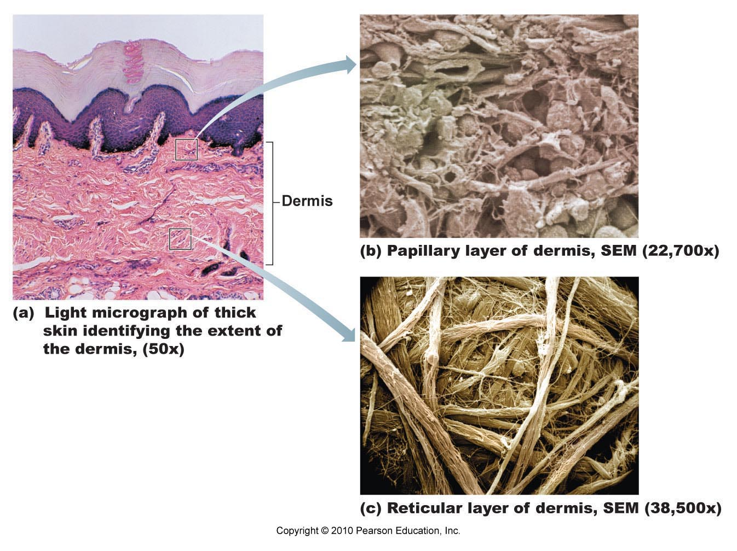

Slide 14
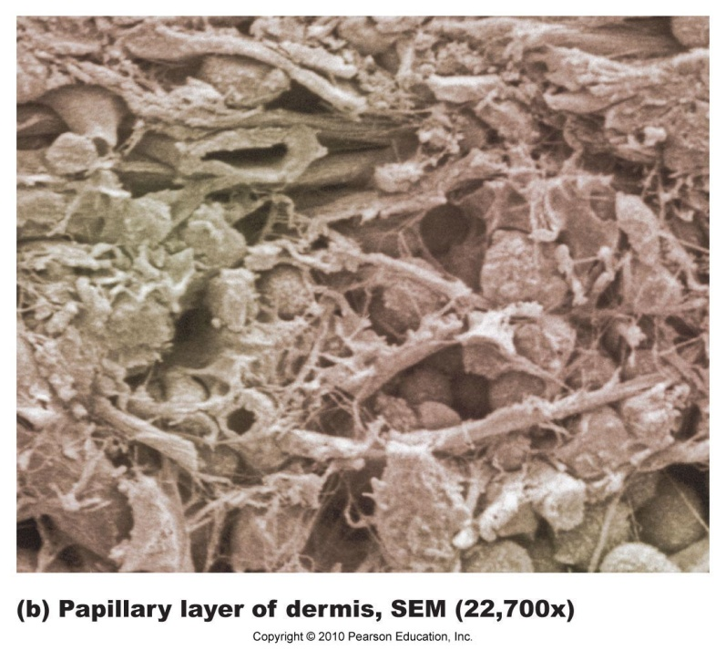
Papillary Layer:
Upper part of dermis
Dermal papillae = peg-like projections
Contain capillary loops
Free nerve endings
Touch receptors (Meissner’s corpuscles)
Forms ridges (large mounds) → increases friction to enhance gripping ability on fingers & feet
Friction ridge pattern = fingerprints

Slide 15
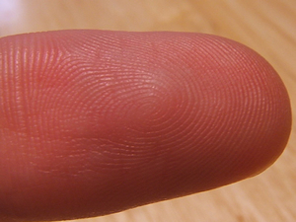
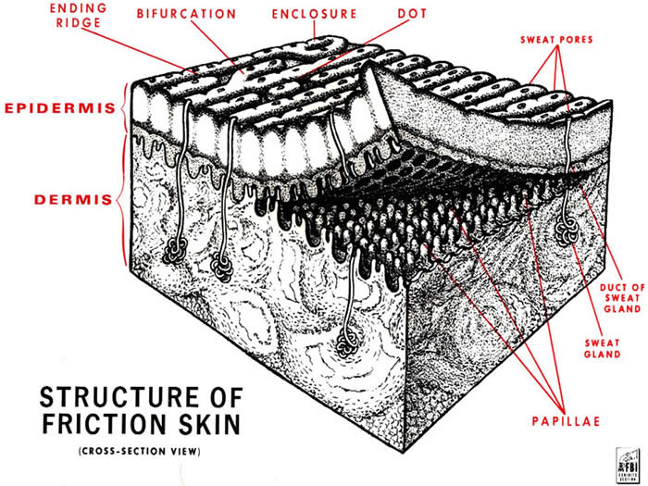

Slide 16
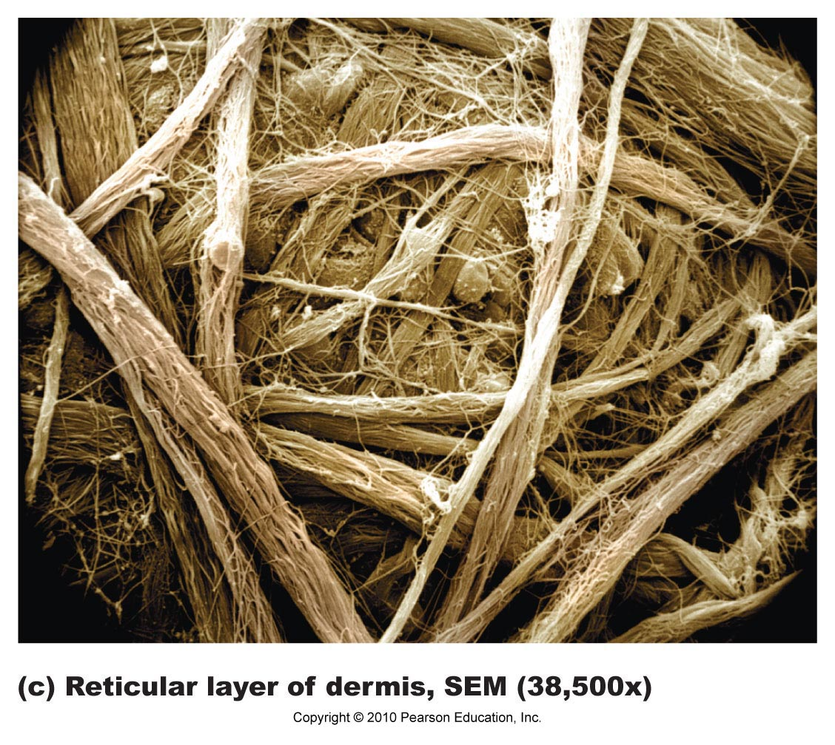
Reticular Layer:
Deepest skin layer
Dense, fibrous connective tissue
Contains blood vessels, sweat & oil glands, pressure receptors (Pacinian corpuscles), WBC’s
Collagen fibers in bundles form cleavage (tension) lines
Incisions made parallel to line heal more readily

Slide 17
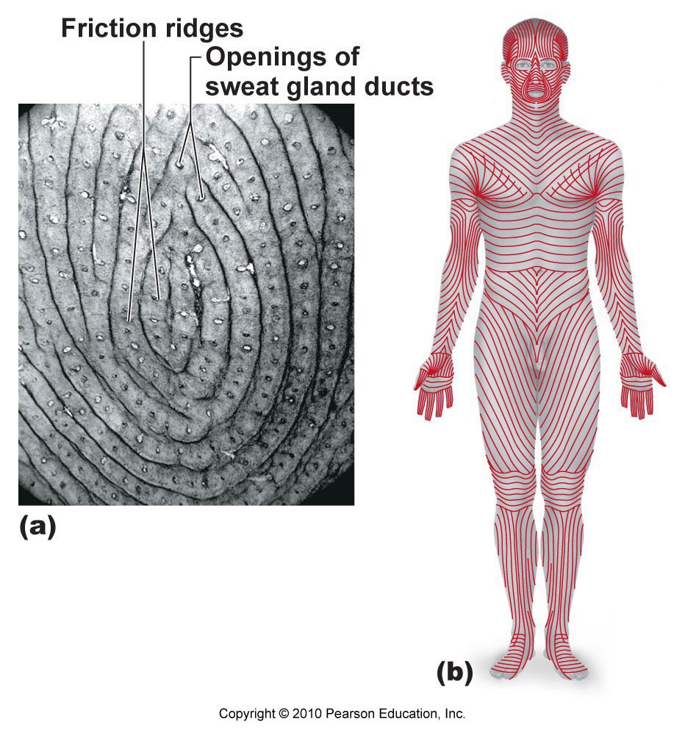

Slide 18
Blister: separation of epidermal and dermal layers
Blood vessels in dermis: maintain body temp.
Cooling: Capillaries swell with heated blood → skin becomes red and warm → radiate heat
Conserve heat: blood bypasses capillaries to skin
Bedsores: if blood (O₂) is restricted to cells → skin cells die & cause ulcers
Bedridden patients need to be turned regularly
Tattoos: deposit pigment within dermis

Slide 19
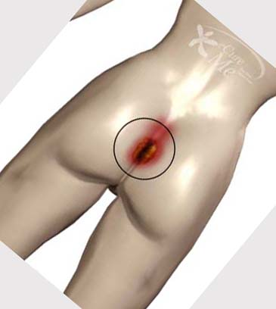
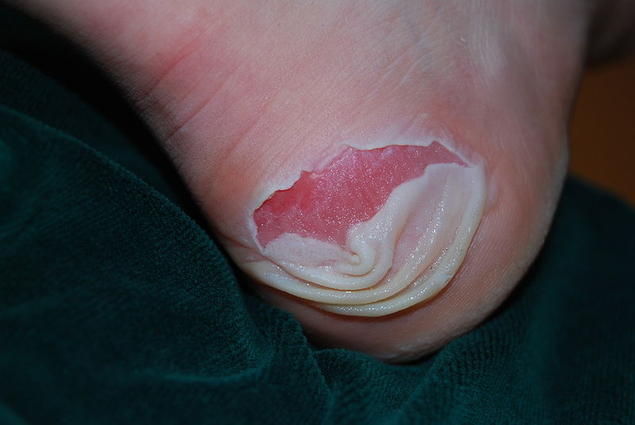
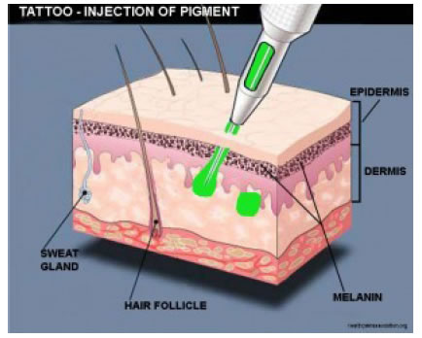
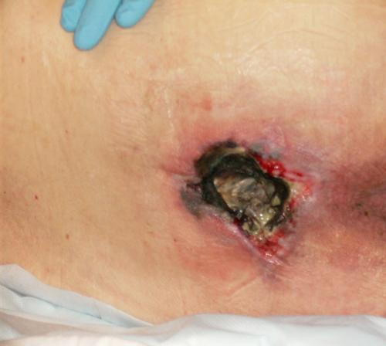

Slide 21
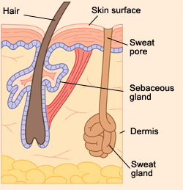
Two types:
Eccrine sweat glands: releases sweat (99% water, salts, vitamin C, antibodies, wastes)
Abundant on palms, soles of feet, forehead
Evaporative cooling
Apocrine sweat glands:
Sweat + fatty substances & proteins → milky/yellowish
With bacteria = body odor
Activated at puberty → sexual scent gland?

Slide 22
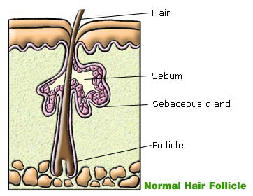
Secrete oil (sebum) into the hair follicle
Waterproofing skin
Soften & lubricate hair, skin
Kills bacteria

Slide 23
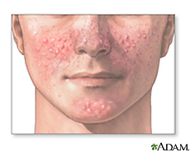
Acne = active inflammation of sebaceous glands caused by bacterial infection (staph)
Treatment:
Reduce oil production
Speed up skin cell turnover (prevent plugged follicles)
Fight bacterial infection
Reduce inflammation

Slide 24
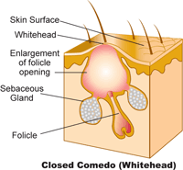
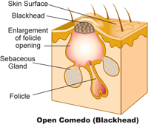
Whitehead = blocked sebaceous gland
Blackhead = sebum oxidizes and dries

Slide 25
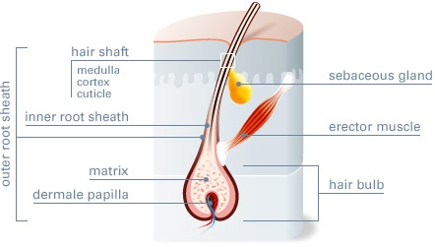
2 main regions: hair root & hair shaft
Project from follicles in dermis
Consists of dead, keratinized cells
Arrector pili (smooth muscles) attached to hair root → pulls hair upright

Slide 26
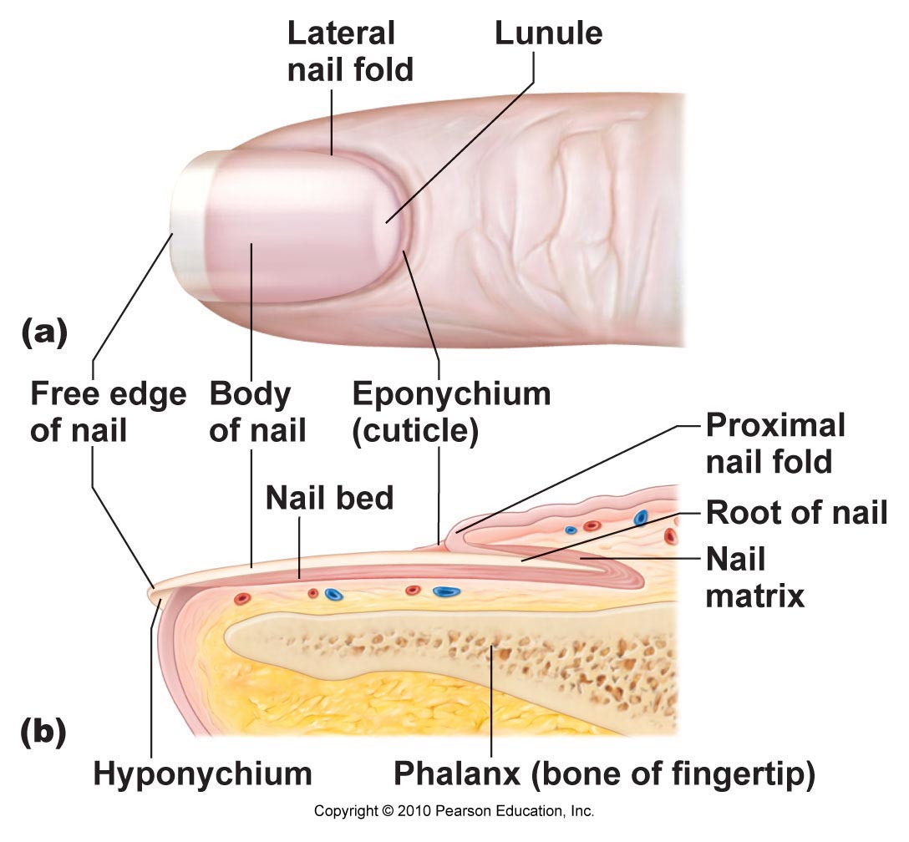
Grows from nail matrix
Visible part of nail is nail body
Cuticle covers nail root
Contains hard keratin

Slide 27
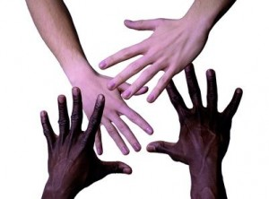
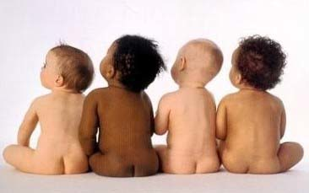

Slide 28
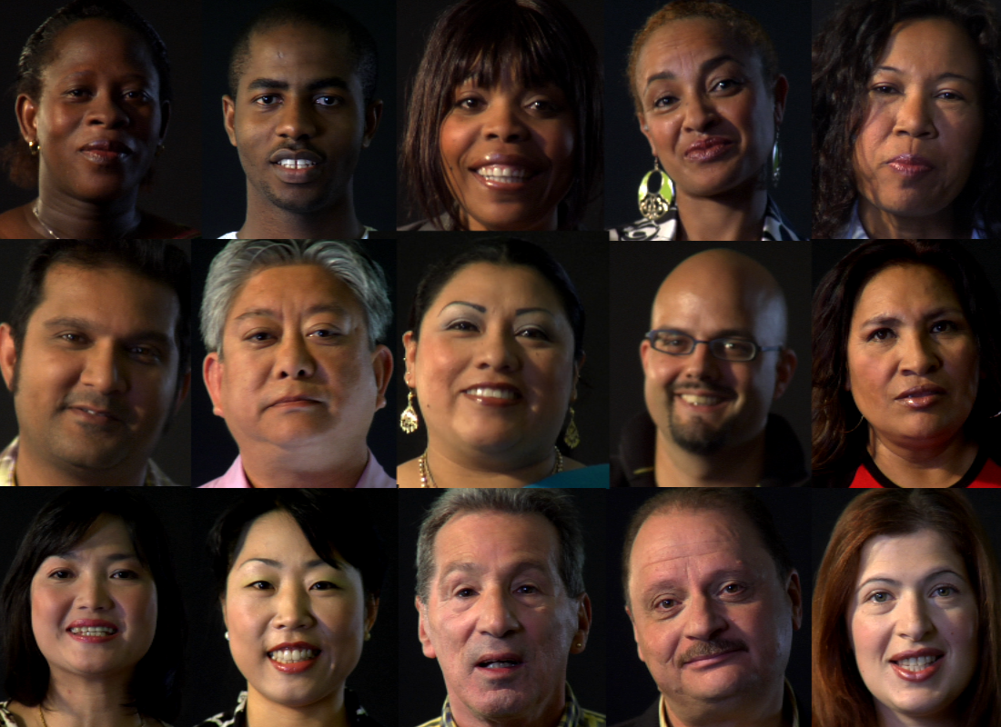

Slide 29
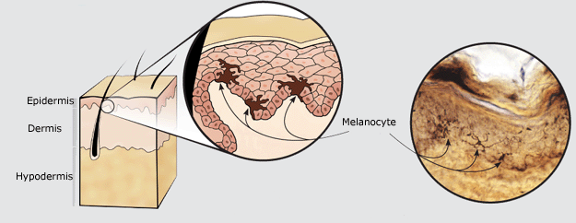
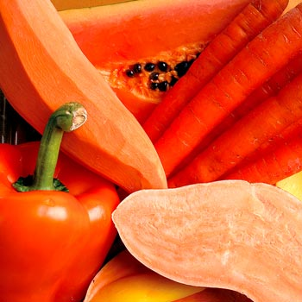
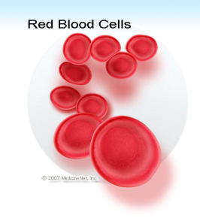
Melanin
Two forms: brown-black & pink-red
Made by melanocytes
Only found in deeper layers of epidermis
Freckles & moles = local accumulations of melanin
Protect DNA from UV radiation
Carotene
Yellow-orange (from carrots)
Accumulate in stratum corneum, hypodermis
Carotene converts to Vitamin A in body
Asians: yellowish skin = melanin + carotene
Hemoglobin
Pinkish hue
Red blood cells in capillaries

Slide 30
Cyanosis: poorly oxygenated blood, blue color
Excessive sun exposure: leathery skin, rashes, skin cancer
Redness: blushing, fever, allergy, inflammation, hypertension (high BP)
Pale skin (pallor): anemia, low blood pressure, fear, anger
Jaundice (yellow cast): liver disorder (bile pigments = bilirubin)
Bronzing: Addison’s disease, pituitary gland tumors
Bruises: blood clots under skin

Slide 32
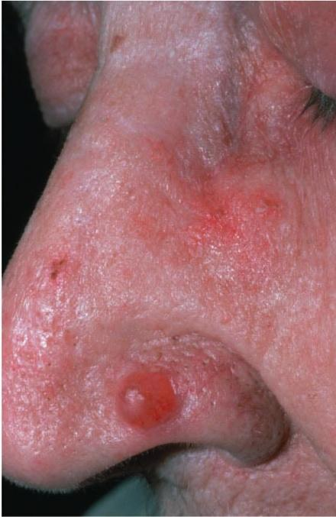
Affects 1 in 5 Americans
Caused by UV damage to DNA
Types:
Basal cell carcinoma
Least malignant, most common (80% skin cancers)
Stratum basale
Sun-exposed areas of face
Shiny, dome-shaped nodules
Slow-growing; rarely metastasizes (spreads)
Removal by surgery (99% cases)

Slide 33
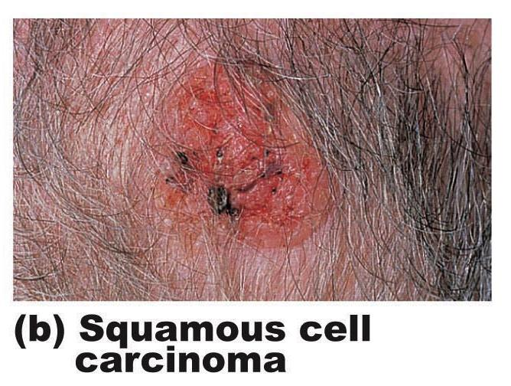
Squamous cell carcinoma
2nd most common
Keratinocytes of stratum spinosum
Scaly, reddened bump
Grows rapidly and can metastasize if not removed
Removal by surgery or radiation therapy

Slide 34
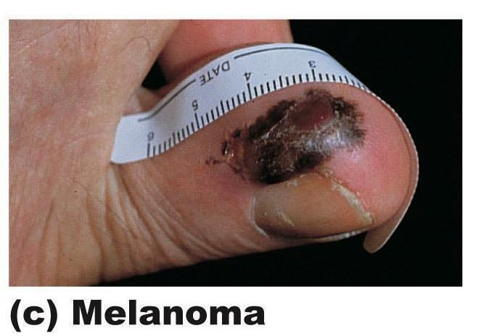
Melanoma
Most dangerous
Highly metastatic, resistant to chemotherapy
1/3 from moles (spreading brown→black patch)
Key = Early detection!!!
Surgery + immunotherapy

Slide 35
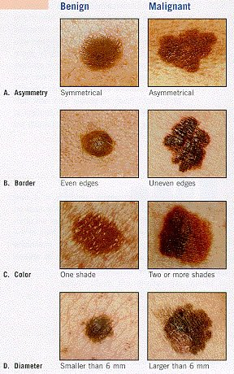
A = Asymmetry: 2 sides of pigmented spot do not match
B = Border irregularity: blurry or jagged edges
C = Color: several colors (brown, black, tan, blue, red)
D = Diameter: >6mm in diameter (pencil eraser)
E = Elevation: raised above surface or uneven surface

Slide 36
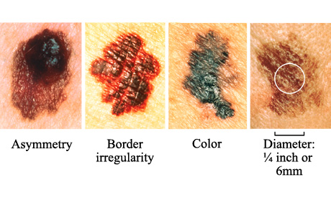

Slide 37
Tissue damage caused by heat, electricity, radiation, chemicals
Main threat: loss of fluids (dehydration, electrolyte imbalance)
Kidney failure, circulatory shock
Treatment: replace fluids via IV
Rule of Nines: estimating extent of burns
Divide body into 11 areas
Each part is 9% of total body area + 1% genital region

Slide 38
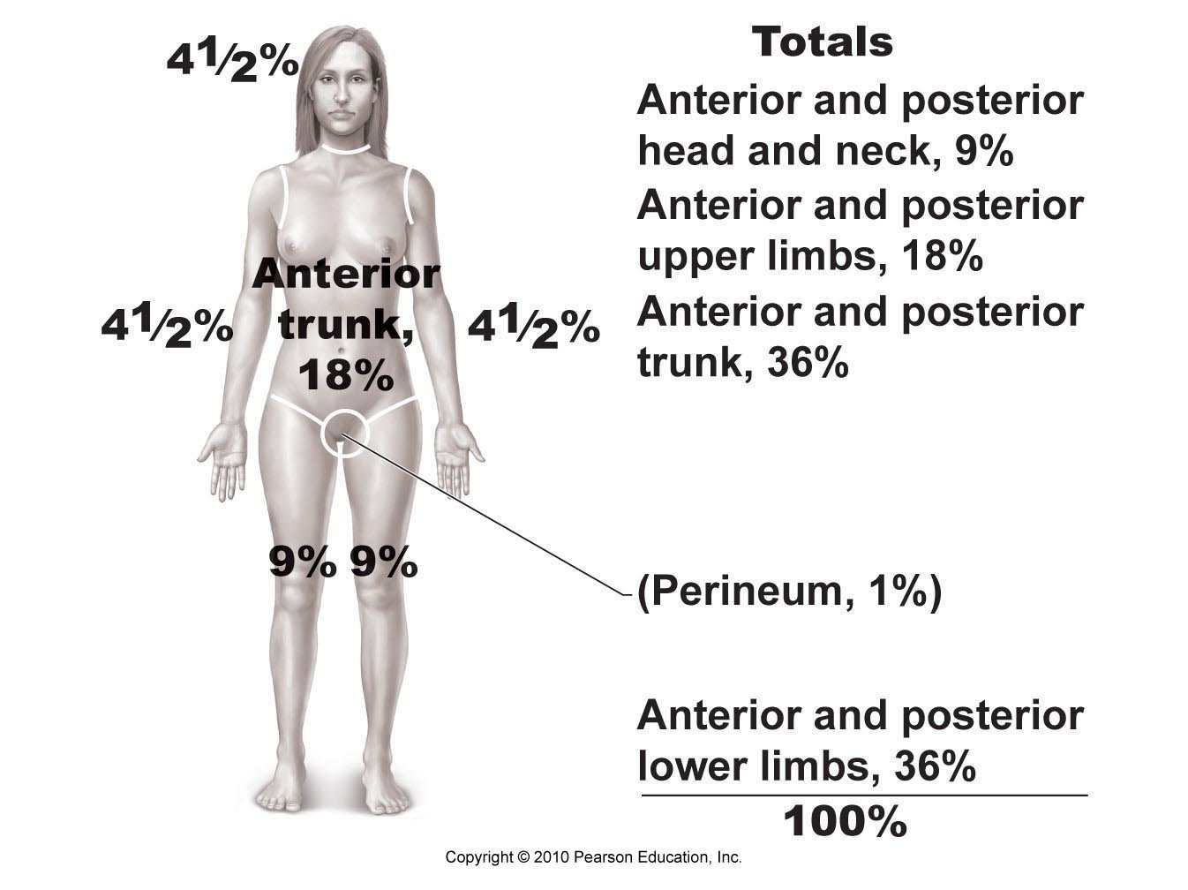

Slide 39
>25% of body with 2nd degree burns
>10% of body with 3rd degree burns
3rd degree burns on face, hands, feet
Face: swelling of respiratory passages → suffocation
Joints: scar tissue formation limits mobility

Slide 40
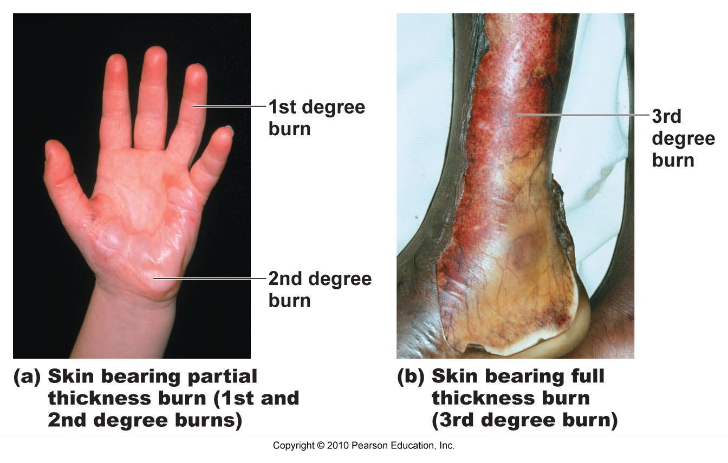
1st-degree burns: only epidermis damaged → swelling, redness, pain (sunburn)
2nd-degree burns: injure epidermis & upper dermis → redness and pain; blisters
3rd-degree burns: entire thickness of skin, destroy nerve endings (no pain) → need skin graft

Slide 41
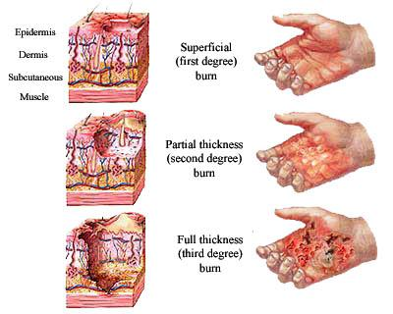

Slide 42
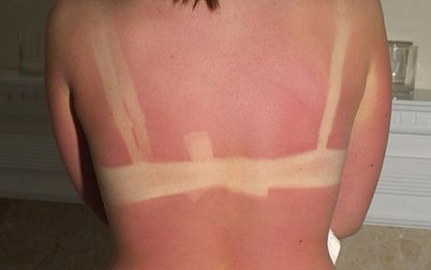
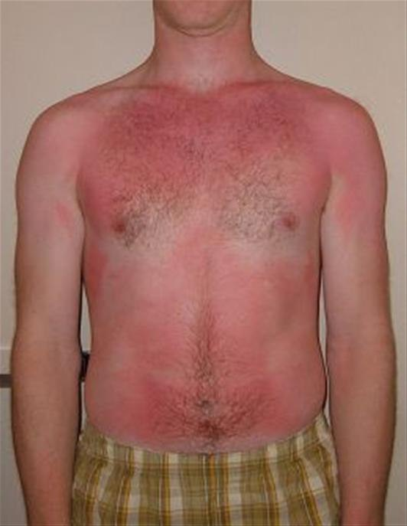
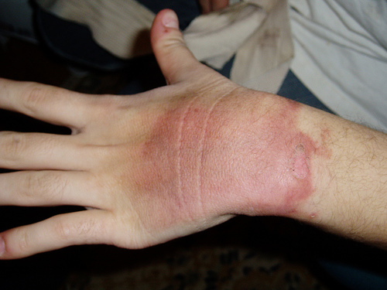

Slide 43
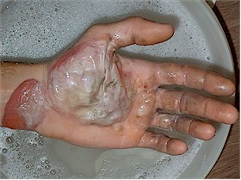
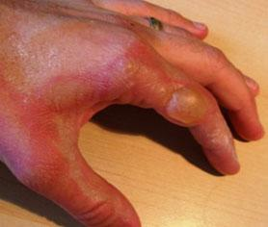
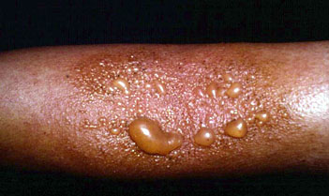

Slide 44
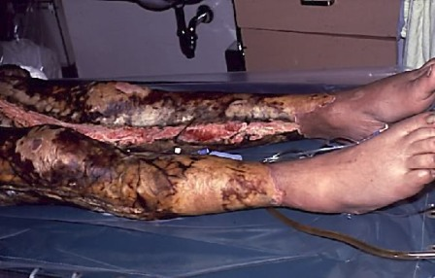

Slide 45
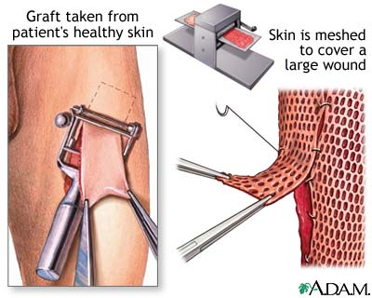
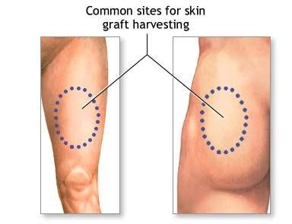
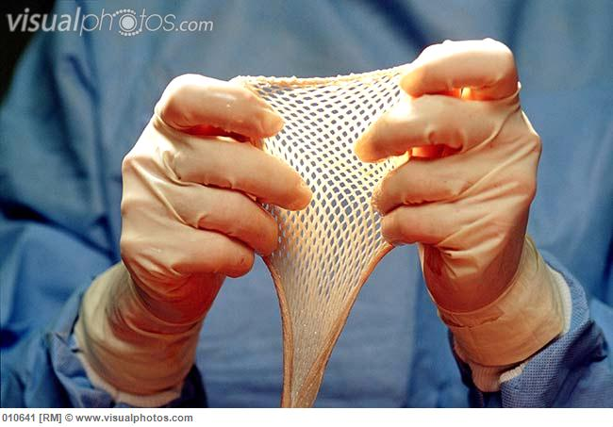
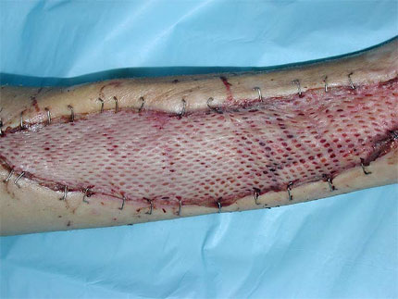

Slide 46
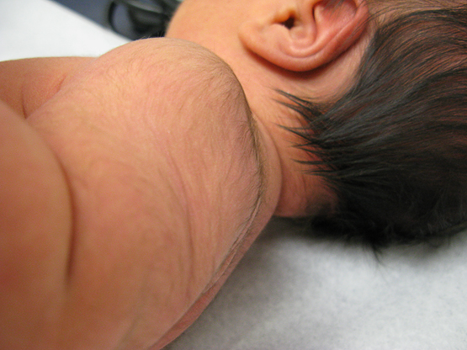
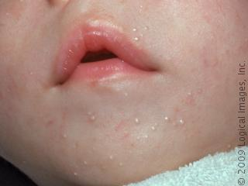
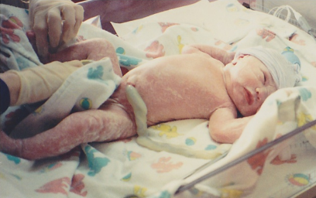
Fetus: downy coat of colorless hairs (lanugo)
At birth:
covered with white, cheesy substance (vernix caseosa) to protect skin in watery environment
Milia: white spots, accumulations in sebaceous glands (baby acne)

Slide 47
Childhood: skin thickens; deposit subcutaneous fat
Adolescence: sebaceous glands activated (oilier hair and skin), acne appears

Slide 48
Adults:
Environmental assaults (sun, wind, chemicals)
Old age: thin skin, less oil (dry skin), less fat, less elasticity, less hair (greying and balding)

