Slide 1
Warm-Up
Based on what you know about Latin root words, what do you think these terms refer to?
Sarcomere
Sarcoplasm
Myofibril
Epimysium
Perimysium
Endomysium
What structure connects muscle to bone?

Slide 2
Warm-Up
What is the organization of a skeletal muscle from the largest to the smallest structures?
Draw and label the parts of a sarcomere. Be sure to include the thick & thin filaments, I band, A band, and Z lines.

Slide 3
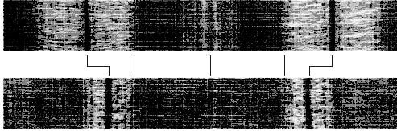
Warm-Up
Describe what happens at the neuromuscular junction.
How would a drug that blocks acetylcholine (ACh) release affect muscle contraction?
Which of the following pictures below shows a contracted muscle? Explain your answer.

Slide 4
Warm-Up
Put the following events in muscle contraction in order:
Calcium binds to troponin → changes shape → myosin binding sites exposed on actin
Myosin head pivots and pulls actin filament toward M line
ATP attaches to myosin and cross-bridge detaches
Action potential travels down sarcolemma along T-Tubules
Myosin cross-bridge forms with actin
Calcium is released from sarcoplasmic reticulum (SR)

Slide 5
Warm-Up
Jay is competing in a chin-up competition. What types of muscle contractions are occurring in his biceps muscles:
immediately after he grabs the bar?
as his body begins to move upward toward the bar?
when his body begins to approach the mat?
When a suicide victim was found, the coroner was unable to remove the drug vial from his hand. Explain.

Slide 6
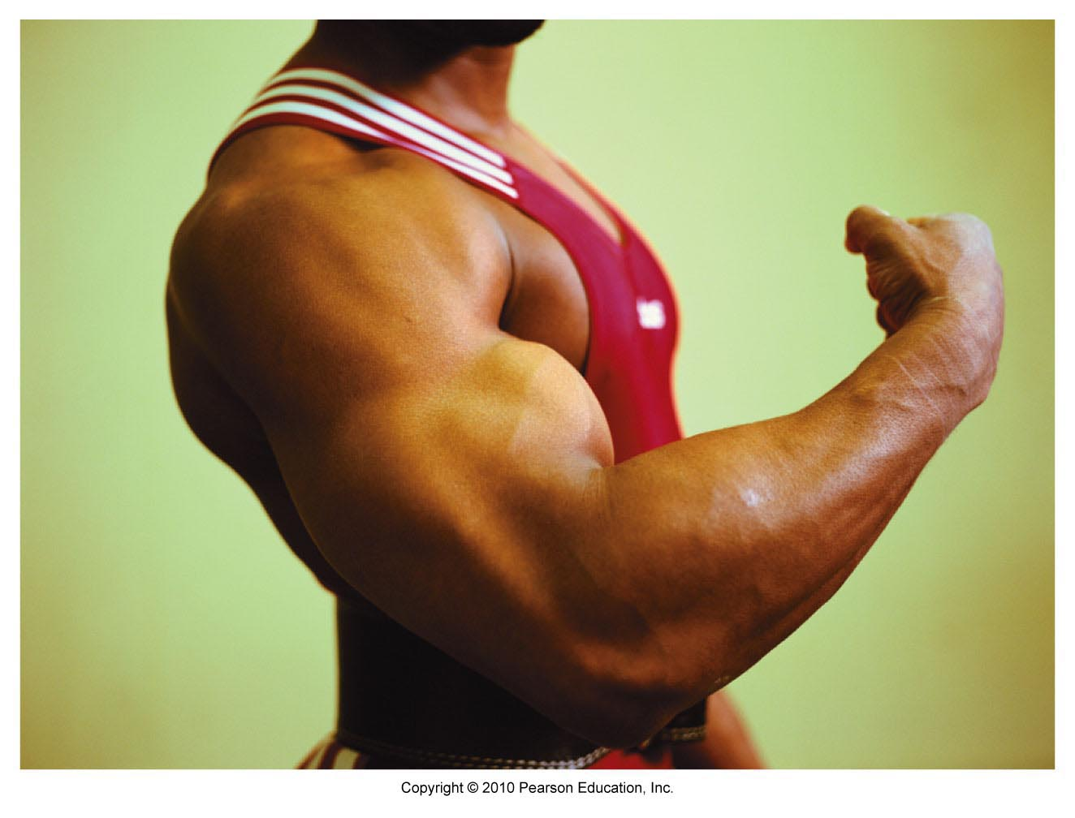
Muscles & Muscle Tissue
Chapter 9

Slide 7
Muscles
“muscle” = myo- or mys-
sarco- = “flesh” - also refers to muscles

Slide 8
Main Functions of Muscles
Produce movement
Maintain posture & body position
Stabilize joints
Generate heat
Additional: protect organs, valves, dilate pupils, raise hairs

Slide 9
Types of Muscle Tissue
Skeletal: voluntary, striated, multinucleated
Cardiac: (heart) striated, involuntary
Smooth: visceral (lines hollow organs), nonstriated, involuntary

Slide 10
Special Characteristics
Excitability – can receive and respond to stimuli
Contractility – can shorten forcibly
Extensibility – can be stretched or extended
Elasticity – can recoil and resume resting length after being stretched

Slide 11
Gross Anatomy of Skeletal Muscle
1 muscle = 1 organ
Each muscle served by a nerve, artery, & vein (1+)
Rich blood supply – need energy & O₂
Connective tissue sheaths: wraps each cell and reinforce whole muscle
Attachment: (1) directly to bone, (2) by tendons or aponeuroses to bone, cartilage, or other muscles

Slide 12
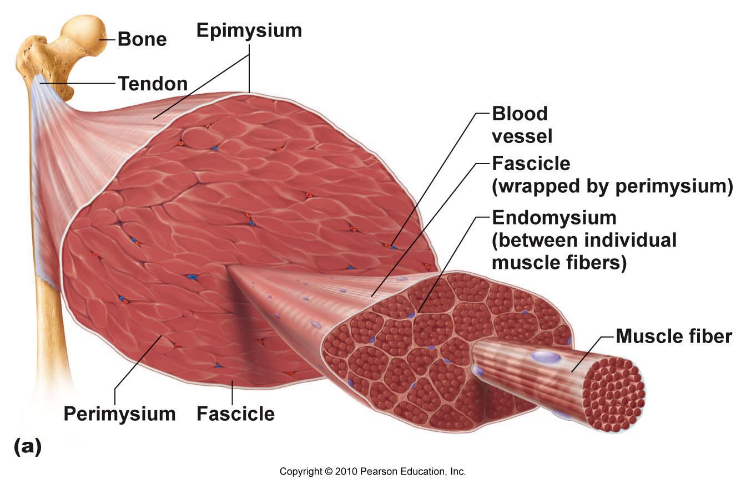

Slide 13
Organization of Skeletal Muscle

Slide 14
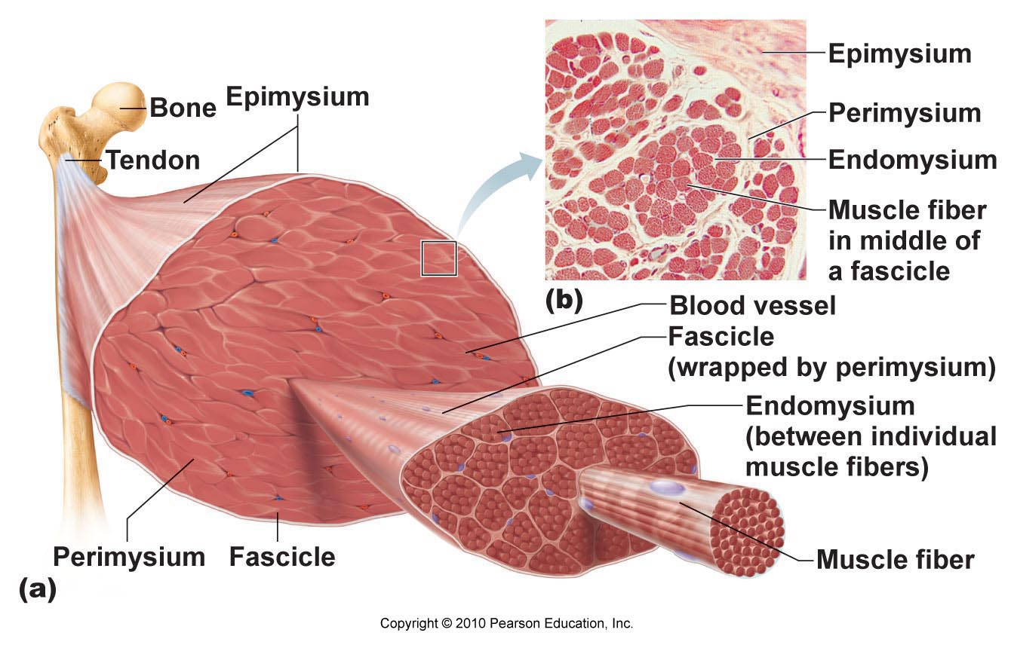

Slide 15
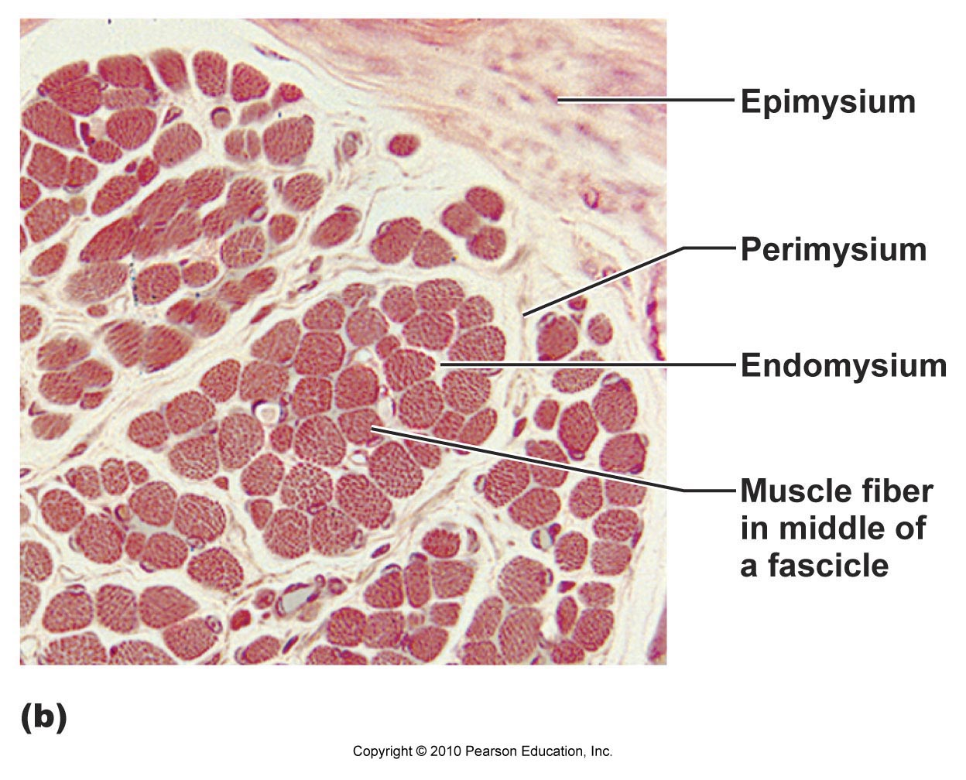

Slide 16
Gross Anatomy of Skeletal Muscle
Video Clip

Slide 17
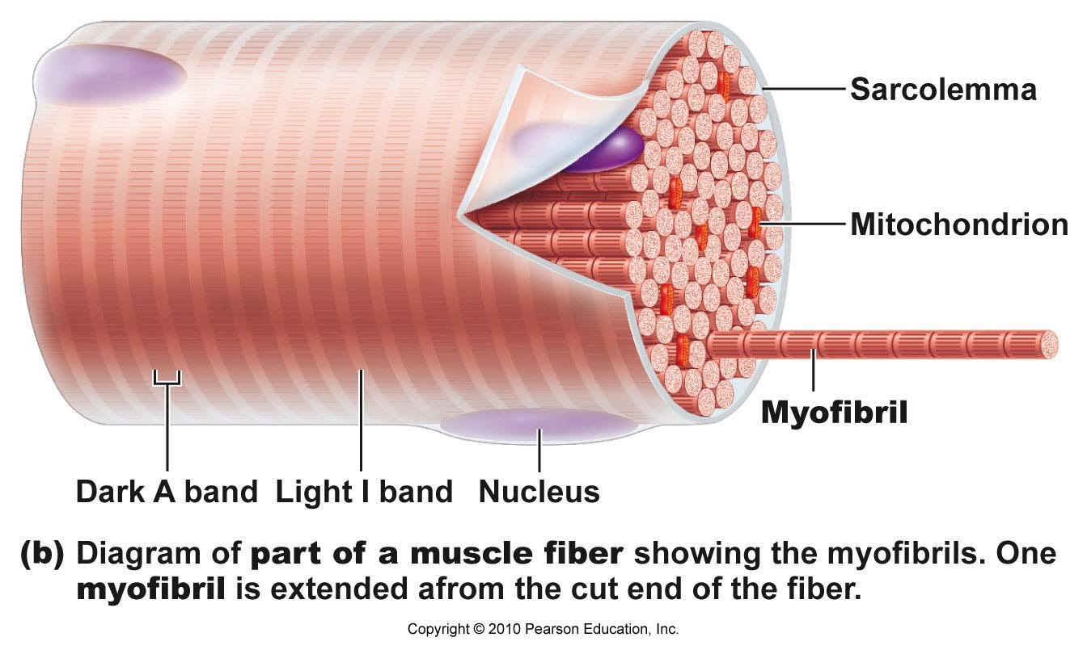
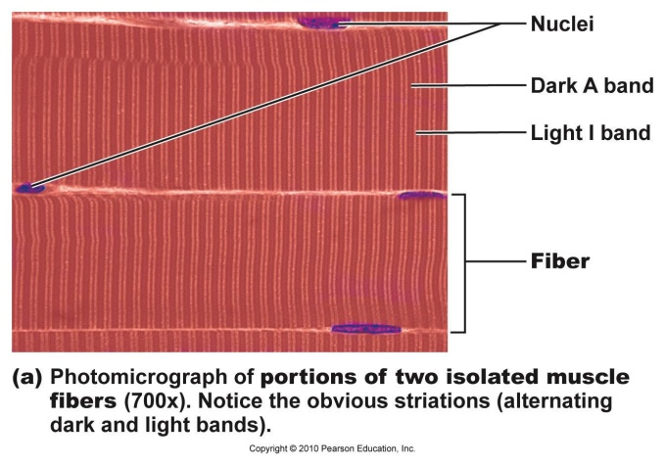
Anatomy of Muscle Fiber
Multinucleate cell
Up to 30 cm long
Sarcolemma (plasma membrane)
Sarcoplasm (cytoplasm)
Myofibril = rodlike organelle
Contains contractile element (sarcomeres)
Alternating light (I) and dark (A) bands

Slide 18
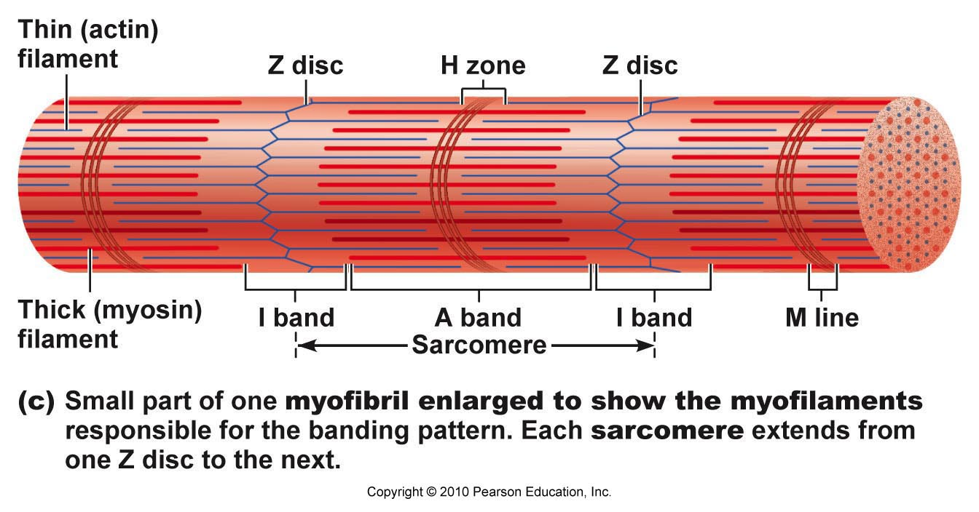
Sarcomere
Smallest contractile unit of muscle fiber
Region between 2 successive Z discs

Slide 19
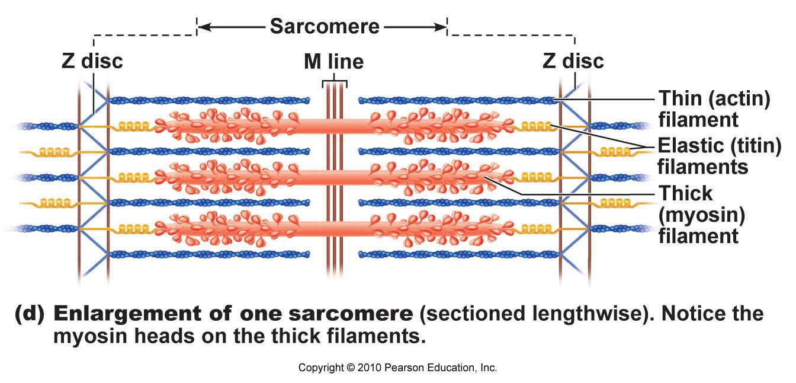
Sarcomere
Protein myofilaments:
Thick filaments = myosin protein
Thin filaments = actin protein

Slide 20
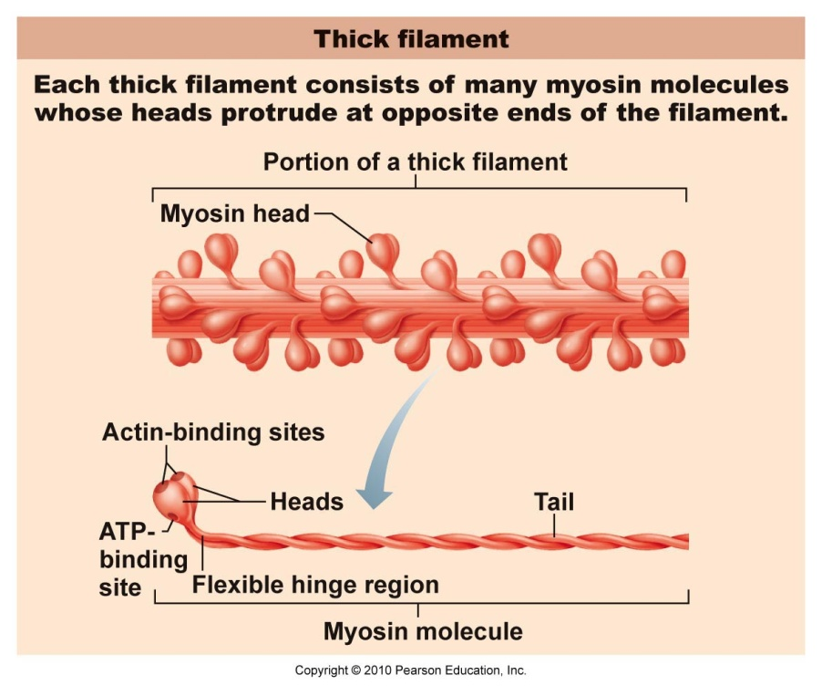
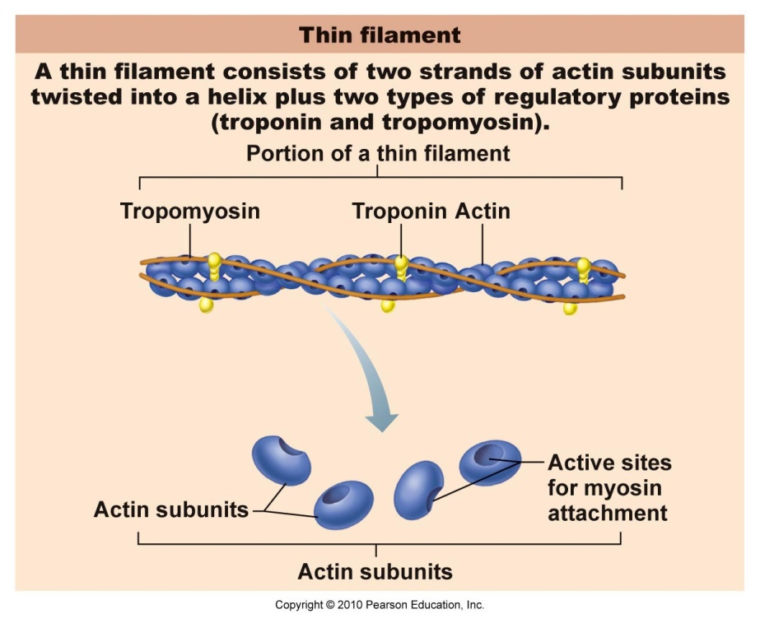
Myofilaments
Thick Filaments
Thin Filaments
Myosin head: forms cross bridges with thin filaments to contract muscle cell
Tropomyosin: protein strand stabilizes actin
Troponin: bound to actin, affected by Ca²⁺

Slide 21
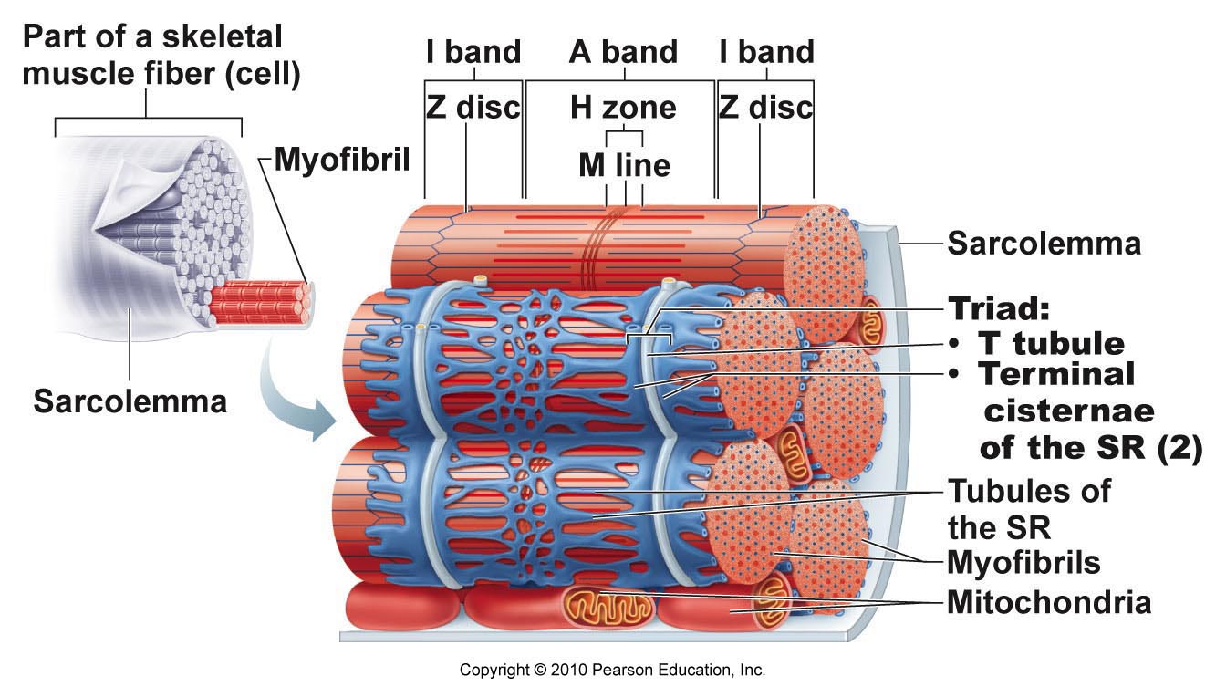
Sarcoplasmic Reticulum (SR): specialized smooth ER, surrounds each myofibril
Stores and releases calcium
T Tubule: part of sarcolemma, conducts nerve impulses to every sarcomere
Triggers release of calcium from SR

Slide 22
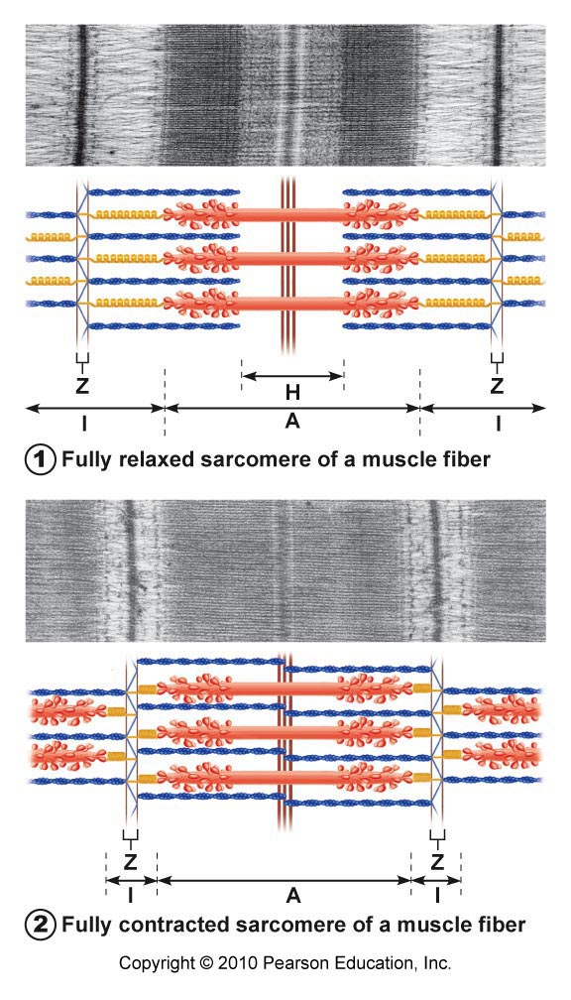
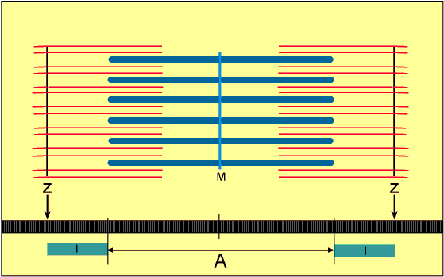
Sliding Filament Model
During contractions: thin filaments slide past thick ones so they overlap more

Slide 23
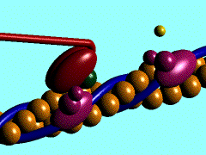
Sliding Filament Model
Myosin heads latch onto active sites on actin to form a cross-bridge
Attachments made/broken → tiny rachets to propel thin filaments to center of sarcomere

Slide 24
Skeletal Muscle Structure
Video Clip

Slide 25
Basic Muscle Contraction
Stimulation by nerve impulse
Generate and send electrical current (action potential) along sarcolemma
Rise in calcium ion levels to trigger contraction

Slide 26
Nerve Impulse
1 nerve cell (motor neuron) stimulates a few or hundreds of muscle cells
Motor unit = 1 neuron + muscle cells stimulated
Axon: extension of neuron
Axon terminal: end of axon
Neuromuscular junction (NMJ): where axon terminal meets muscle fiber
Synpatic cleft: space between neuron & muscle fiber
Acetylcholine (ACh): neurotransmitter

Slide 27
Excitation of Muscle Cell
Action potential travels down axon and arrives at neuromuscular junction
Release of acetylcholine (ACh) into synaptic cleft
ACh diffuses across cleft & attaches to ACh receptors on sarcolemma of muscle fiber
Rush of sodium (Na⁺) into sarcoplasm produces action potential in sarcolemma
ACh broken down

Slide 28
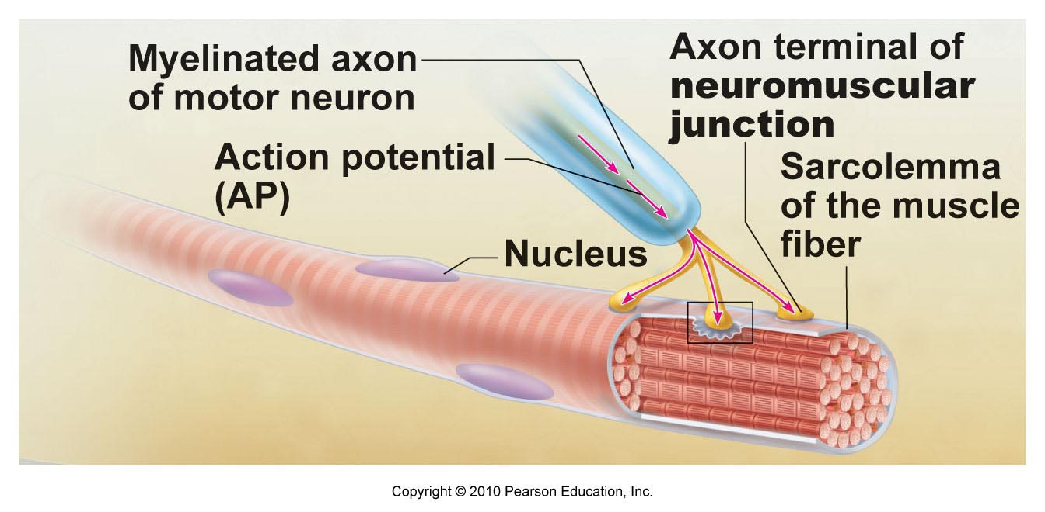

Slide 29
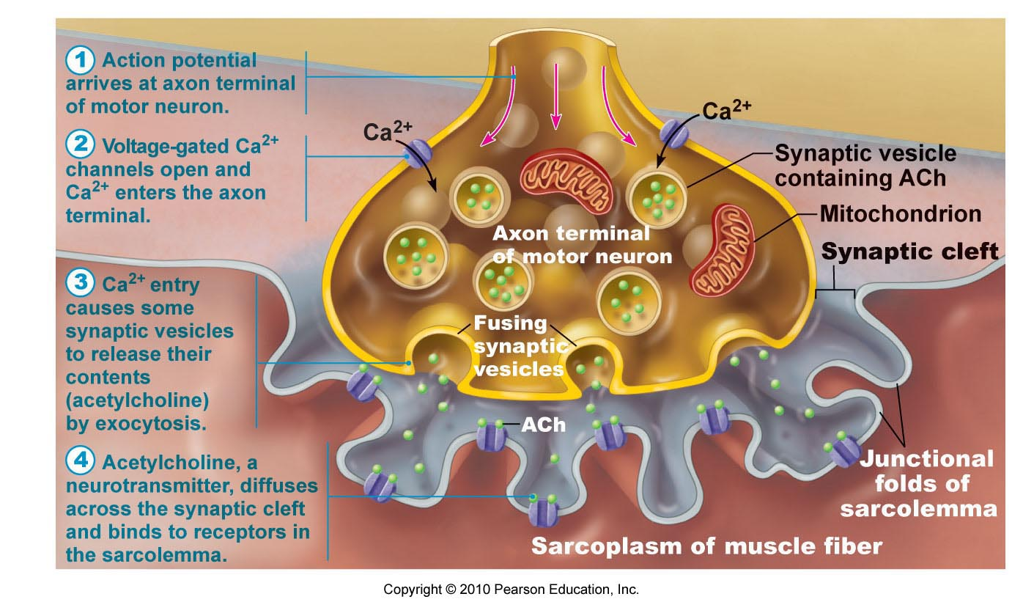

Slide 30
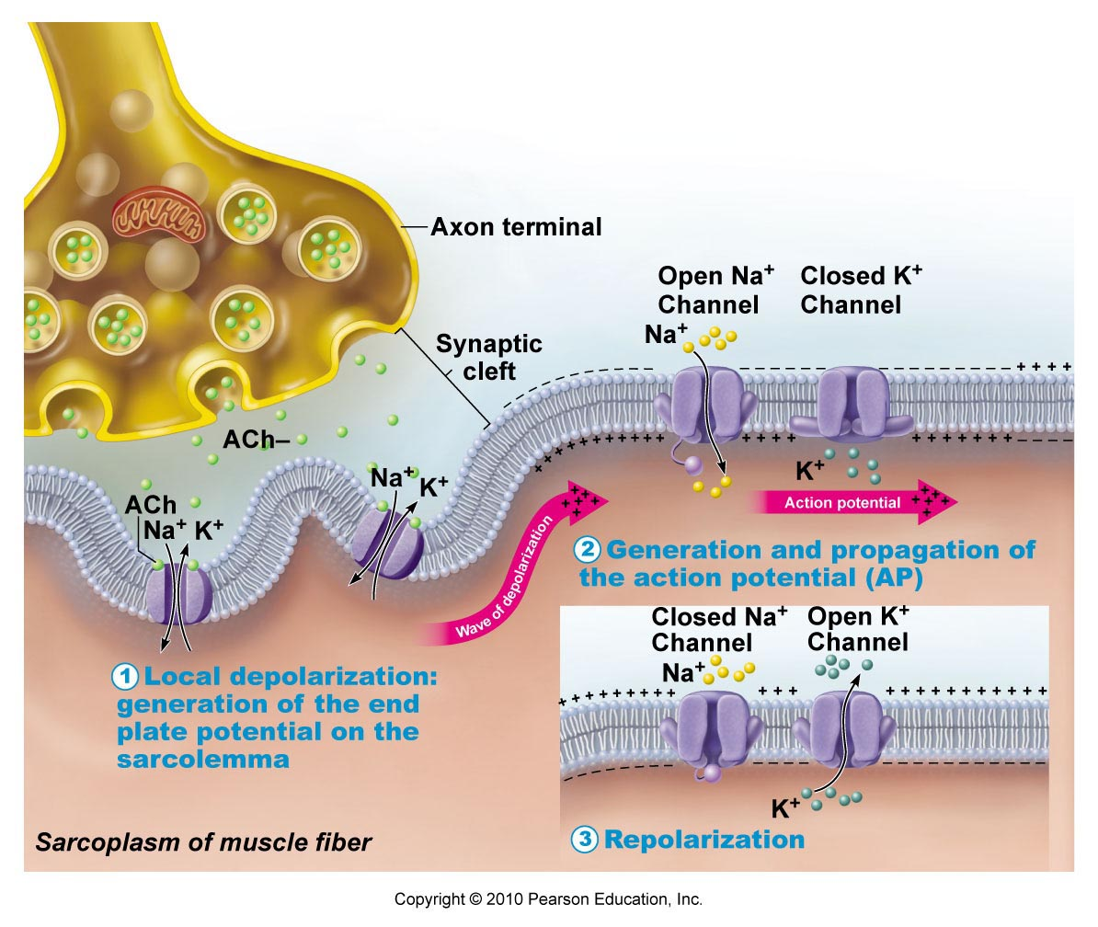

Slide 31
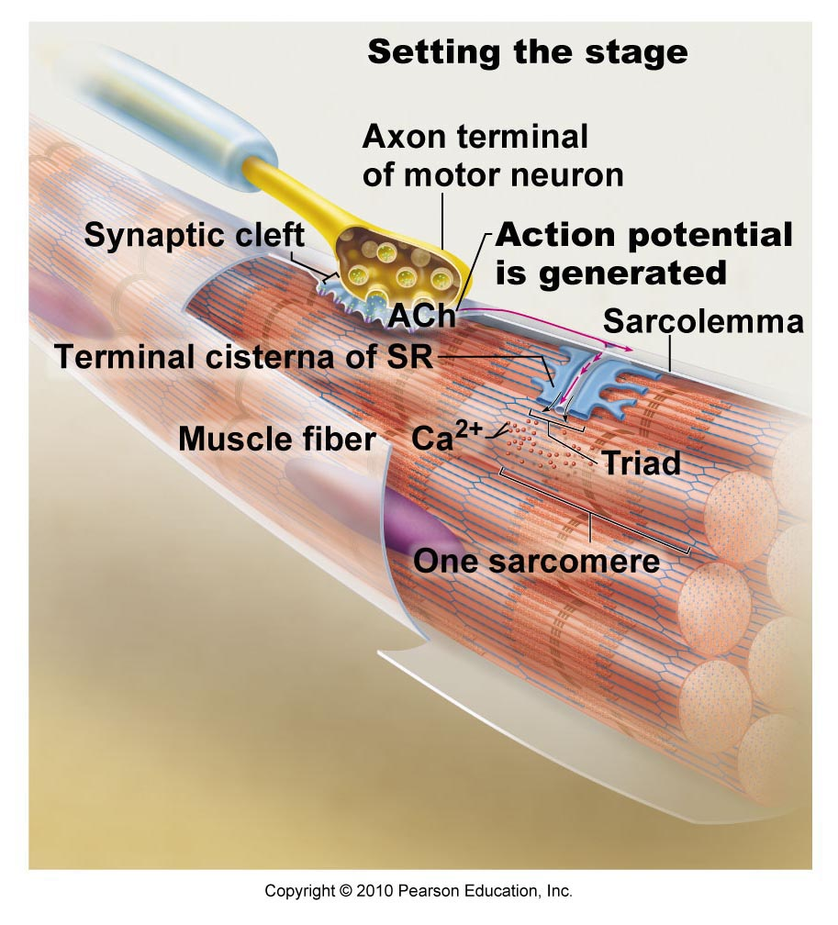

Slide 32
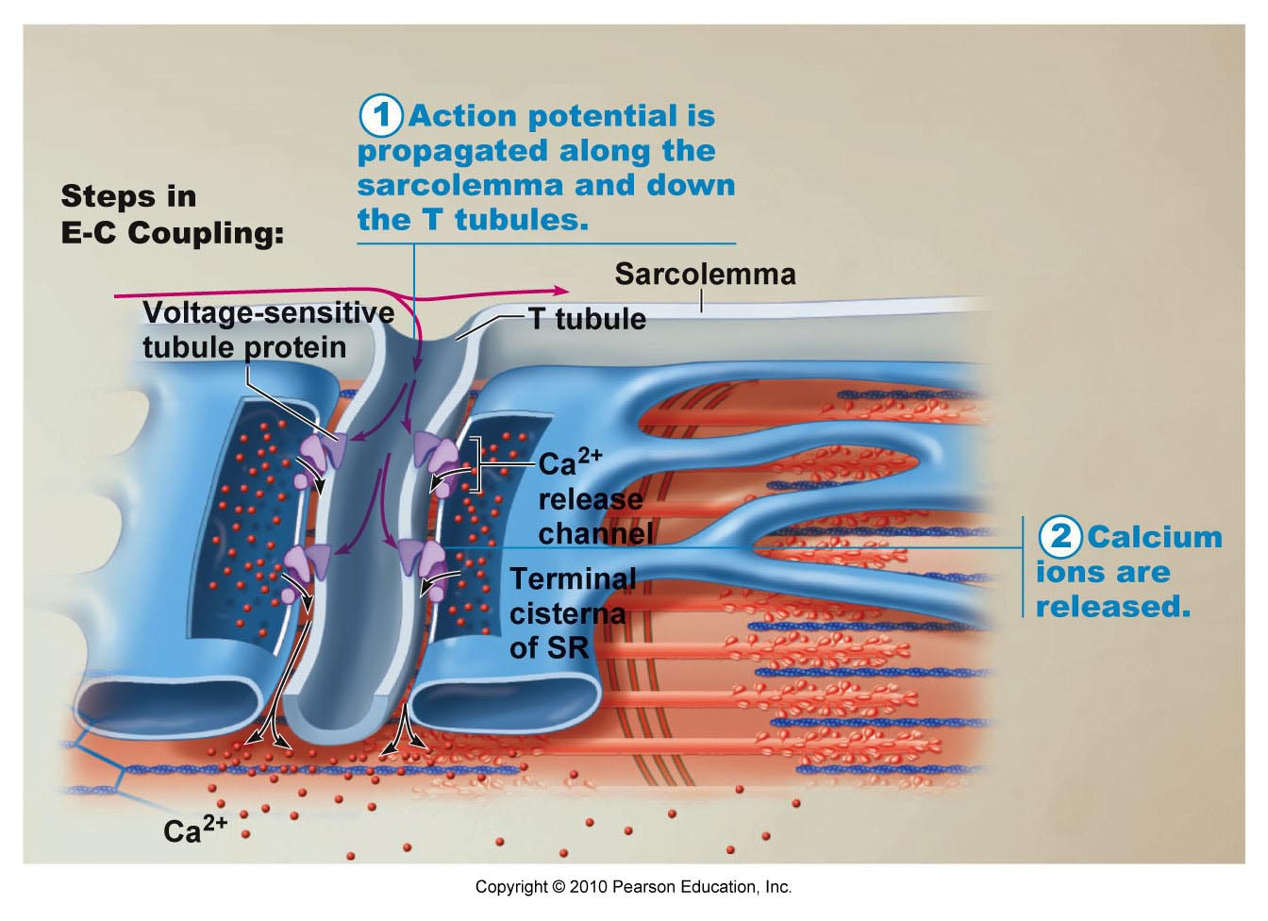

Slide 33
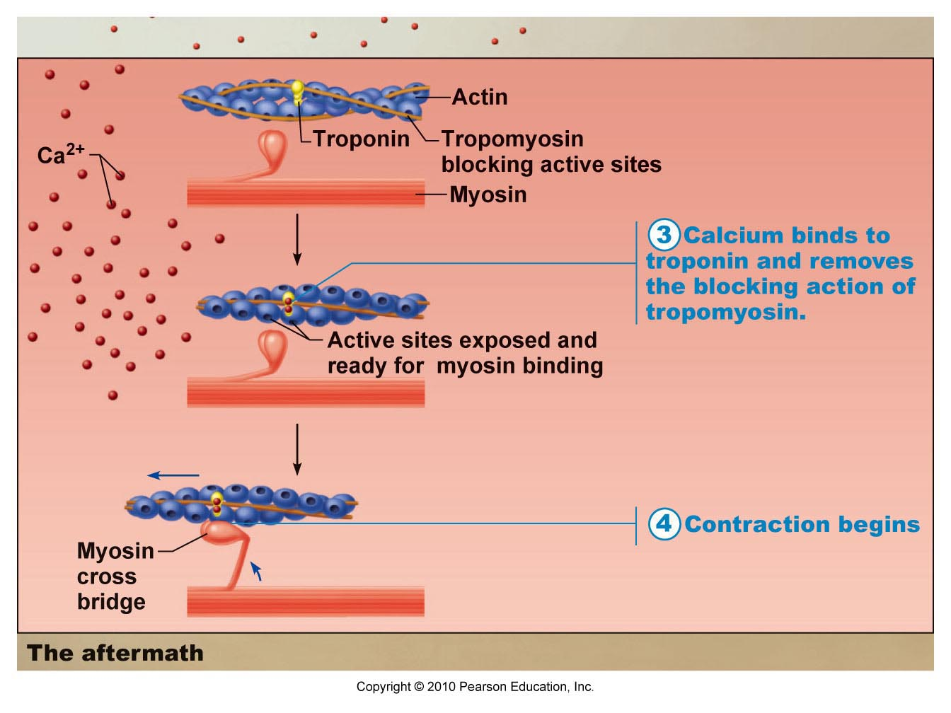

Slide 34
Contraction of Muscle Cell
Action potential travels down sarcolemma along T-Tubules
Calcium is released from SR
Calcium binds to troponin → changes shape → myosin binding sites exposed on actin
Myosin cross-bridge forms with actin
Myosin head pivots and pulls actin filament toward M line
ATP attaches to myosin and cross-bridge detaches
Myosin can be reactivated

Slide 35
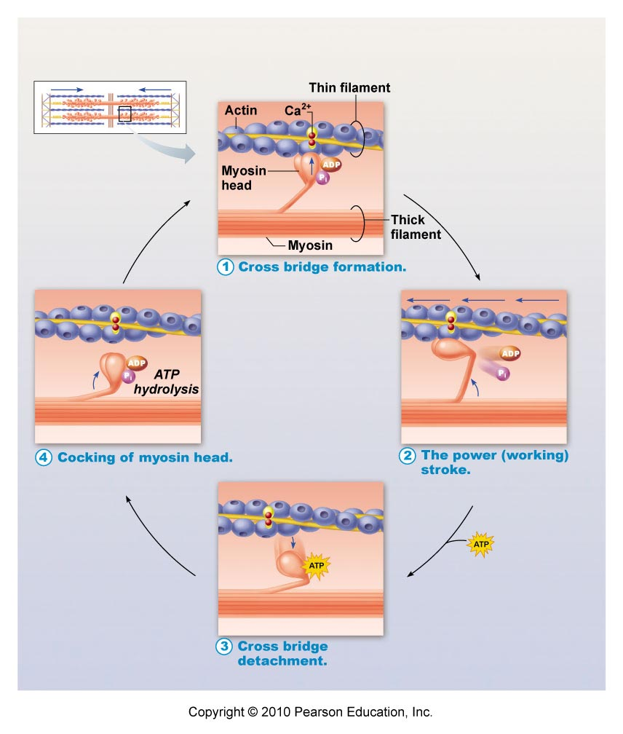

Slide 36
Action Potentials and Muscle Contraction
Video Clip

Slide 37
Neuromuscular Junction
Video Clip

Slide 38
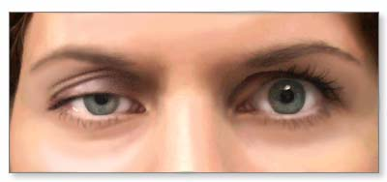
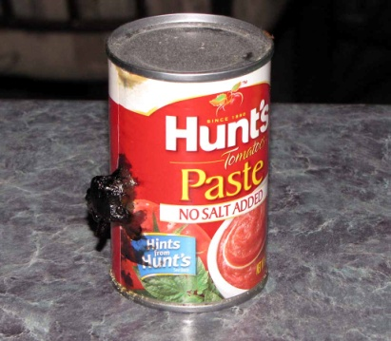
Homeostatic Imbalances
Myasthenia gravis: loss of ACh receptors in sarcolemma by immune system attack → progressive muscular paralysis
Botulism: from bacterial toxin; prevents release of ACh at synaptic terminals → muscular paralysis
Rigor mortis: “death stiffness” = no ATP production, myosin cross-bridges “stuck” until proteins break down (peak: 12 hrs, fades: 48-60 hrs later)

Slide 39
Muscle Responses
Twitches (single, brief, jerky contractions) = problem
Healthy muscle = smooth contraction
Graded muscle responses: different degrees of muscle shortening
Greater force by:
Increase frequency of muscle stimulation
Contractions are summed (max tension = complete tetanus)
Increase # muscle cells being stimulated

Slide 40
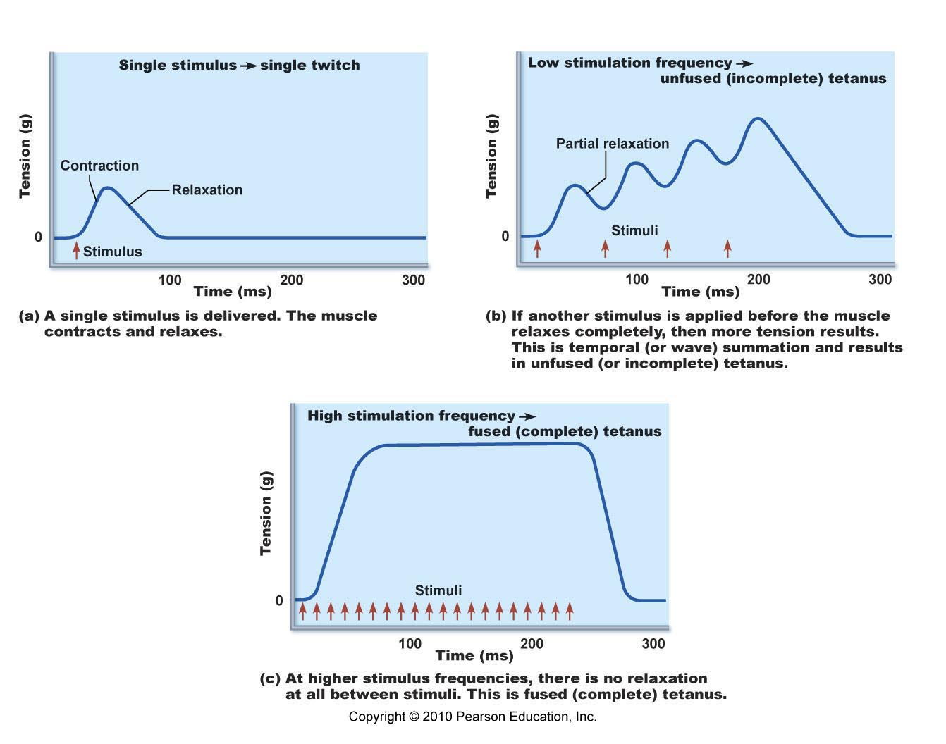
Muscle response to changes in stimulation frequency

Slide 41
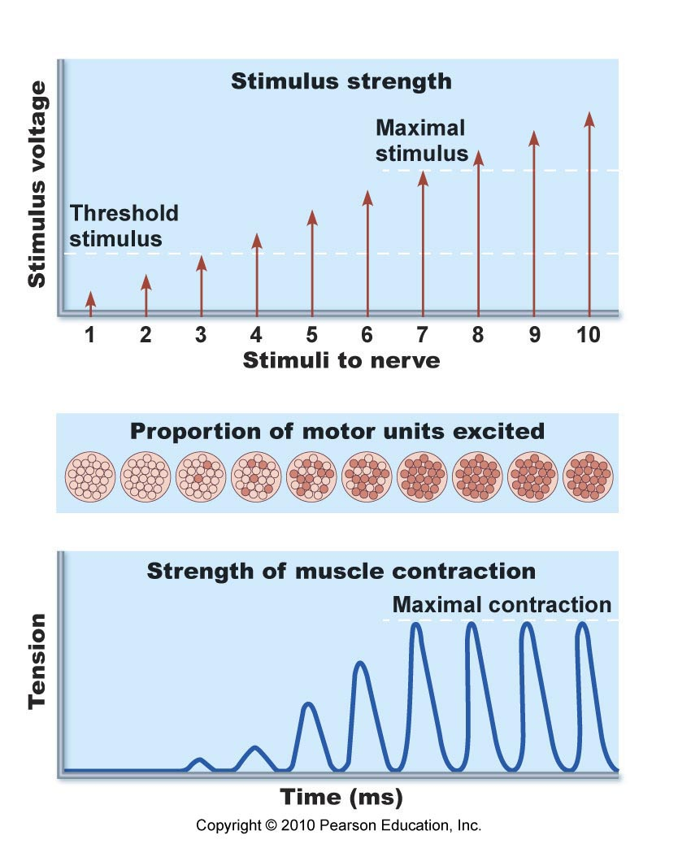
Increasing stimulus → Increasing muscle tension

Slide 42
Energy
ATP = only energy source for muscles
Regenerated by:
Creatine phosphate (CP): transfers energy to ATP
Aerobic respiration: complete glucose breakdown with O₂ present
Lactic acid fermentation: glucose breakdown without O₂
Muscle fatigue: lack of O₂, ATP supply low, lactic acid accumulates, soreness → muscle contracts more weakly until it stops

Slide 43
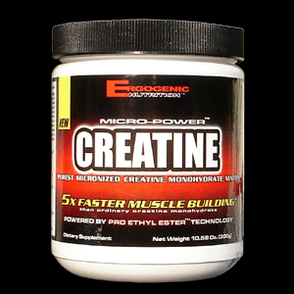
Creatine Phosphate Supplements
Muscle cells store phosphocreatine (Pcr) for sprinting and explosive exercise
Forms/uses: powders, tablets, energy bars, drink mixes
Supplements can enhance sprint performance and lean muscle mass (no evidence to aid endurance performance)
Side effects: weight gain, anxiety, diarrhea, fatigue, headache, kidney problems, nausea, vomiting, rash
No recommended for people with diabetes, kidney or liver problems
Caution: Drink lots of water to avoid dehydration
Effects of long-term usage: unknown

Slide 44
Types of Contractions
Isotonic
Isometric
“same tension”
Muscle length changes
Concentric: shortens
Eccentric: lengthens
Eg. bicep curl, bend knee, smiling
“same length”
Muscle length stays same
Tension increases
Moving against heavy load or immovable object
Eg. lifting heavy weights

Slide 45
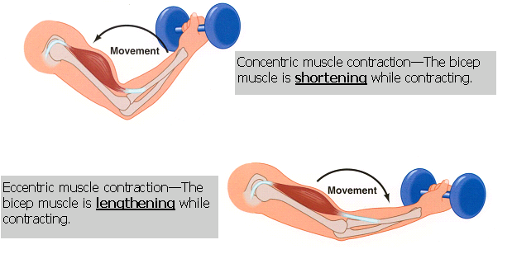
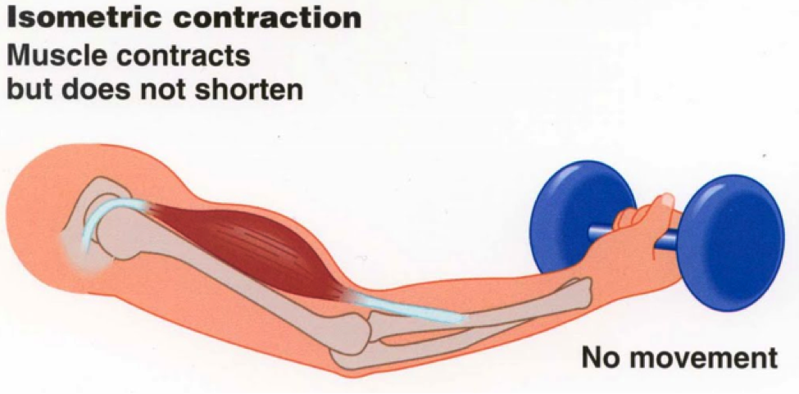
Isotonic Contractions

Slide 46
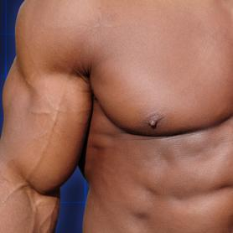
Muscle Tone
Muscles: firm, healthy, ready for action
Some fibers contracting even when muscle is relaxed
Nerve Damage (paralysis):
Flaccid: muscles soft & flabby
Atrophy: wasting away if not stimulated

Slide 47
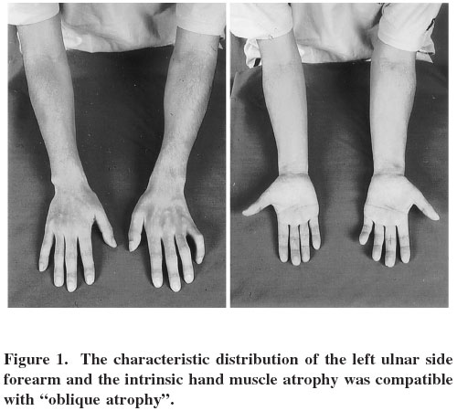
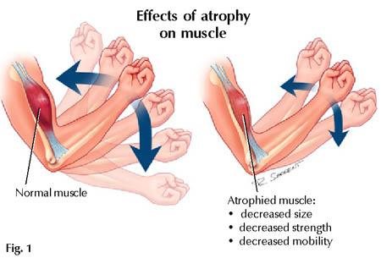

Slide 48
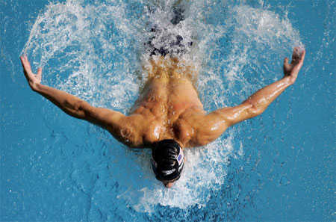
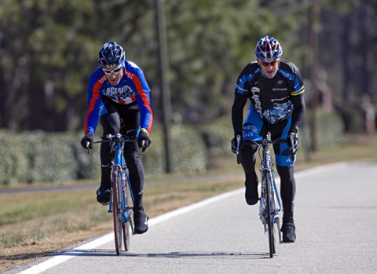
Exercise = Use it or lose it!
Aerobic (endurance) Exercise
stronger, more flexible muscles, greater resistance to fatigue
No increase in muscle size
↑ blood supply, ↑ mitochondria, ↑ O₂ storage
↑ efficiency of metabolism, heart function
Eg. aerobics, jogging, biking

Slide 49
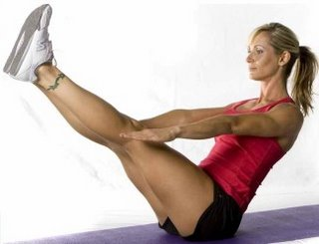
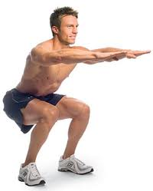
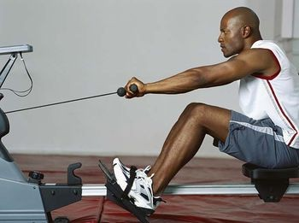
Exercise = Use it or lose it!
Resistance/Isometric Exercise
Muscles vs. immovable object
↑ muscle cell size (more contractile filaments)
↑ muscle size and strength
Eg. weights, using own body

Slide 50
Muscle Cramps
Sudden or involuntary contraction of muscles
Causes: long periods of exercise or physical labor, medications, dehydration, muscle strain, nerve/kidney/thyroid disorders
Medical Condition: Inadequate blood supply, nerve compression, mineral depletion (Ca, K, Mg)
Treatment: stretching exercises, muscle relaxant, hydration, Vitamin B supplements, apply cold/heat

Slide 51
Health & Fitness
Forcing a muscle to work hard promotes strength & endurance
Heavy workout day → 1-2 days of rest or light workout for muscle recovery
Overuse injuries – muscle or joint pain
Best program: alternate aerobic & anaerobic activities

Slide 52
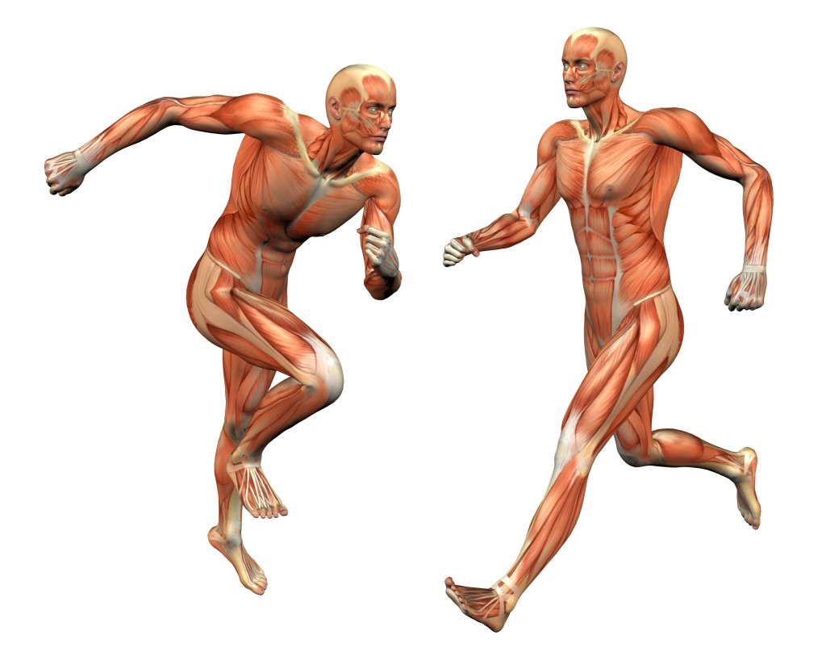
The Muscular System
Chapter 10

Slide 53
Five Golden Rules of Skeletal Muscle Activity
All muscles cross at least one joint (+ a few exceptions).
The bulk of muscle lies proximal to the joint crossed.
All muscles have at least 2 attachments: origin + insertion
Muscle can only pull; they never push.
During contraction, the muscle insertion moves toward origin.

Slide 54
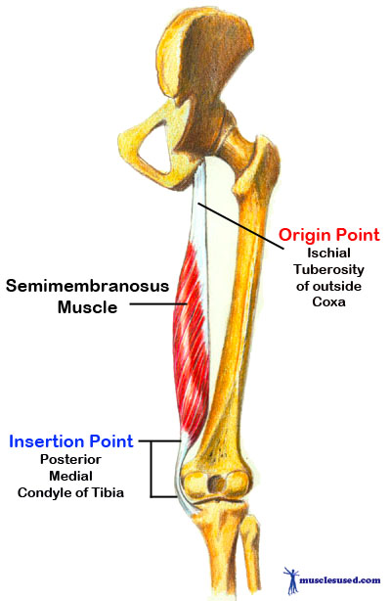
Muscle Origin & Insertion
Every skeletal muscle attached to bone or connective tissue at 2+ points
Origin: attached to immovable (less movable) bone
Insertion: attached to movable bone

Slide 55
Naming Skeletal Muscles
Location (associated with bone; temporalis)
Shape (deltoid = triangle, trapezius = trapezoid)
Relative size (maximus, minimus, longus)
Direction of muscle fibers (rectus = straight, transversus, oblique)
Number of origins (biceps, triceps, quadriceps)
Location of attachments (sternocleidomastoid = sternum & clavicle origins, mastoid insertion)
Action of muscle(flexor, extensor, adductor)

Slide 56
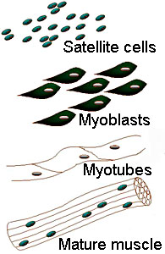
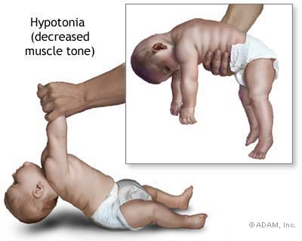
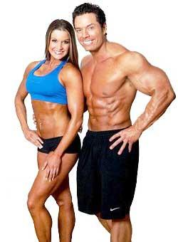
Developmental Aspects
Muscles develop from myoblasts (embryonic cells)
Muscle fibers formed when myoblasts fuse
Newborn: uncoordinated movements, reflexive
Regeneration: skeletal & cardiac (very limited); smooth muscle (throughout life)
Women (Muscle = 36% body mass), Men (42%) → difference due to testosterone

Slide 57
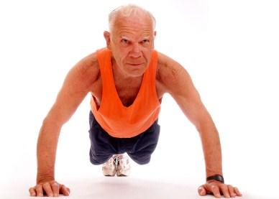
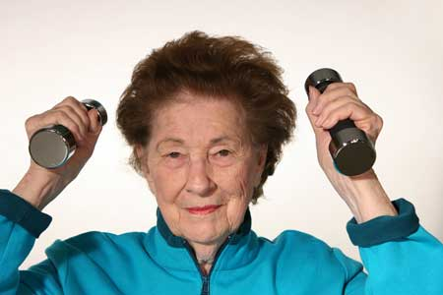
Aging & Muscles
With age, muscle mass decreases & become more sinewy
Strength decreases by 50% by age 80
Exercise helps retain muscle mass and strength

Slide 58
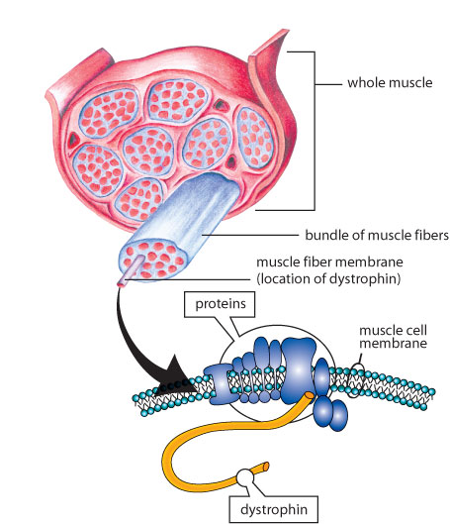
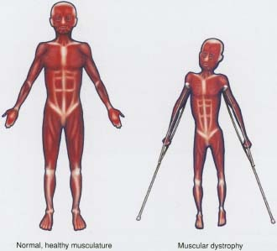
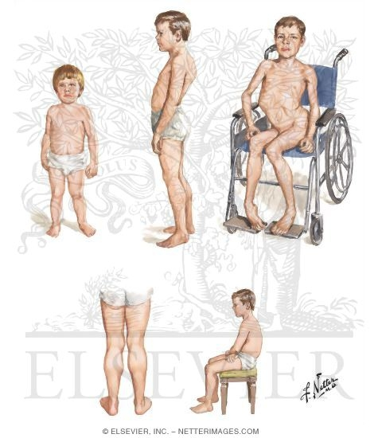
Homeostatic Imbalances
Muscular Dystrophy: inherited muscle-destroying diseases → muscles atrophy & degenerate
Duchenne muscular dystrophy (DMD): sex-linked recessive disorder; missing dystrophin protein

