Slide 1
Human Brain

Slide 2
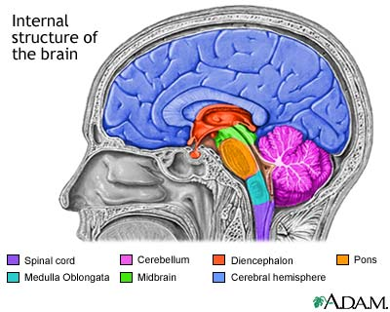
4 Major Regions
Cerebral Hemispheres
Diencephalon
Brain stem
Cerebellum

Slide 3
1. Cerebral Hemispheres (Cerebrum)
L & R hemispheres
Corpus callosum: large fiber tract; connects 2 hemispheres
Lobes: major regions (named for cranial bones)
Parietal, frontal, occipital, temporal
Gyri (gyrus) = elevated ridges of tissue
Sulci (sulcus) = shallow grooves
Fissures = deeper grooves, separate large regions of brain
Motor & sensory function: opposite hemispheres

Slide 4
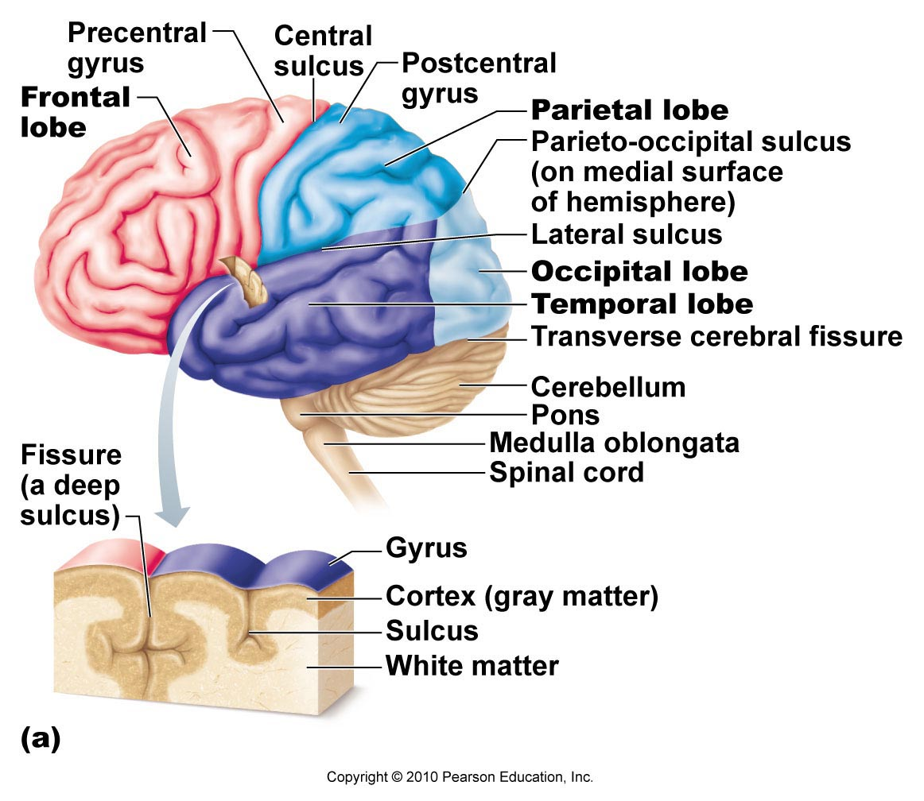

Slide 5
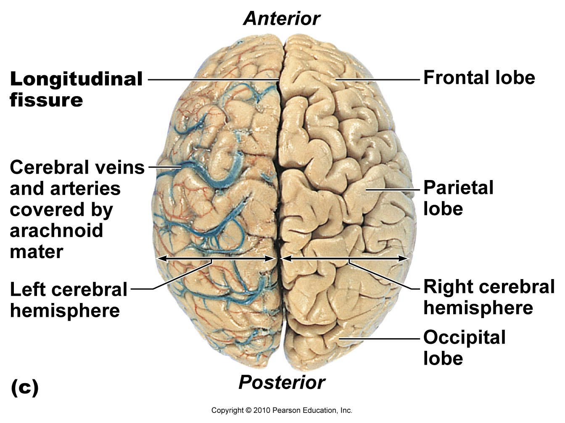

Slide 6
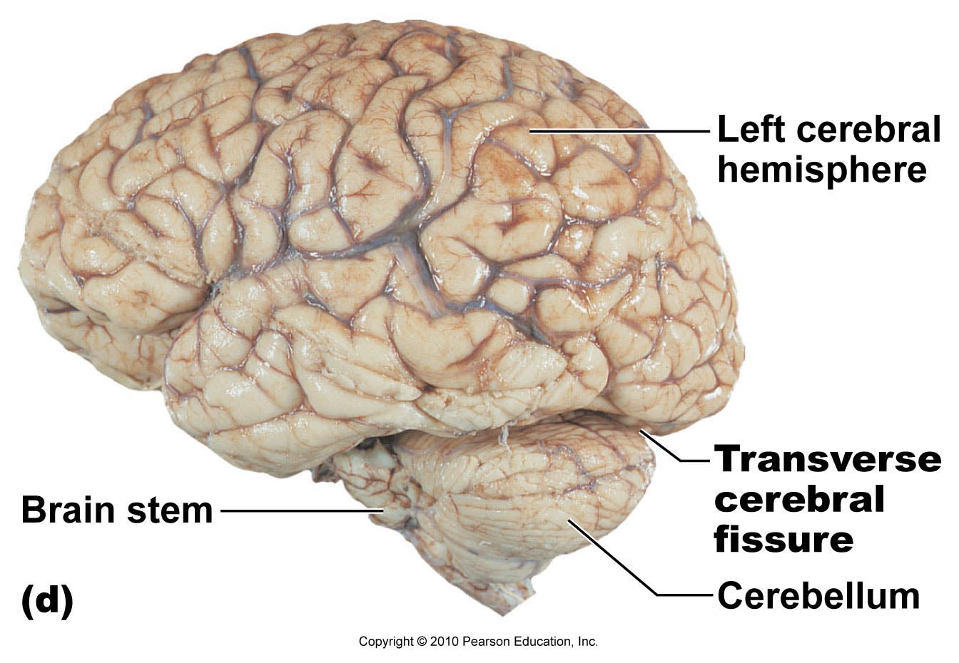

Slide 7
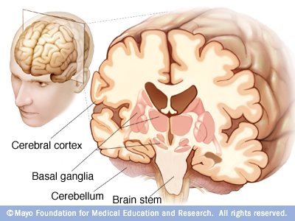
Cerebral Cortex
Grey matter
“Executive suite” → conscious mind

Slide 8
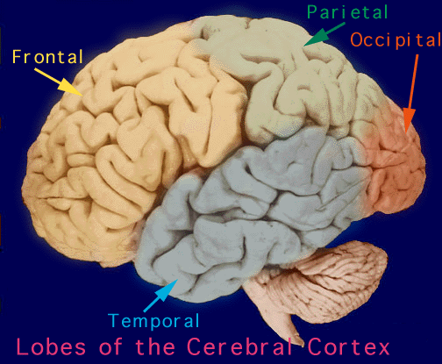

Slide 9
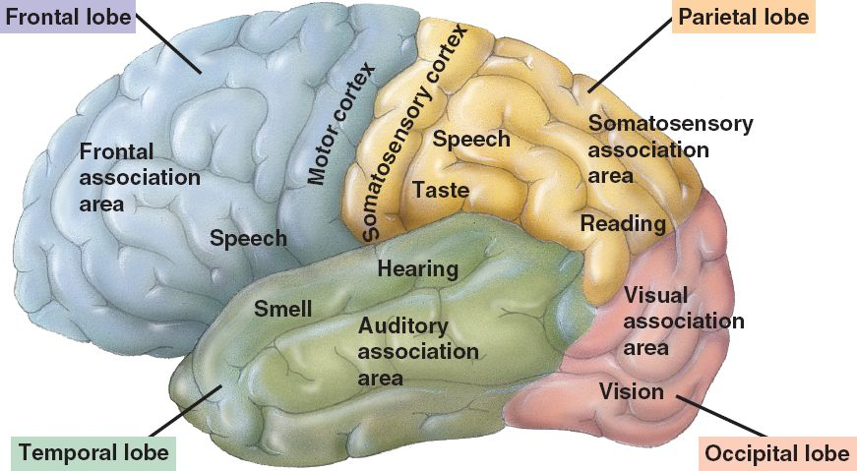
Functions of the Major Lobes

Slide 10
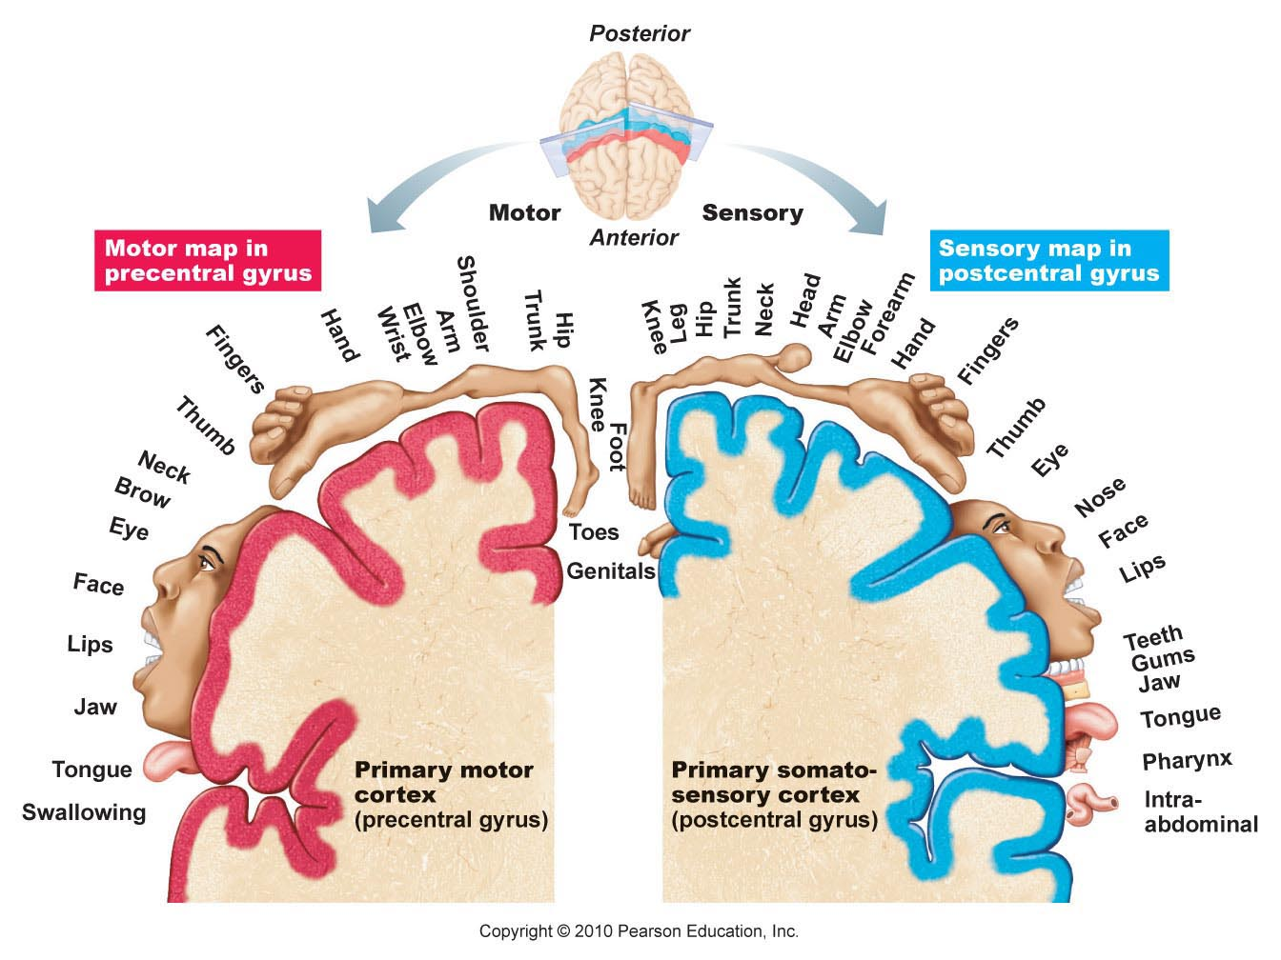

Slide 11
2. Diencephalon (interbrain)
3 main structures:
Thalamus: relay station for incoming info
Hypothalamus:
Autonomic control center (heart rate, BP, digestion)
Emotional response (limbic system)
Body temperature regulation
Regulate food intake
Sleep-wake cycles
Control endocrine system → pituitary gland at base
Epithalamus: pineal gland (sleep-wake cycle)

Slide 12
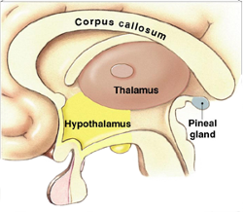
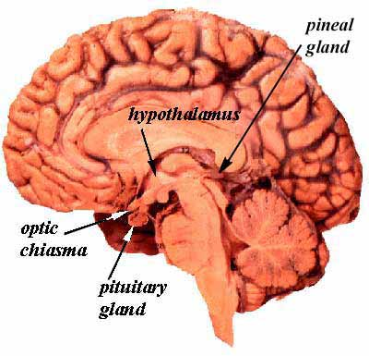
Diencephalon

Slide 13
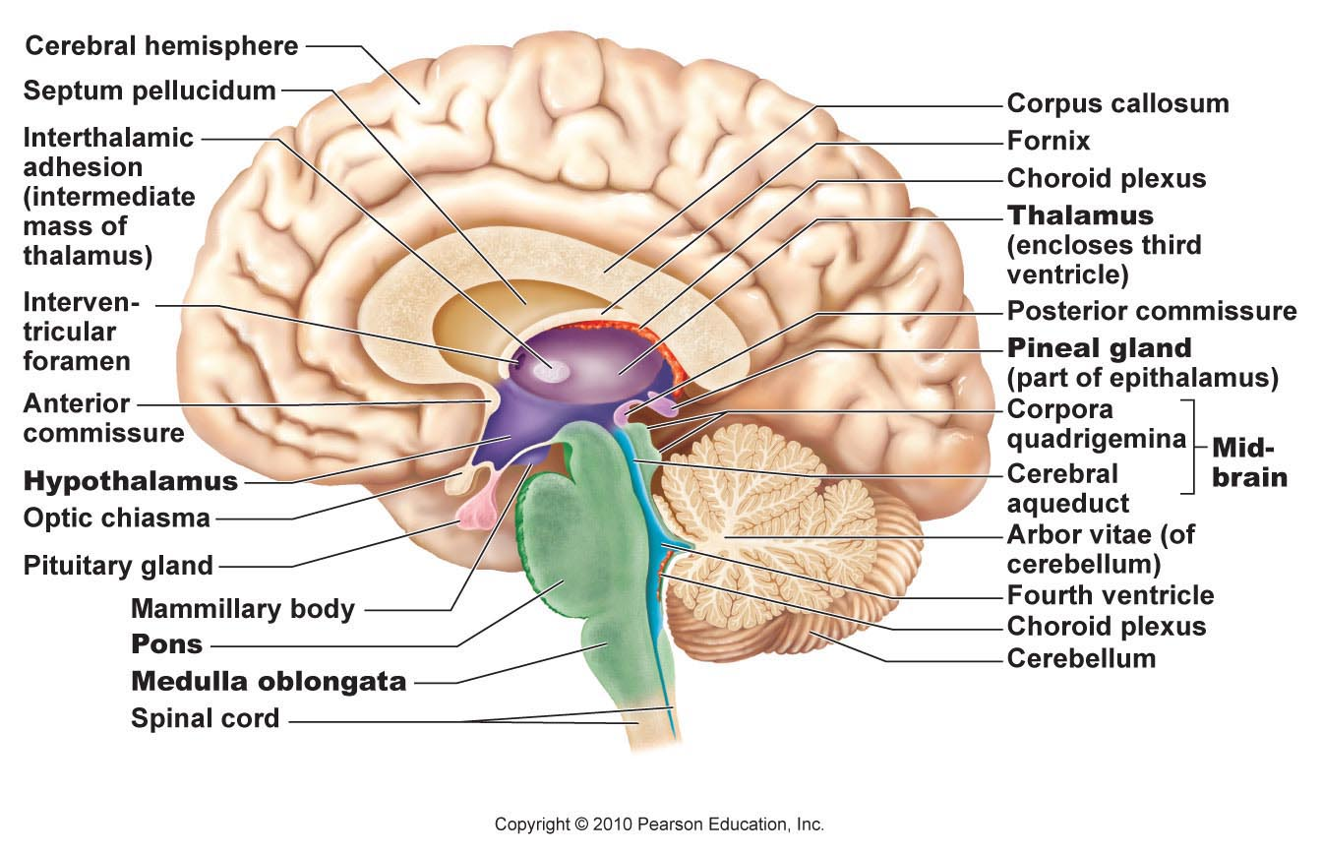

Slide 14
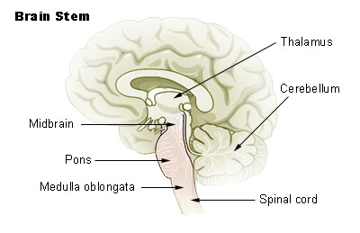
3. Brain Stem
Programmed, automatic behaviors for survival
3 regions:
Midbrain: vision, hearing, reflex
Pons: breathing
Medulla oblongata: heart rate, BP, breathing, swallowing, vomiting, coughing, sneezing

Slide 15
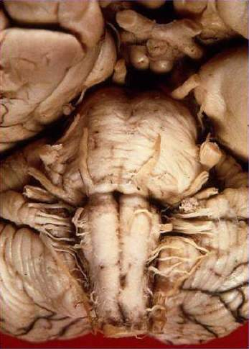
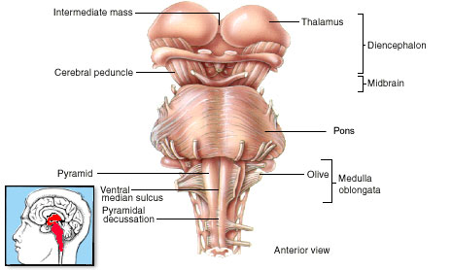
Brain Stem

Slide 16
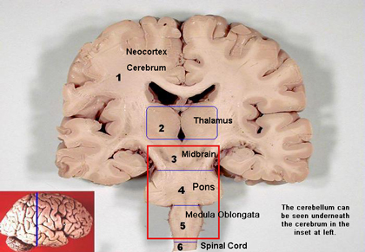

Slide 17
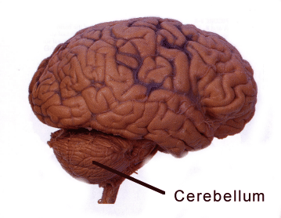
4. Cerebellum
Balance, equilibrium, timing of skeletal muscle activity

Slide 18
Protection of CNS
Meninges: connective tissue covering CNS structures
Dura mater (leathery outer), arachnoid mater (web-like middle), pia mater (surface of brain)
Meningitis: inflammation of meninges; bacterial or viral infection
Cerebrospinal fluid (CSF): watery cushion to protect NS from trauma
Lumbar (spinal) tap – test for infection, tumors, multiple sclerosis

Slide 19
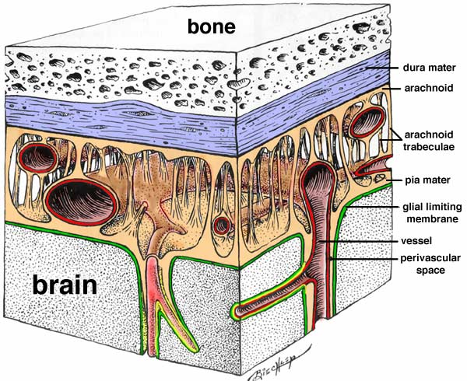

Slide 20
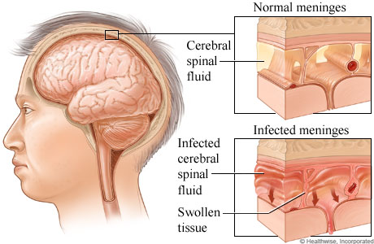
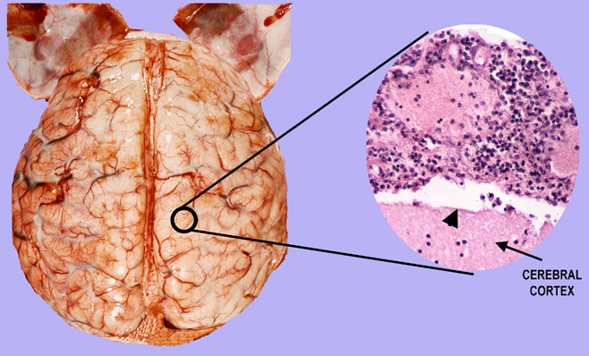
Meningitis

Slide 21
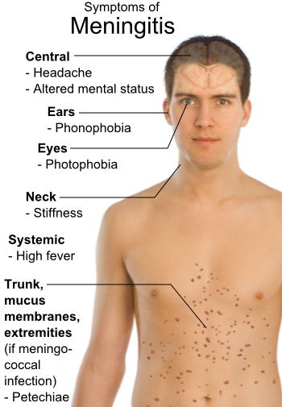
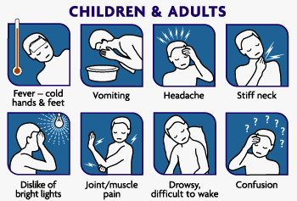
Symptoms of Meningitis

Slide 22
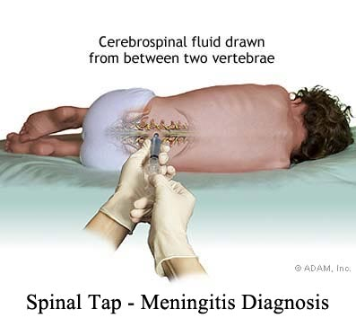
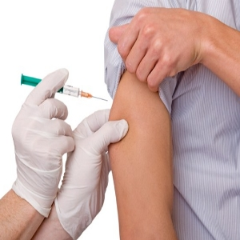
Treatment for Meningitis
Bacterial → antibiotics
Herpes meningitis → antiviral meds
IV fluids
Prevention: vaccines for bacterial infections (HiB)

Slide 23
Blood-Brain Barrier: endothelial cells in capillaries prevent substances from crossing into brain
NO:
YES:
Urea
Toxins
Proteins
White blood cells
Bacteria
Most drugs
Water
Glucose
Amino acids
Gases
Fat-soluble substances
Some drugs: anesthetics, alcohol, nicotine

Slide 24
The Nervous System

Slide 25
Nervous System
Master controlling and communicating system

Slide 26
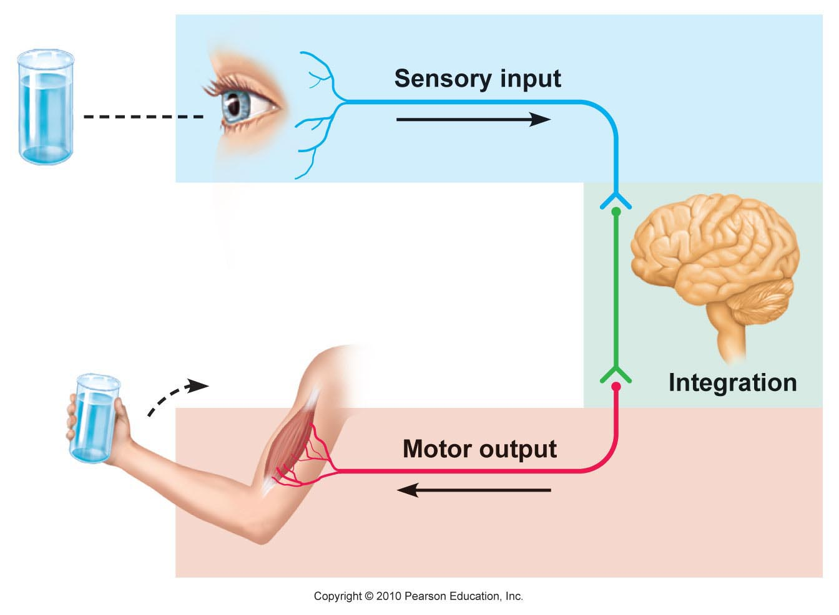
Basic Functions
Sensory input – gather information
Integration – process and interpret sensory input
Motor output – response by muscles and glands

Slide 27
Organization
Central Nervous System (CNS)
Brain & spinal cord
Integrative and control centers
Peripheral Nervous System (PNS)
Nerves (spinal nerves, cranial nerves)
Communication lines between CNS and rest of body
Two Divisions:
Sensory (afferent) Division: Sensory receptors → CNS
Motor (efferent) Division: CNS → effectors (muscles & glands)

Slide 28
Motor Division
Somatic nervous system (voluntary) – control skeletal muscles
Autonomic nervous system (ANS) (involuntary) – regulate smooth muscles, cardiac, glands
Subdivisions: sympathetic & parasympathetic

Slide 29
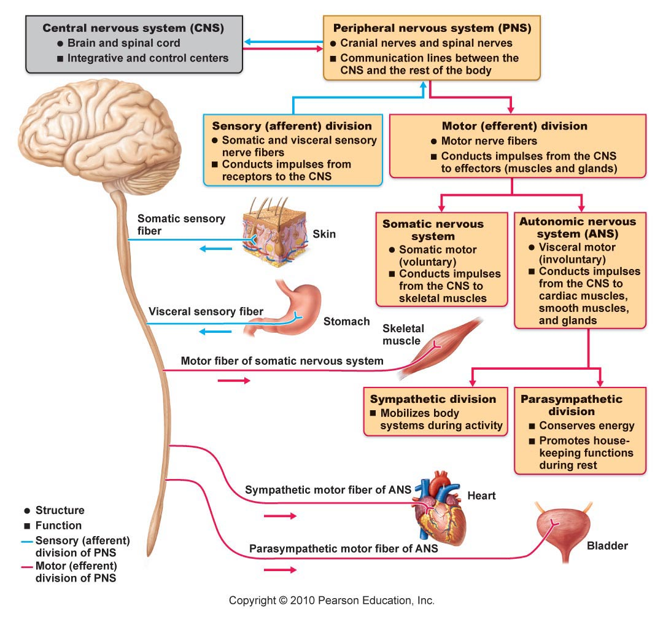

Slide 30
Nervous Tissue
Neurons (nerve cells) - transmit message
Anatomy:
Cell body – contains nucleus; metabolic center
Dendrite – fiber that conveys messages toward cell body
Axon – conduct nerve impulses away from the cell body
Axon terminals – end of axon; contain neurotransmitters & release them
Synaptic cleft/synapse – gap between neurons

Slide 31
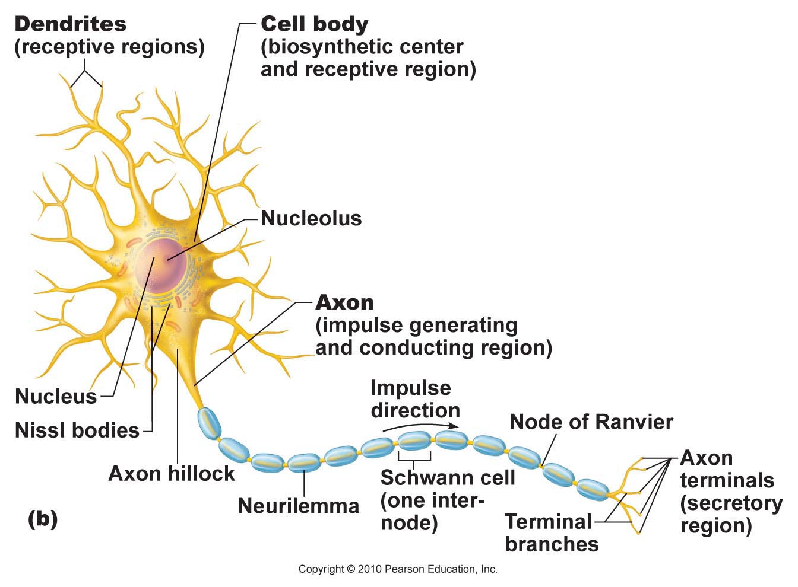

Slide 32
Nervous Tissue
Supporting cells (Neuroglia)
CNS: astrocytes, microglia, ependymal cells, oligodendrocytes
barrier between capillaries and neurons
protect neurons
immune/defense
line brain and spinal cord cavities
wrap nerve fibers
produces myelin sheaths (covering)
PNS: Schwann cells, satellite cells
surround large neurons
protect & cushion

Slide 33
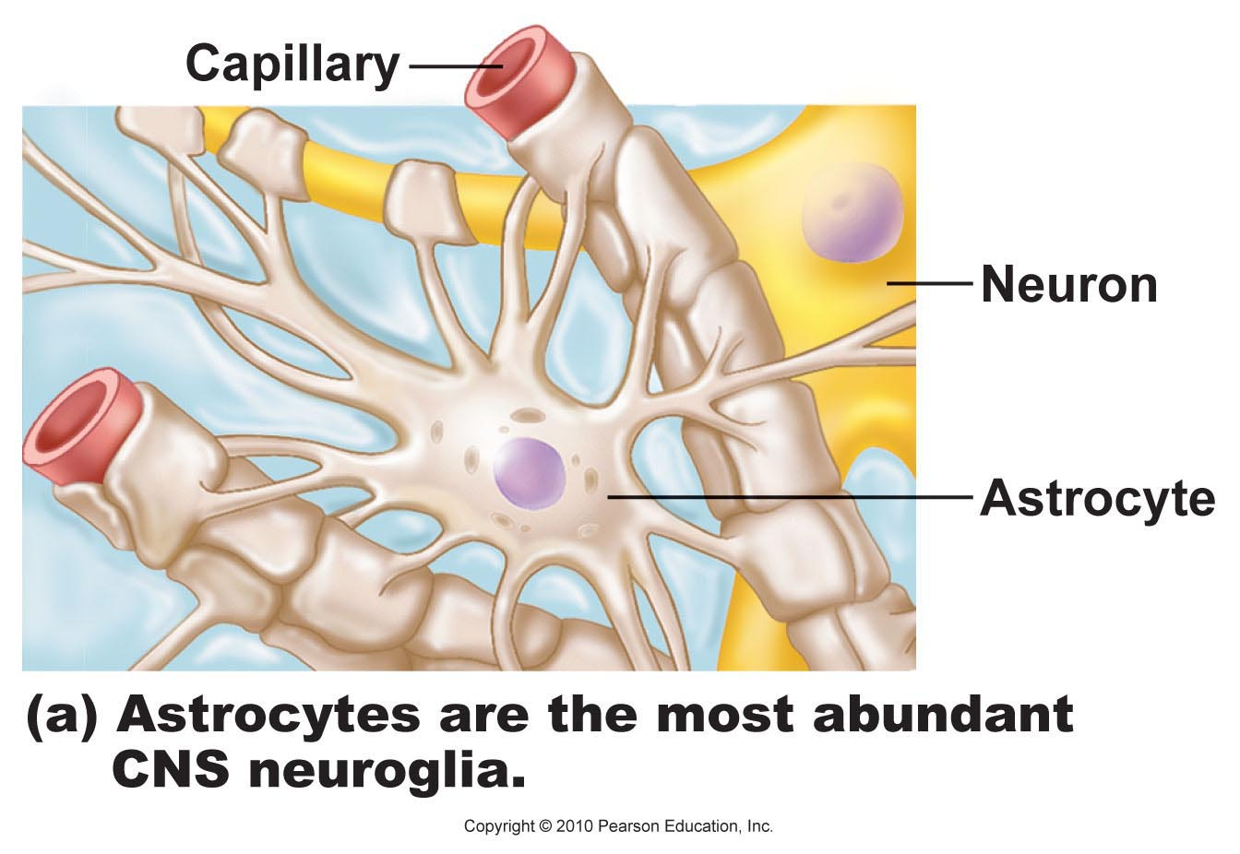
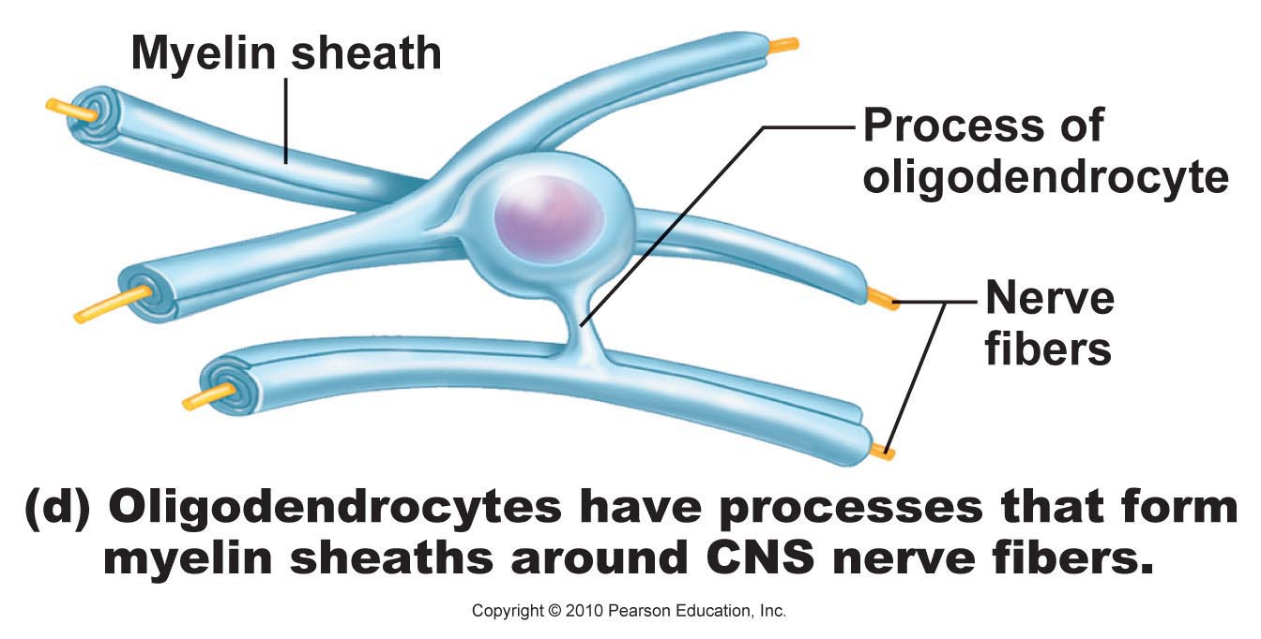
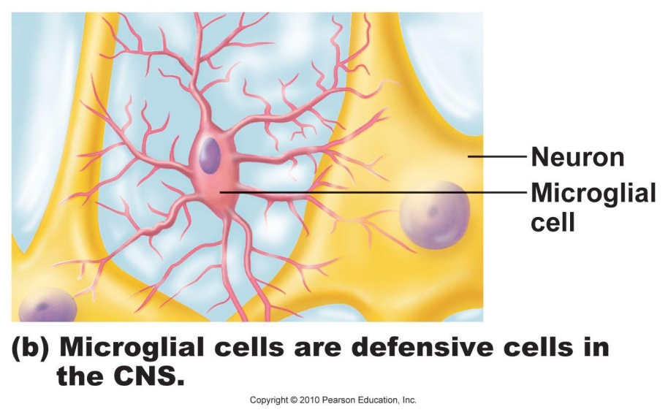
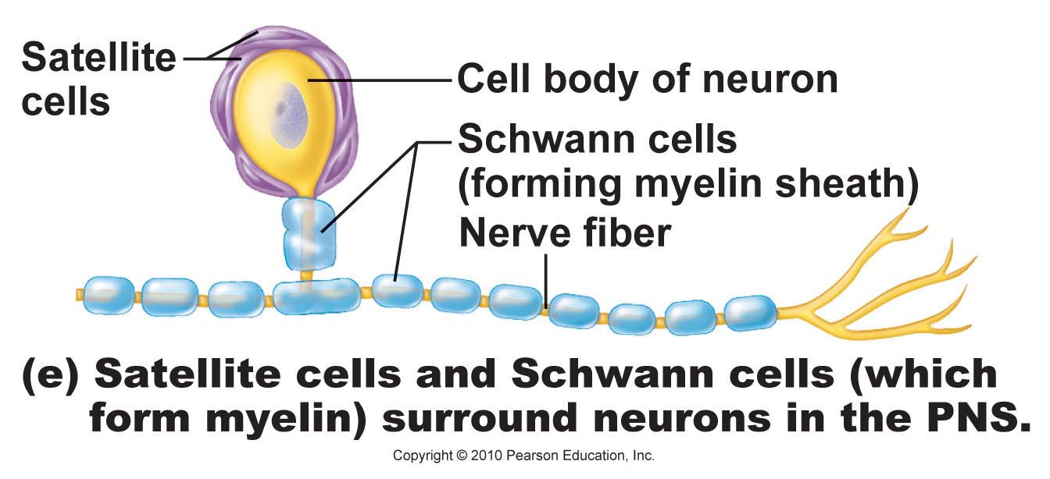
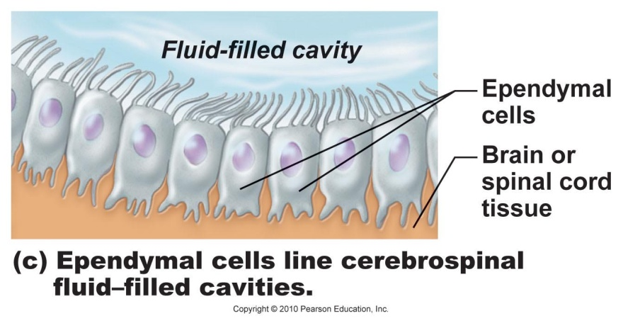

Slide 34
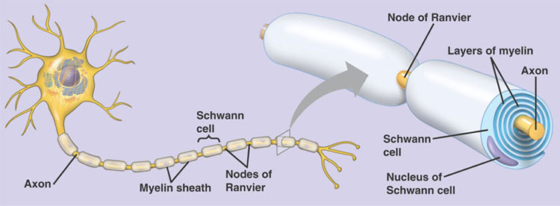
Myelin: whitish, fatty material that covers nerve fibers to speed up nerve impulses
Schwann cells: surround axons and form myelin sheath
Myelin sheath: tight coil of wrapped membranes
Nodes of Ranvier: gaps between Schwann cells

Slide 35
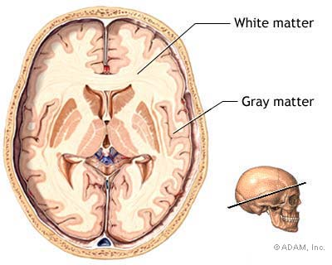
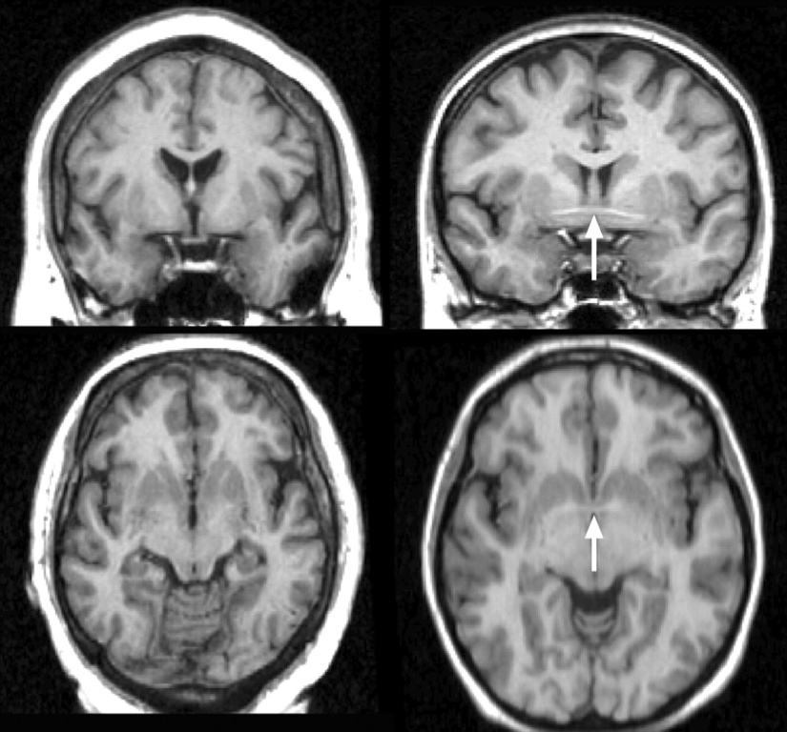
Ganglia: collections of cell bodies
Bundles of nerve fibers = tracts (CNS) or nerves (PNS)
White matter: dense collections of myelinated fibers
Gray matter: unmyelinated fibers & cell bodies

Slide 36
ItIt’It’s a Mad, Mad, Mad Neuron

Slide 37
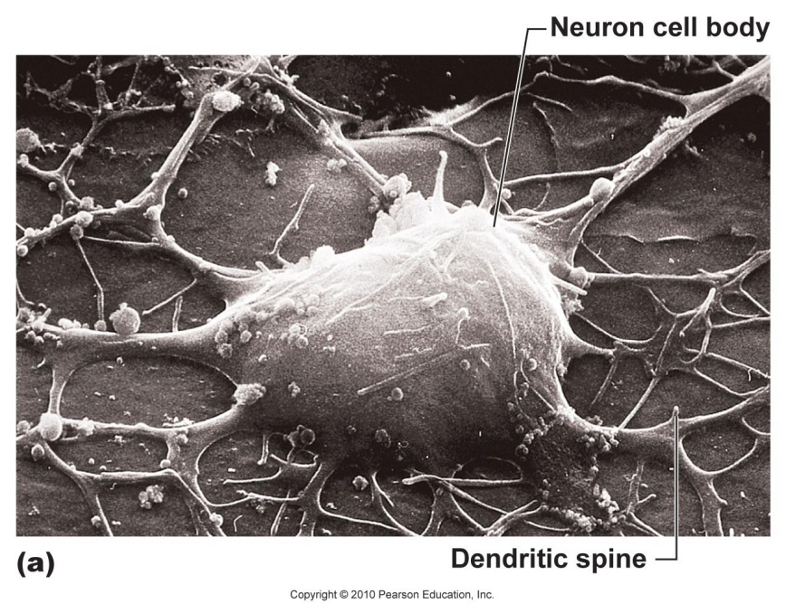
Classification of Neurons

Slide 38
Functional Classification: direction nerve impulse is traveling
Sensory neurons | Motor neurons | Interneurons
carry impulses from sensory receptors to CNS | carry impulses from CNS to muscles & glands | connect sensory & motor neurons
Vision, hearing, equilibrium, taste, smell, pain, pressure, heat

Slide 39
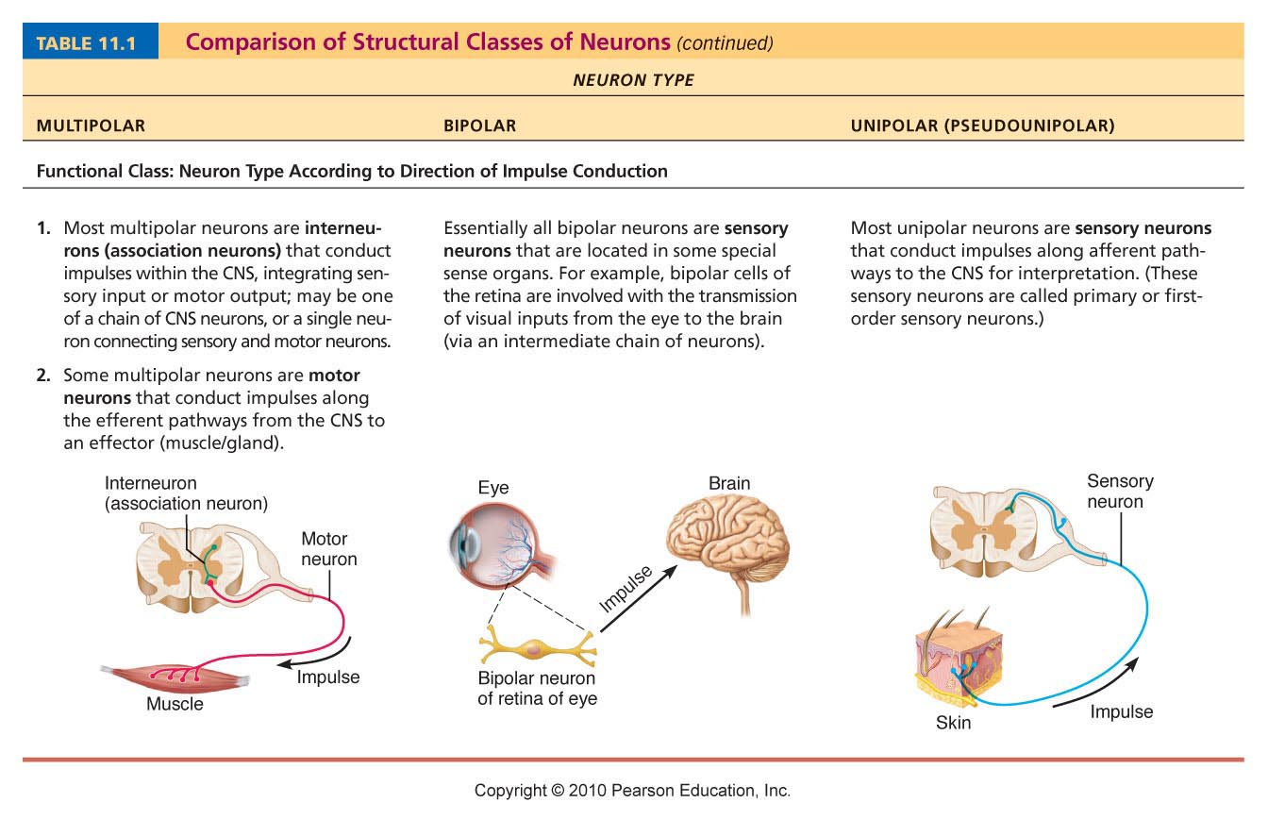

Slide 40
Structural Classification: # processes extending from cell body
Multipolar | Bipolar | Unipolar
1 axon, several dendrites | 1 axon, 1 dendrite | 1 process
Most common (99%) | Rare | Short with 2 branches (sensory, CNS)
Eg. Motor neurons, interneurons | Eg. retina, nose, ear | Eg. PNS ganglia

Slide 41
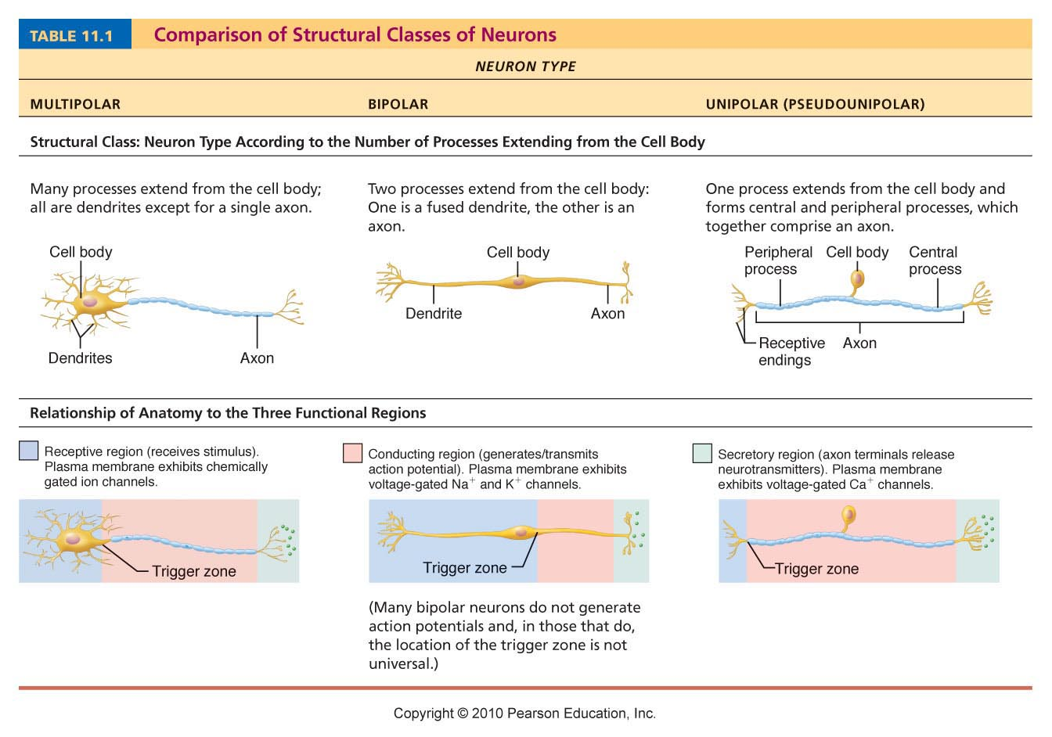

Slide 42
Nerve Impulses

Slide 43
Neuron Function
Irritability: ability to respond to stimulus & convert to nerve impulse
Conductivity: transmit impulse to other neurons, muscles, or glands

Slide 44
Exciting a Neuron:
Cell membrane at rest = polarized
Na⁺ outside cell, K⁺ inside cell
Inside is (-) compared to outside
Stimulus → excited neuron (Na⁺ rushes in) → becomes depolarized
Depolarization activates neuron to transmit an action potential (nerve impulse)
All-or-none response
Impulse conducts down entire axon
K+ diffuses out → repolarization of membrane
Na+/K+ ion concentrations restored by sodium-potassium pump (uses ATP)

Slide 45
Resting membrane potential (-70mV)

Slide 46
Gated Ion Channels (Na⁺ and K⁺)

Slide 47
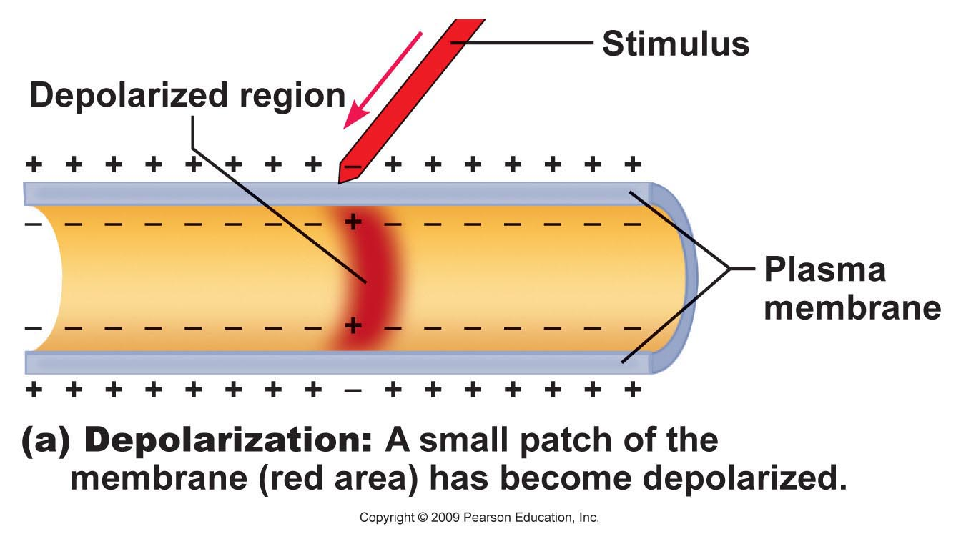
Depolarization

Slide 48
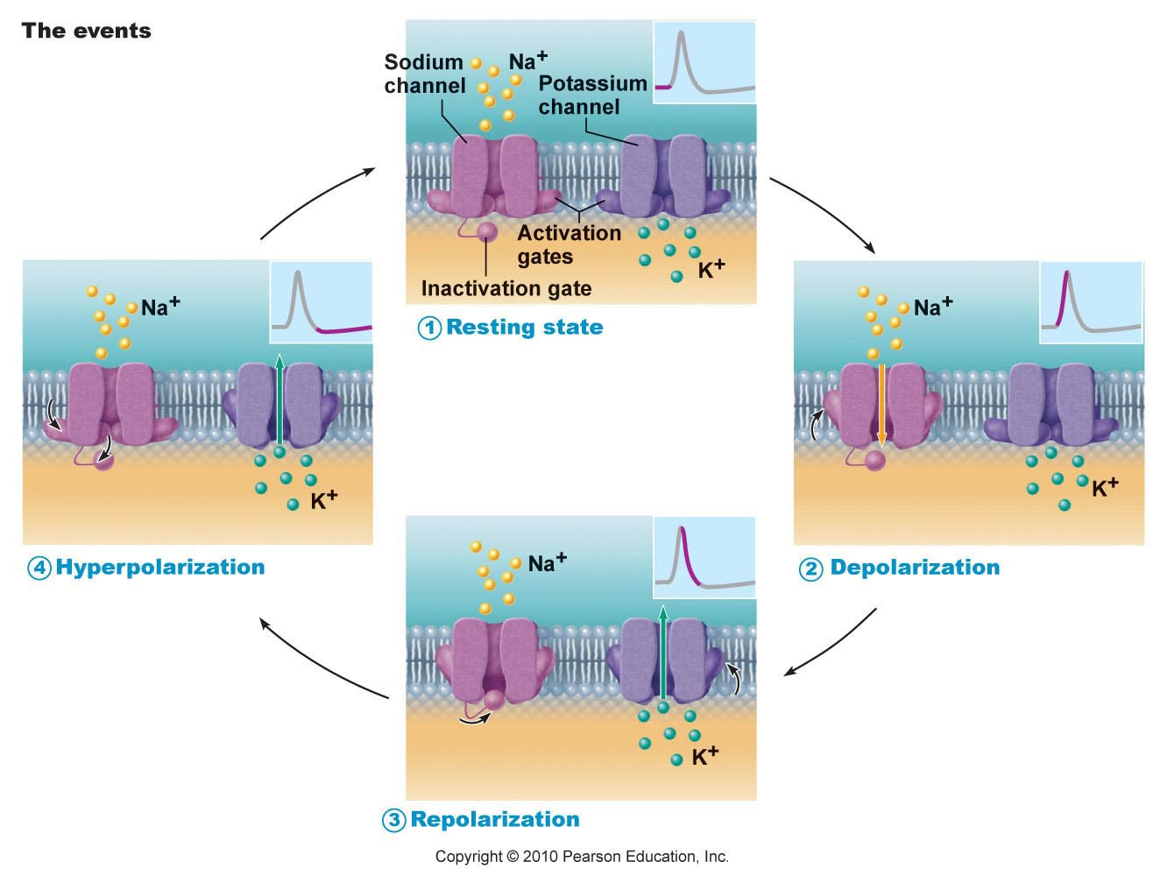

Slide 49
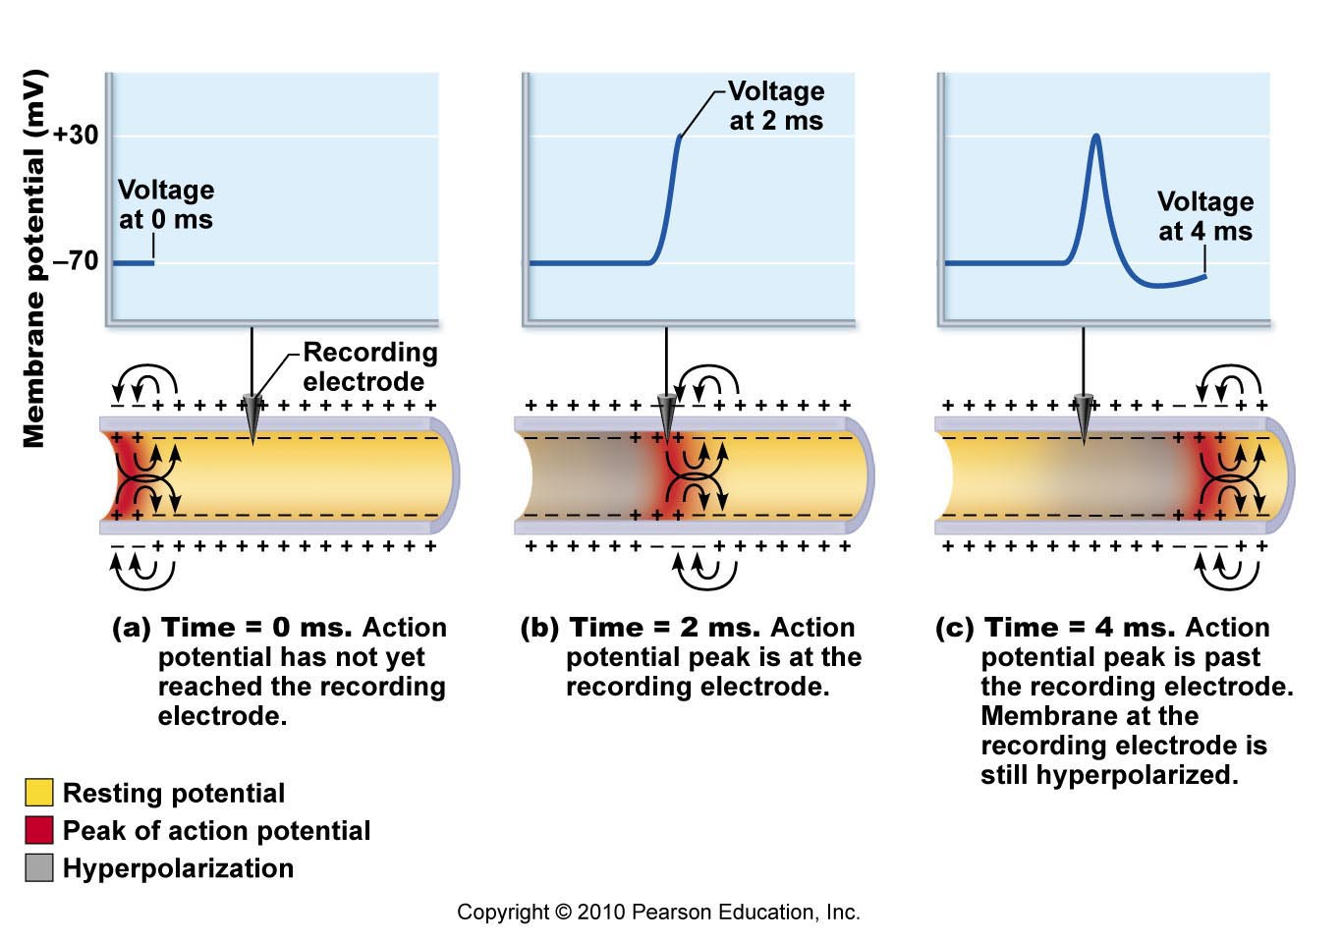

Slide 50
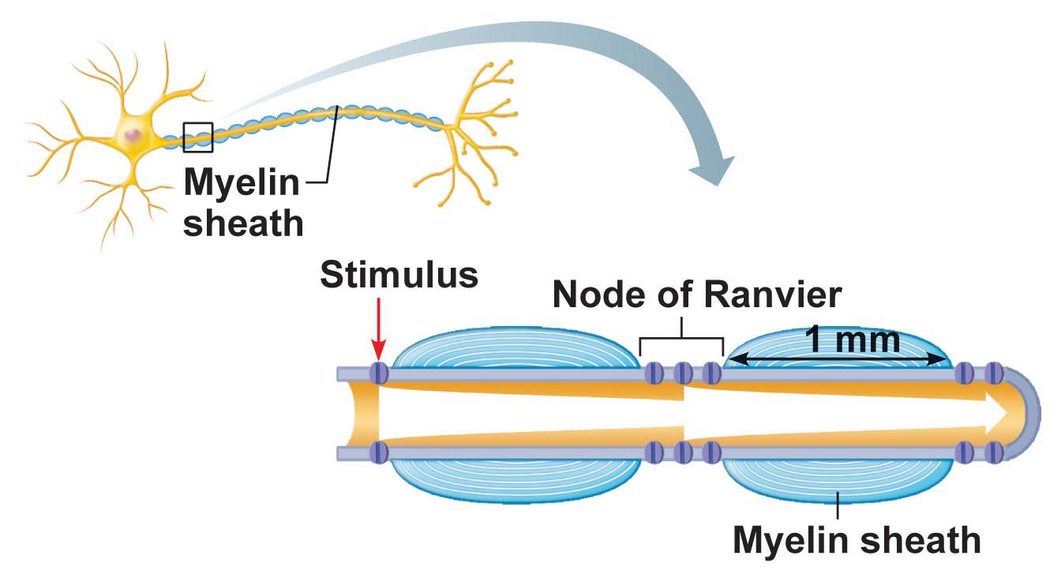
Saltatory conduction: electrical signal jumps from node to node along myelinated axon (30x faster!)

Slide 51
Multiple Sclerosis (MS)
Autoimmune disease
Myelin sheaths destroyed → reduced to hardened lesions (scleroses)
Blindness, muscle weakness, speech disturbance, urinary incontinence
Treatment: interferons, glatiramer (hold off attacks)

Slide 52
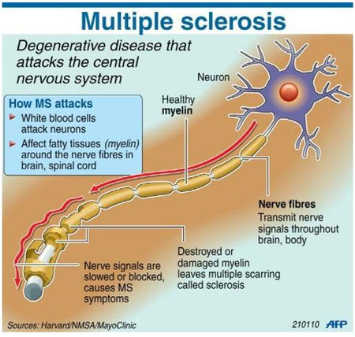
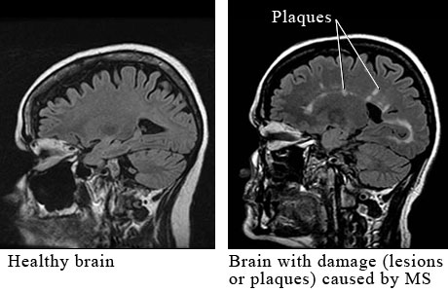
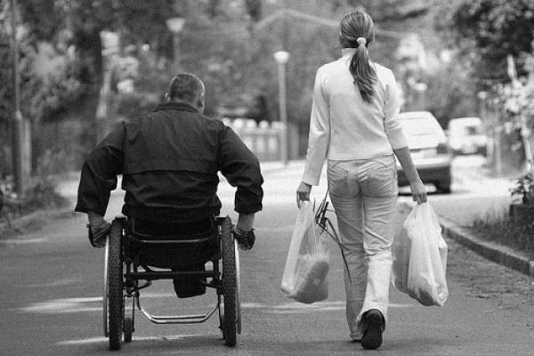

Slide 53
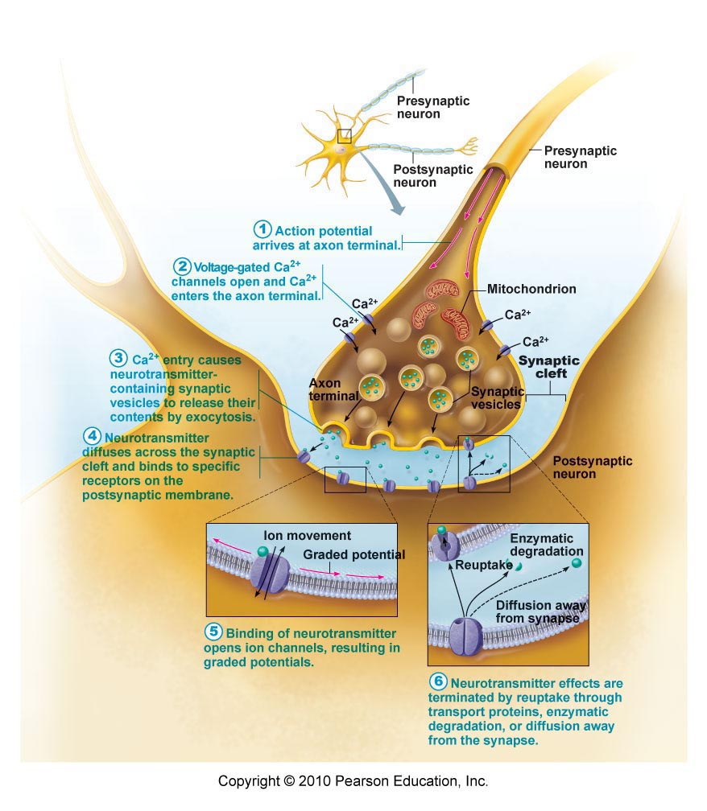
Nerve Conduction
Action potential reaches axon terminal → vesicles release neurotransmitters (NT) into synaptic cleft
NT diffuse across synapse → bind to receptors of next neuron
Transmission of a nerve impulse = electrochemical event

Slide 54
Neuron Talk

Slide 55
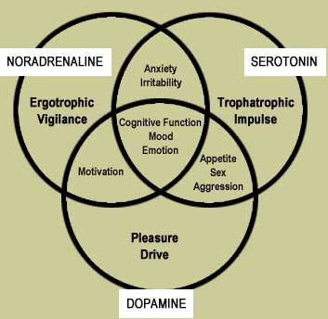
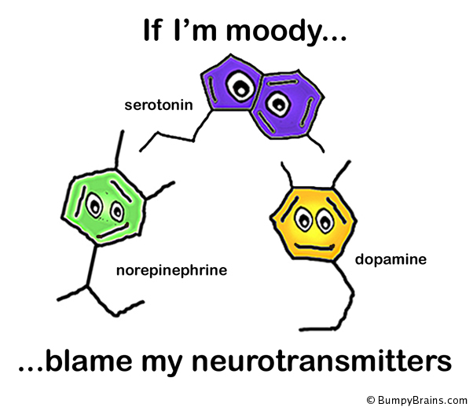
Neurotransmitters
50+ identified
Excitatory: cause depolarization
Inhibitory: reduce ability to cause action potential
Eg. acetylcholine, serotonin, endorphins

Slide 56
Mouse Party

Slide 57
Neurotransmitters
Neurotransmitter
Action
Affected by:
Acetylcholine
muscle contraction
botulism, curare (paralytic), nicotine
Dopamine
“feeling good”
cocaine, amphetamines
Serotonin
sleep, appetite, nausea, mood, migraines
Prozac, LSD, ecstasy
Endorphins
inhibit pain
morphine, heroin, methadone
GABA
main inhibitory NT
alcohol, Valium, barbiturates

Slide 58
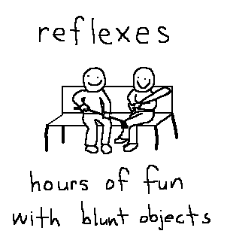

Slide 59
Reflexes
Rapid, predictable, involuntary responses to stimuli
Somatic Reflexes: stimulate skeletal muscles
Eg. jerking away hand from hot object
Autonomic Reflexes: regulate smooth muscles, heart, glands
Eg. salivation, digestion, blood pressure, sweating

Slide 60
Reflex Arc (neural pathway)
Five elements:
Receptor – reacts to stimulus
Sensory neuron
CNS integration center
Motor neuron
Effector organ – muscle or gland

Slide 63
Reflex Activities
Patellar (Knee-jerk) Reflex
Pupillary Reflex

Slide 64
Patellar (Knee-jerk) Reflex
Pupillary Reflex
Stretch reflex
Tapping patellar ligament causes quadriceps to contract → knee extends
Help maintain muscle tone, posture, & balance
Optic nerve → brain stem → muscles constrict pupil
Useful for checking brain stem function and drug use

Slide 65
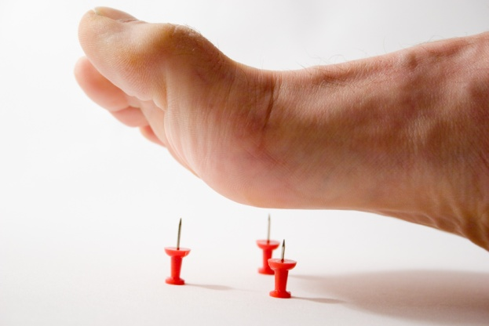
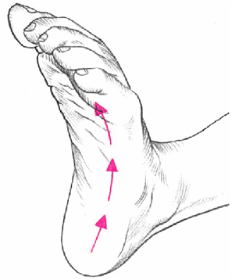
Flexor (withdrawal) reflex:
painful stimulus → withdrawal of threatened body part
Pin prick
Plantar reflex:
draw object down sole of foot → curling of toes
Babinski’s sign: check to see if motor cortex or corticospinal tract is damaged

Slide 66
Voluntary Reactions
More neurons and synapses are involved → longer response times
Reflex = Involuntary Reaction
Voluntary Reaction

