Slide 1
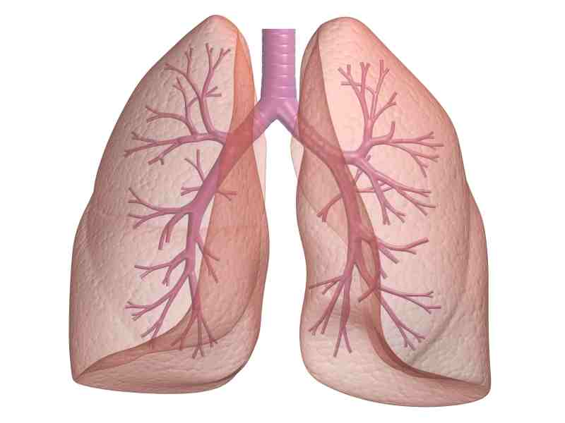
RESPIRATORY SYSTEM

Slide 2
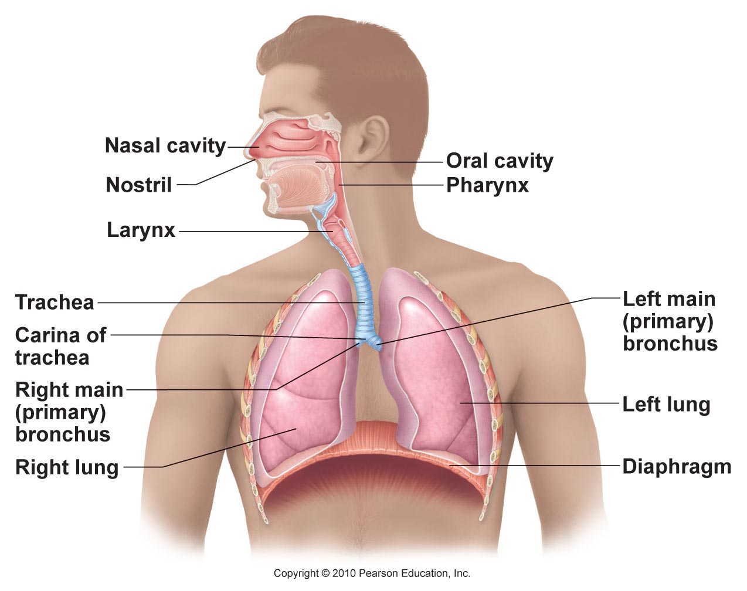
RESPIRATORY SYSTEM
Function: supply O₂ to the blood and remove CO₂

Slide 3
ANATOMY
Nose/mouth: filtered, warmed, humidified
Mucus traps bacteria & foreign debris
Cilia sweep mucus toward throat → digested by stomach
Pharynx: throat (passage for food/air)
Tonsils: clusters of lymphatic tissue
Larynx: contains vocal cords
Epiglottis: covers larynx when liquids/food swallowed
Trachea: windpipe; lined with cartilage (C-shaped)
Bronchi: branches to lungs
Bronchioles: smaller branches
Lungs → Alveoli: air sacs for gas exchange

Slide 4
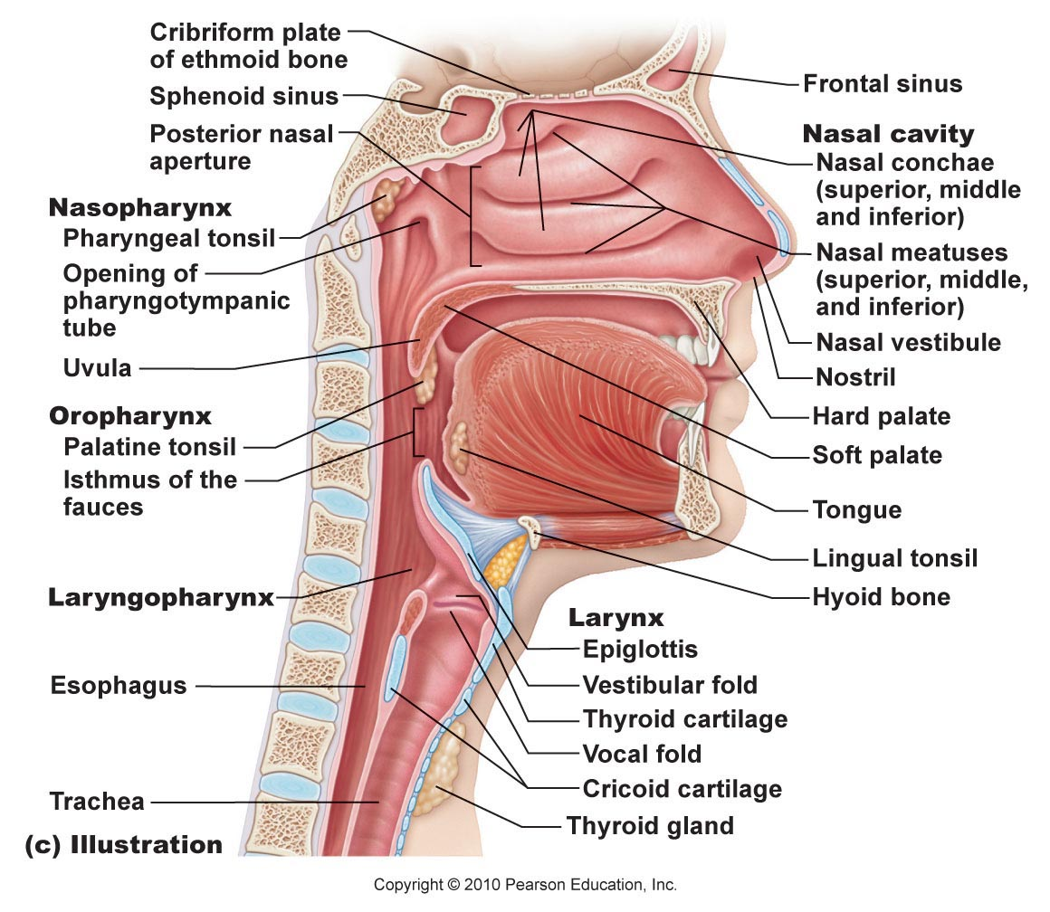

Slide 5
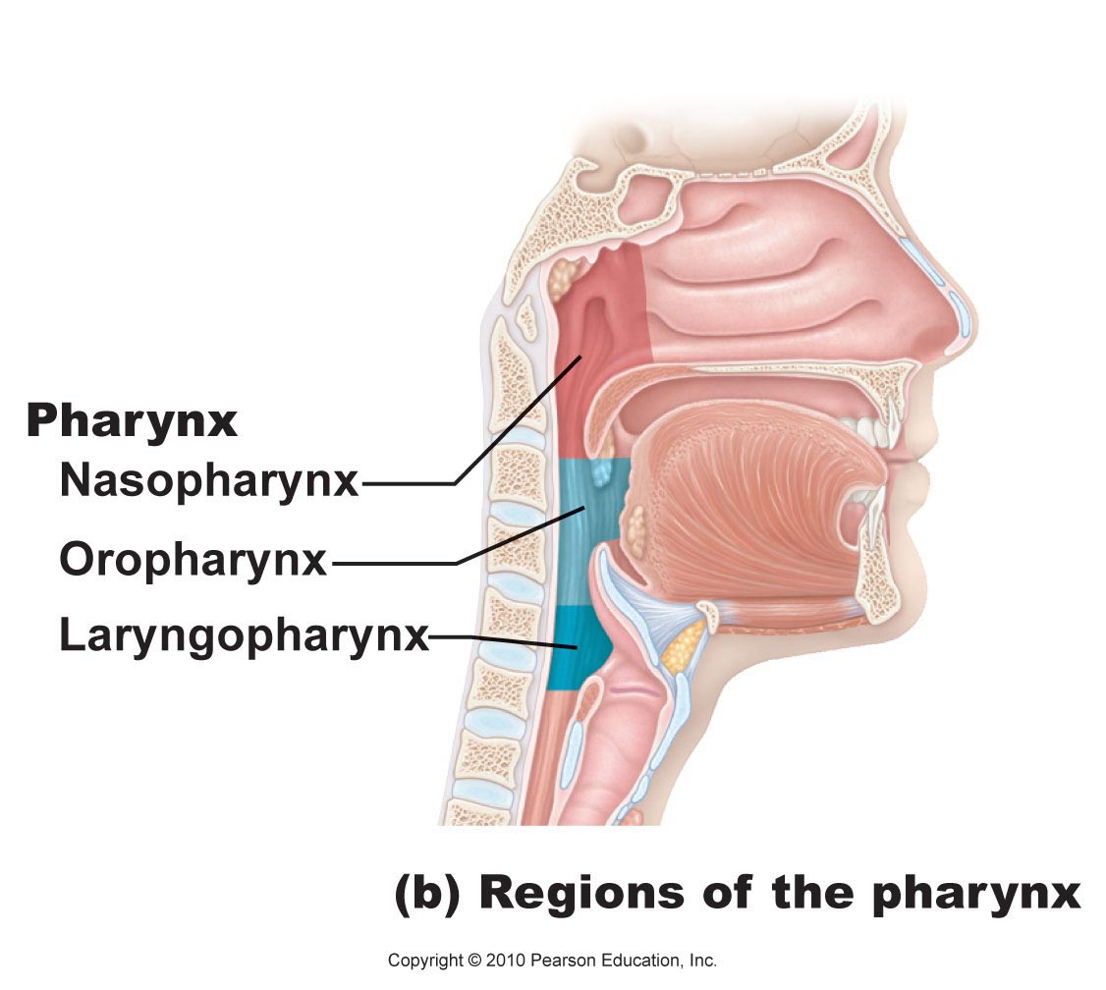
PHARYNX

Slide 6
VOCAL CORDS

Slide 7
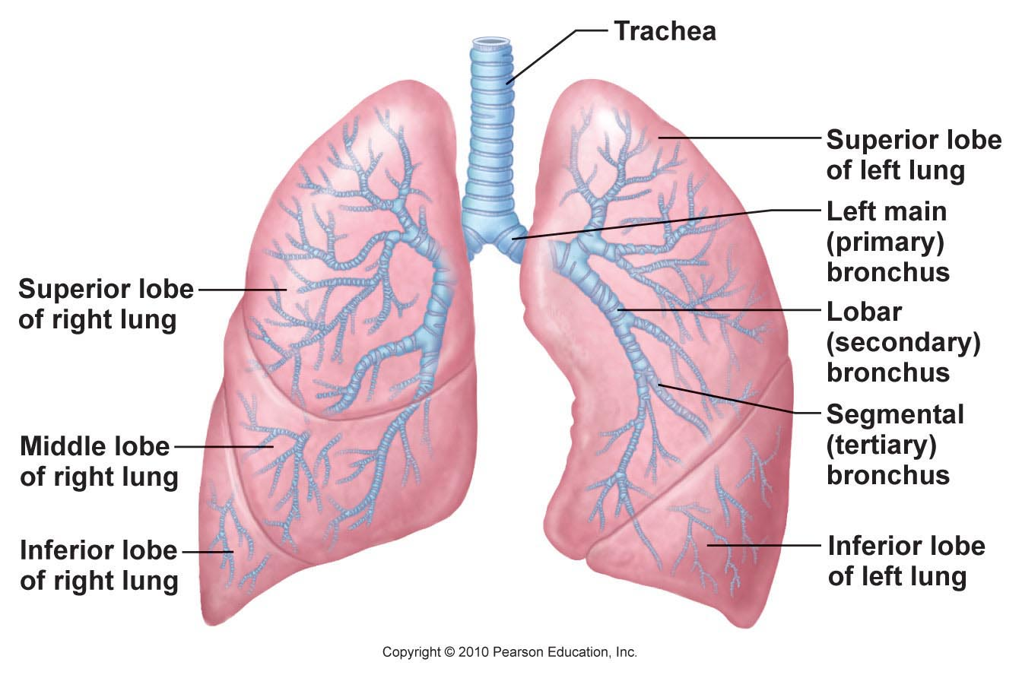
LUNGS

Slide 8
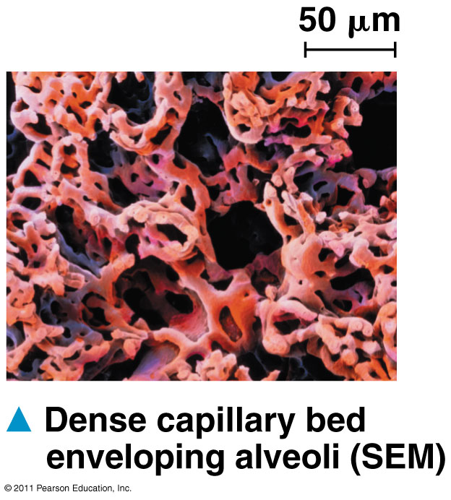
ALVEOLI

Slide 9
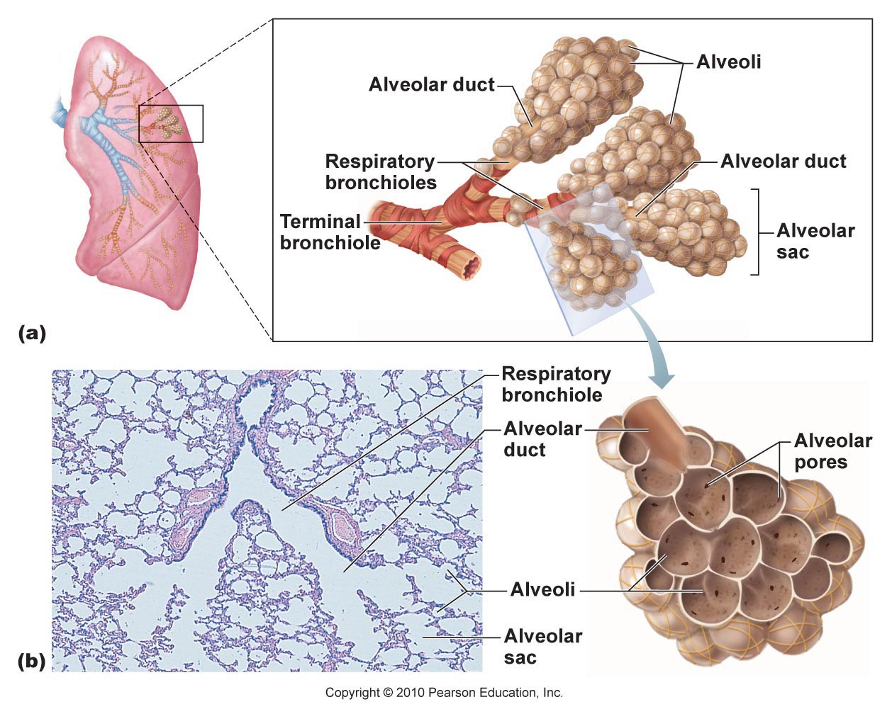

Slide 10
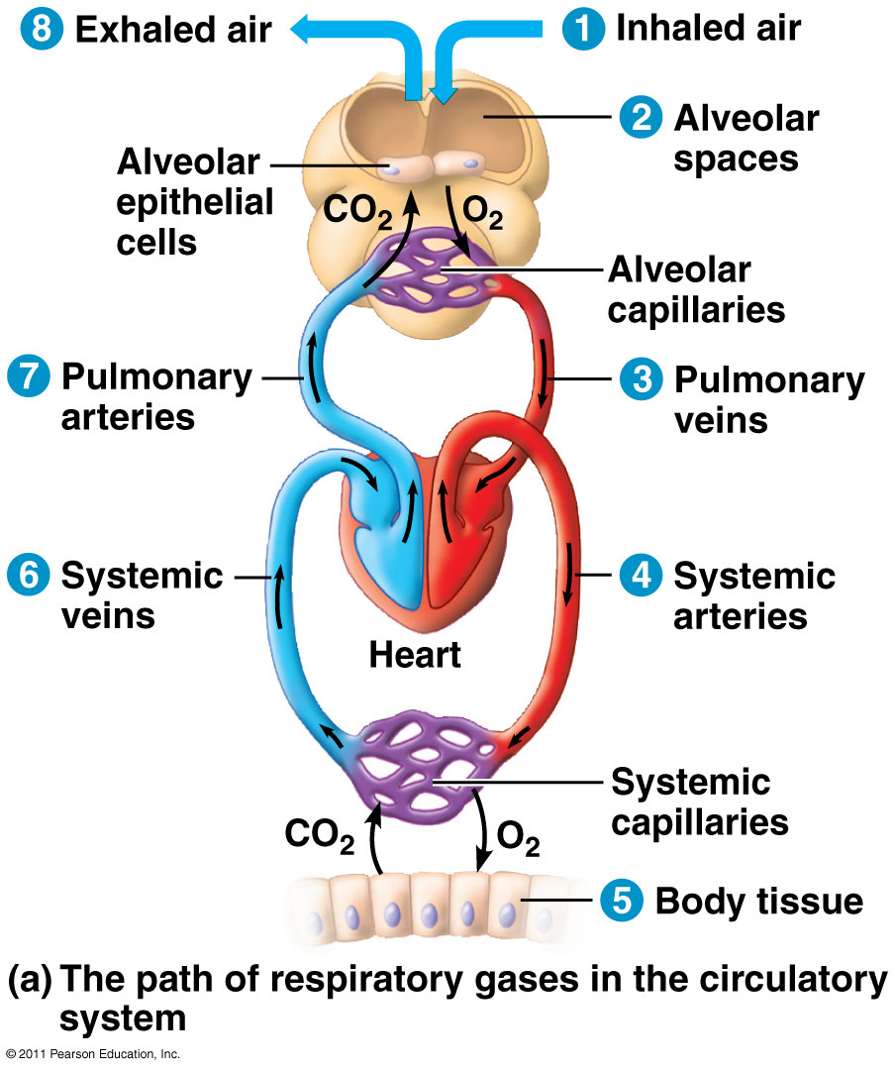

Slide 11
MECHANICS OF BREATHING
Inspiration: air flowing into lungs
Expiration: air leaving lungs
Muscles:
Diaphragm: dome-shaped muscle separating thoracic and abdominal cavities
External intercostals: pulls ribs to elevate rib cage → inspiratory muscles
Internal intercostals: depresses rib cage

Slide 12
Inspiration
Expiration
Diaphragm contracts & flattens
External intercostals lifts rib cage
Lungs stretched to larger size
Air pressure inside lungs decrease
Air sucked into lungs
Inspiratory muscles relax
Rib cage descends, lungs recoil
Gases forced out

Slide 13
INSPIRATION VS. EXPIRATION

Slide 14
RESPIRATORY CAPACITY
Factors that affect capacity: size, age, sex, physical condition

Slide 15
Vital Capacity (VC): total exchangeable air
VC = TV + IRV + ERV
Tidal Volume (TV): amount of air in/out during normal breath (~500ml)
Inspiratory Reserve Volume (IRV): forced in air over tidal volume (~3100)
Expiratory Reserve Volume (ERV): air forcibly exhaled (~1200)
Residual Volume (RV): air still left in lungs (~1200)
allows gas exchange to continue between breaths

Slide 16
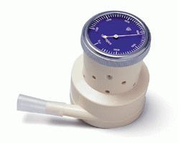
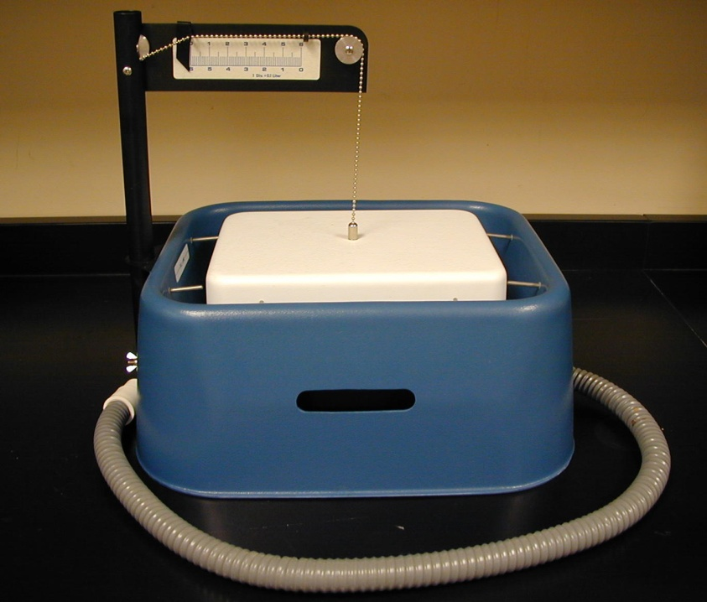
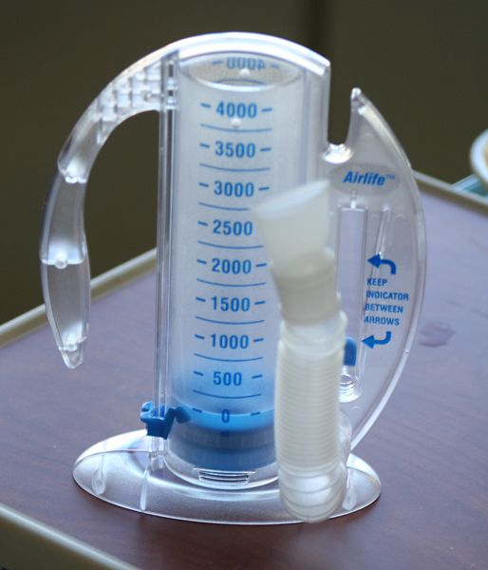
SPIROMETER
Used to measure respiratory capacities

Slide 17
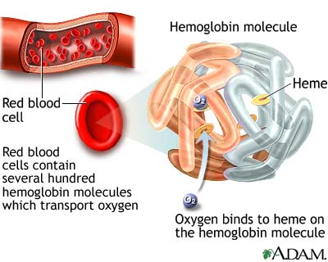
GAS TRANSPORT IN BLOOD
Oxygen: attaches to hemoglobin molecules inside RBC’s
Hemoglobin: respiratory pigment, contains 4 heme groups with iron (Fe)

Slide 18
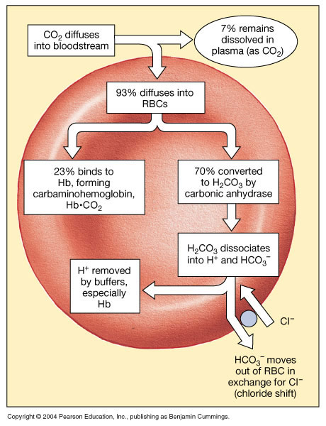
GAS TRANSPORT IN BLOOD
Carbon dioxide:
Transported as bicarbonate ions (70%)
Bound to hemoglobin (23%)
Dissolved in plasma (7%)

Slide 19
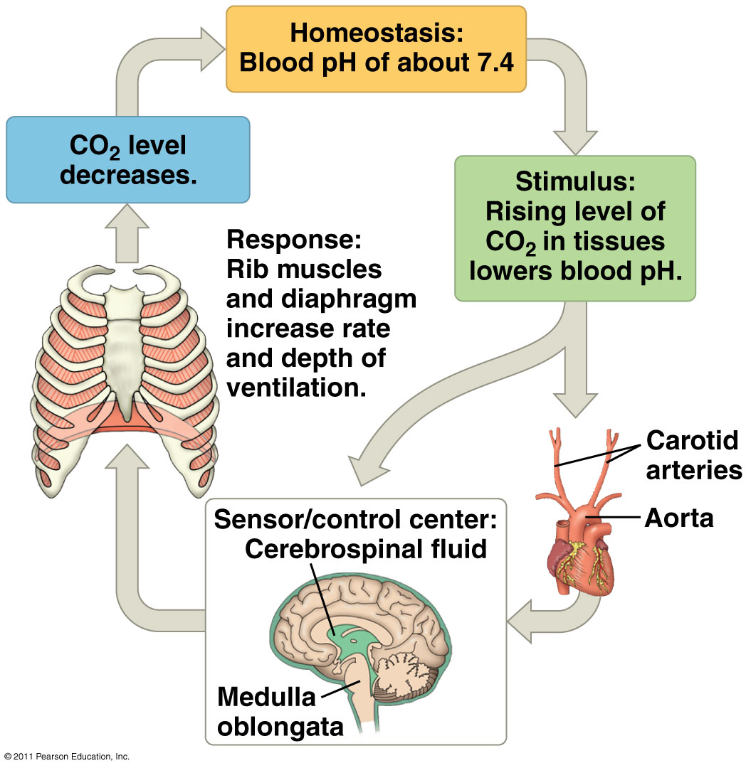
CONTROL OF RESPIRATION
Control center = medulla oblongata
Responds to pH changes in blood
High CO₂ → carbonic acid forms → lowers pH
O₂ sensors in the aorta and carotid arteries

Slide 20
CHRONIC OBSTRUCTIVE PULMONARY DISEASE (COPD)
Group of lung diseases → blocks airflow and makes breathing difficult
Emphysema (lose elasticity of lung tissue) & chronic bronchitis (excess mucus)
Features:
History of smoking
Labored breathing (wheezing, shortness of breath)
Coughing & frequent pulmonary infections
Hypoxic (inadequate O₂ delivery – bluish skin)

Slide 21
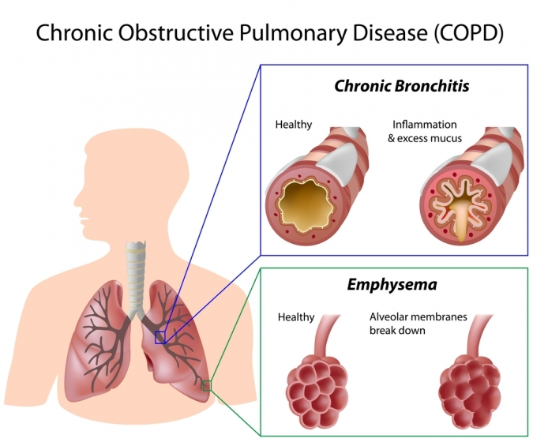

Slide 22
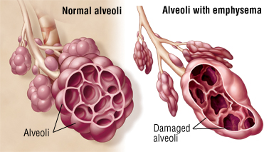
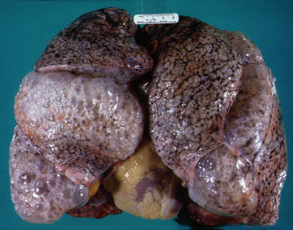
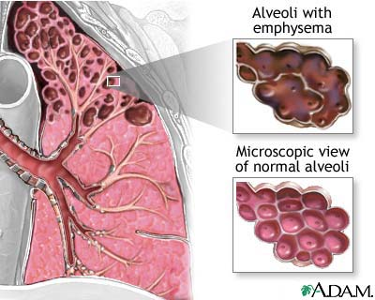
EMPHYSEMA

Slide 23
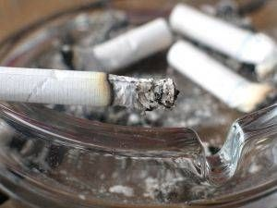
LUNG CANCER
Uncontrolled growth of abnormal cells in lungs
#1 cause of cancer deaths
Leading cause = SMOKING
Low survival rate (avg. 9 mths after diagnosis)
Contributes to atherosclerosis, heart disease
Treatment: remove diseased lobes, radiation, chemotherapy

Slide 24
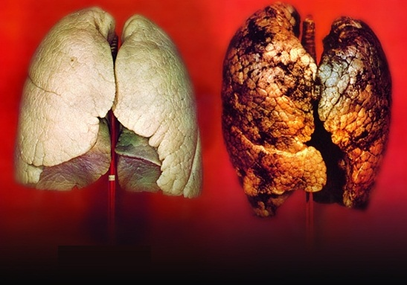
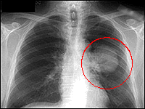
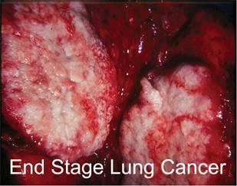

Slide 25
RESPIRATORY DISORDERS
Asthma: inflamed, hypersensitive bronchial passages that respond to irritants
Bronchitis: bronchi swollen and clogged
Pneumonia: inflammation of lung caused by infection
Tuberculosis (TB): infectious disease caused by M. tuberculosis bacterium

