Slide 1
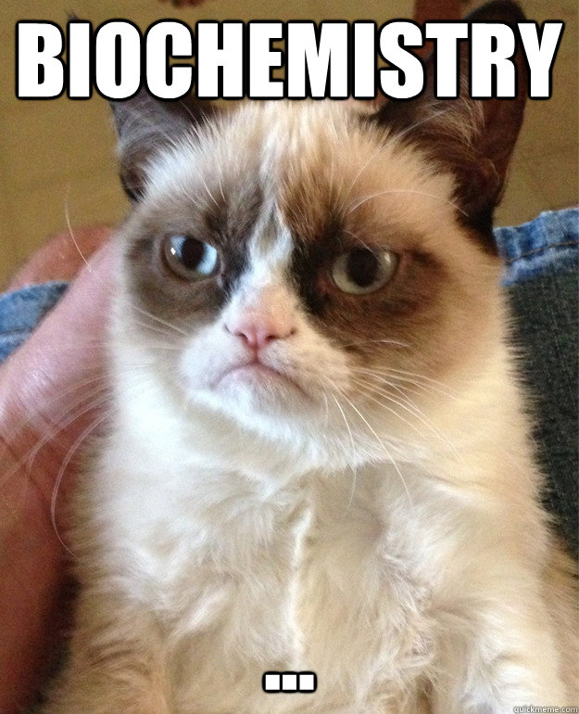
Unit 2
Biochemistry
Who’s excited?

Slide 2
Warm Up

Slide 3
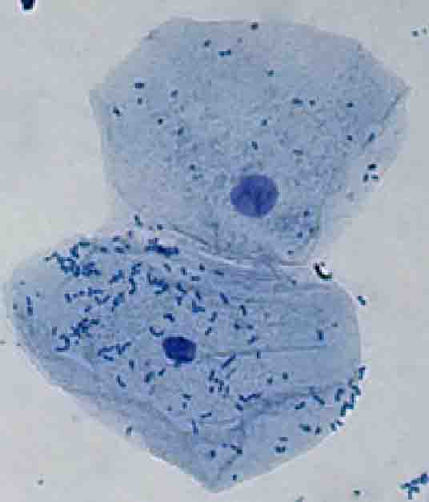
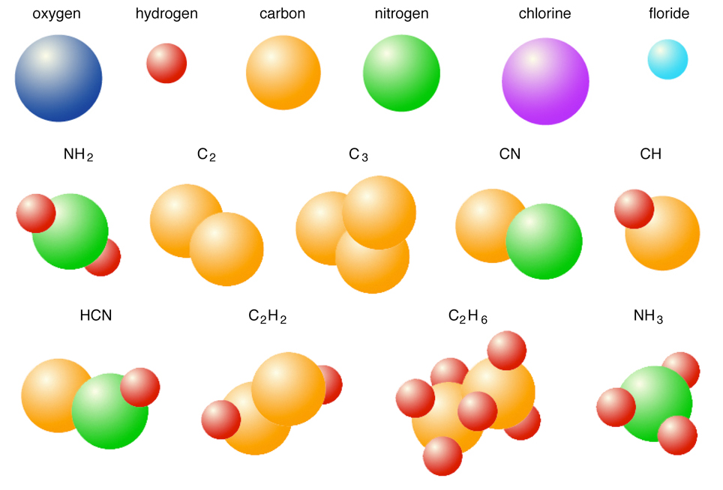
Macromolecules (or polymers) are made of small repeating units called monomers (aka subunits). Your body needs these molecules to perform functions. Your source of these is the food you eat. It is possible to use chemistry to perform indicator tests to see if these macromolecules are found in a sample.

Slide 4
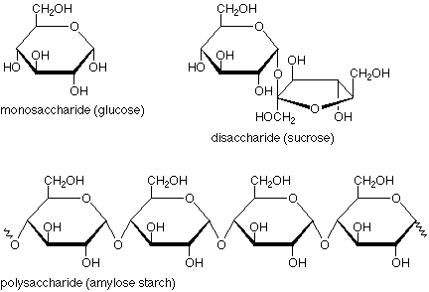
Carbohydrates are atoms of C, H, O arranged into a polygon monomer called a monosaccharide.
Examples of small carbs are glucose and sucrose. These are quick energy sources for your cells.
Examples of large carbs are starch and glycogen. These are longer energy because they are bigger.
Plants have a special carb called cellulose. This big carb provides support for plants as part of their cell wall.
Benedict is a chemical that indicates if glucose is present by turning from blue to orange if boiled
Iodine indicates if starch is present by turning from yellow/orange to blue/black.

Slide 5
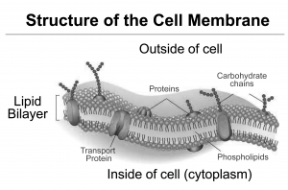
Lipids are atoms of C, H, O arranged into a monomer called a triglyceride. Lipids have long tails called fatty acids. These can be saturated or unsaturated. Saturated fatty acids form kinks and are liquid at room temperature like plant oils. Unsaturated fatty acids form NO kinks and are solid at room temperature like animal fats.
Lipids are important sources of long-term energy. They are often stored by animals and can serve as insulation as well.
The most important type is a phospholipid. Phospholipids’ unique shapes form the cell membrane around the outside of EVERY cell.
The indicator for lipids is a brown paper bag. Lipids get absorbed and leave a transparent spot.

Slide 6
Nucleic acids are atoms of CHNOP arranged into a 3-part monomer called a nucleotide. Nucleotides come in multiple different types and can store information in their sequence.
Deoxyribonucleic acid (aka DNA) is a double strand of nucleotides that carries the code for cells to make their needed molecules like proteins.
Ribonucleic acid (aka RNA) is a single strand of nucleotides that performs different jobs to help DNA make proteins.

Slide 7
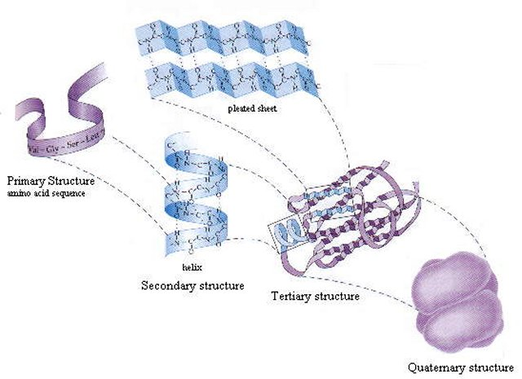
Proteins are atoms of CHNOPS arranged into a monomer called an amino acid. Amino acids come in 20 different types and MUST go in the right order to form the right shaped protein.
A protein’s shape is important to the job it performs. There are 6 important jobs.
Structure – like hair, nails, muscle Communication – like the hormone insulin
Immune protection – like antibodies
Absorb light – like melanin and chlorophyll
Transport – like hemoglobin in your blood
Enzymes – like catalase that breaks down hydrogen peroxide
Biurent indicates if protein is present by turning from blue to purple.

Slide 8
These four macromolecules are found in EVERY living thing on Earth. Cells make and break down these molecules as part of the cell’s regulation and homeostasis needed for survival.
Summary:

Slide 9
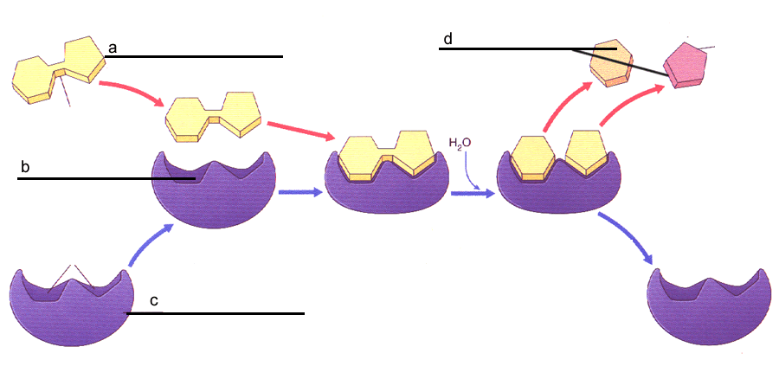
Enzymes are a group of proteins that allow organisms to regulate internal conditions by speeding up chemical reactions. Enzymes convert substrates into products and have 4 unique properties.
Enzymes speed up chemical reactions (synthesizing and digestion) by bringing substrates together in the optimum orientation, thus lowering the activation energy which is needed to start the reaction. Since enzymes are usually proteins, they are called organic catalysts.
Enzymes have a specifically shaped active site that fits with only certain substrates.

Slide 10
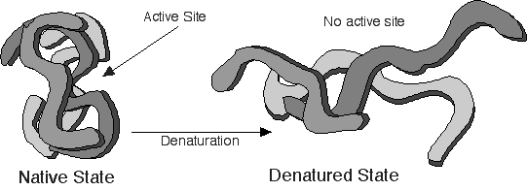
3. Enzymes are unchanged during the reaction, so they are reusable.
4. Enzymes work at their optimum rate in only some conditions. Changes in pH, temperature and salinity can denature the enzyme or change its shape. Now the substrates don’t fit and the reaction doesn’t occur.

Slide 11
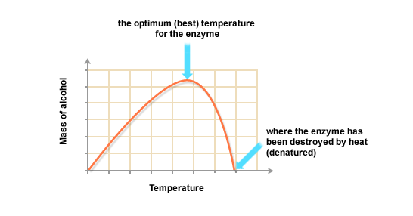
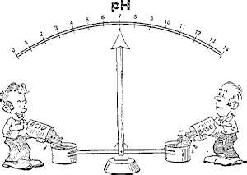
The reaction rate of enzymes is highest in the optimum conditions of each unique organism (thermal vent bacteria, penguins, cacti). Changes in the optimum conditions can cause the enzymes to denature which can lead to death. Organisms and their cells have mechanisms to help minimize changes in temperature, pH and salinity.
Buffers help balance or regulate the pH within cells.
pH is a scale to measure if a solution is an acid or a base. The value of 7 is neutral, below 7 are called acids above 7 are called bases.
Buffers can respond to changes in pH to help maintain homeostasis to prevent enzymes from becoming denatured.

